Slide 1
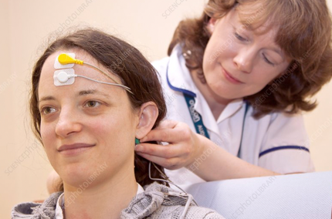
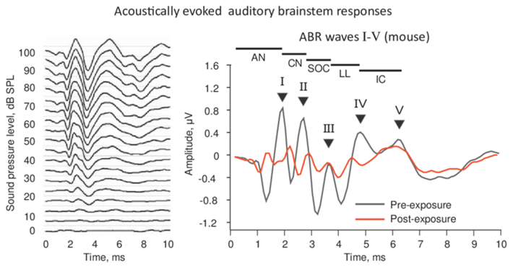
Auditory Evoked Potentials
ABR (Auditory Brainstem Response)
The ABR can be used for:
testing hearing
testing brain damage
The auditory brainstem response (ABR) is an electrical signal recorded via electrodes placed on the scalp during first 10 milliseconds after an auditory stimulus (click in headphones).
The measured recording is a series of six to seven vertex positive waves of which I through V are evaluated.

Slide 2
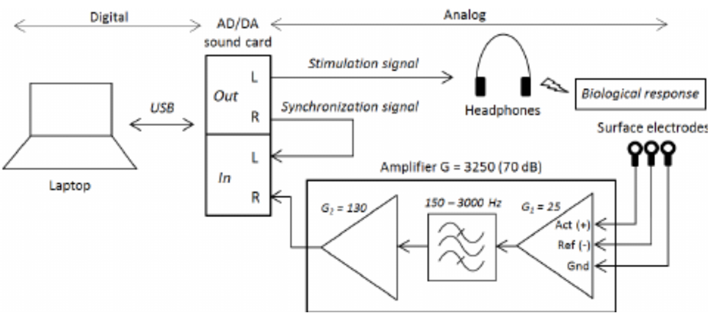

Slide 3
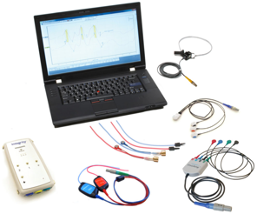
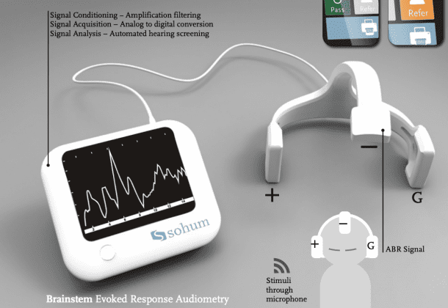
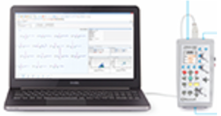
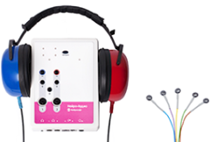
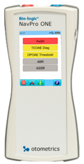
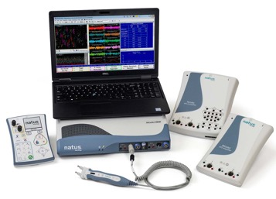
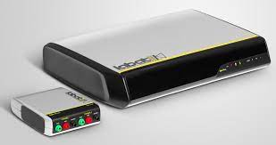
Vivosonic
https://vivosonic.com/
Sohum Hearing Screening Device
https://sohumforall.com/hearing-screening/
Dantec
https://www.dantecmedical.com/
Neurosoft
https://neurosoft.com/en/catalog/audio/ABR
Nicolet EDX EMG/NCS/EP/IOM System
Bio-logic NavPRO ONE - Auditory Evoked Potential Device https://hearing-balance.natus.com/en-us/products-services/bio-logic-navpro-one
Labat International EPIC Plus

Slide 4
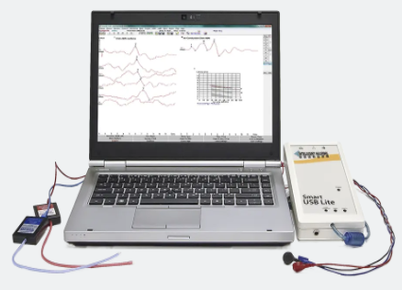
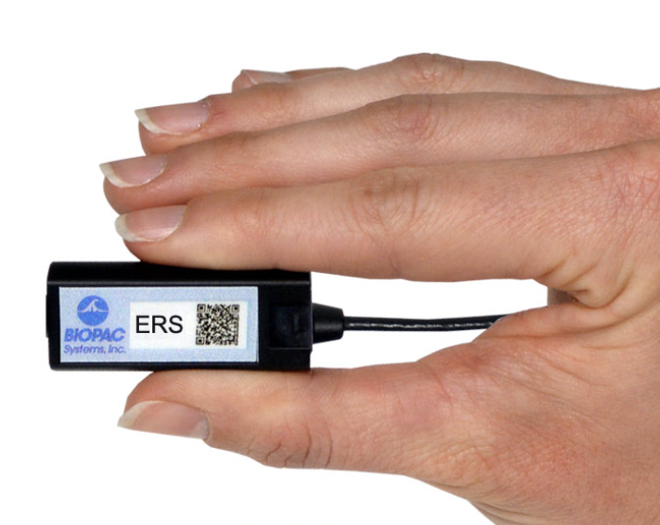
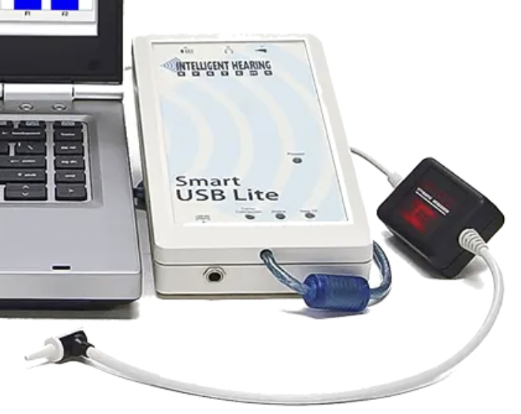
abr evoked potentials usb
SmartEP
https://ihsys.info/site/en/diagnostics/smartep/
USB Lite single channel
BIOPAC
https://www.biopac.com/application/ers-evoked-response/advanced-feature/auditory-brainstem-response-abr/
https://www.biopac.com/product/ers-smart-amplifier/

