Slide 1
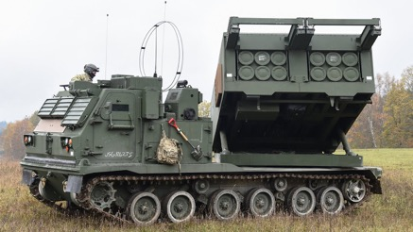
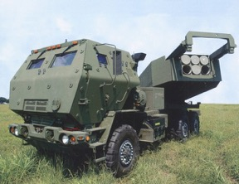
Artillery
Multiple rocket launchers
GPS guided rockets, 3 m accuracy
Range ~80 km (up to 300 km – depends on the rockets)
m270 MLRS
(Multiple Launch Rocket System)
in service since 1983
M142 HIMARS
(High Mobility Artillery Rocket System)
in service since 2010, wheeled

