Slide 1
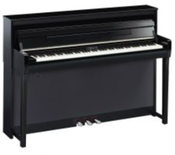
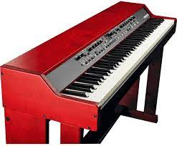
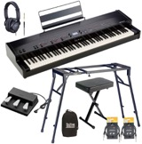
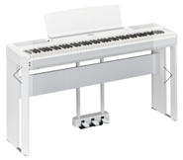
Digital Piano
New:
- https://www.kraftmusic.com/
- https://www.sweetwater.com/
- https://www.samash.com/
Used: - https://www.facebook.com/marketplace/ - https://www.ebay.com/ - https://nextdoor.com/ - https://offerup.com/ - https://newyork.craigslist.org/ - https://poshmark.com/ - https://www.tradesy.com/ - https://www.mercari.com/ - https://www.letgo.com/ - https://www.amazon.com/ - https://www.varagesale.com/ - https://www.decluttr.com/ - https://www.wallapop.com/
Yamaha Clavinova
Escapement - since CLP-535 (500, 600, 700 series) Counterweighted:
CLP-585, 685, 785 Prices new: CLP-785 - $6,200 CLP-685 - $5K ?
CLP-585 - $4K ?
Nord Grand
Kawai keys
Steinway sound
~ $5K
(with speakers, stand, etc.)
Kawai mp11se
Best keys (real)
heavy
~$3K (with speakers, stand, etc.)
Yamaha P-515
~ $2K

Slide 2

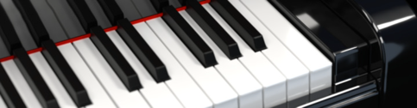

Pianoteq (software emulating piano sounds) from MODARTT : Models and Data for Arts and Technology
https://www.modartt.com/
https://forum.modartt.com/
Pianoteq is a compuer app (Windows, Mac, Linux) that simulates sound of real piano.
Pianoteq uses Fourier modeling, thus keeping software small and light - less than 50 MB on disk. .. No need in loading tens of gigabytes of sampled data .. No need in large memory, fast SSD disks, or very fast CPUs.
Sounds are very high quality
Multiple customization options
Simulates pedal noise, key release, and hammer noise
Simulates different positions of microphones
2006 – first version, 2021 – version 7.5
Pianoteq - Is Sampling Becoming Obsolete?
- https://www.youtube.com/watch?v=QPOMVq82DC4
Latest Pianoteq 7.5 update is even better: - https://www.youtube.com/watch?v=1QdEuY4m5BE Roland FP10 + Pianoteq - Chopin - https://www.youtube.com/watch?v=tpaCYzGk9t4 Pianoteq 7 : Steinway D H. Classical, Chopin Nocturne 20 - https://www.youtube.com/watch?v=Y6yU9zM-rzE
VST = Virtual Studio Technology
- https://en.wikipedia.org/wiki/Virtual_Studio_Technology
VST instruments receive notes as digital information via MIDI,
and output digital audio.
- https://www.pianodreamers.com/midi-connection-guide/
Here is a good review of different virtual sounds
- https://www.pianodreamers.com/best-piano-vst-plugins/
Some examples of sampled libraries:
Spectrasonics Keyscape
- https://www.spectrasonics.net/products/keyscape/index.php
Synthogy Grand Pianos
- https://www.synthogy.com/index.php/products/software-products/ivory-2-grand-pianos
Synthogy Mobile (via Korg):
- https://synthogy.com/index.php/products/licensed-partners/ivory-mobile-grand
Three mobile plugins: Neo Soul Keys, Korg Module, iLectric
- https://www.youtube.com/watch?v=7x07OqFDkJg
Forum (Piano World):
- http://forum.pianoworld.com/ubbthreads.php/topics/2815714/vst-basics.html
Usage:
keyboard => USB cable => computer => speakers

Slide 3
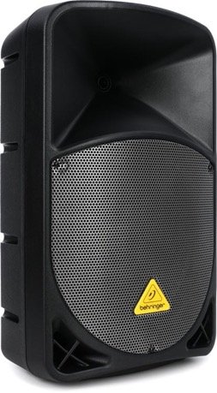
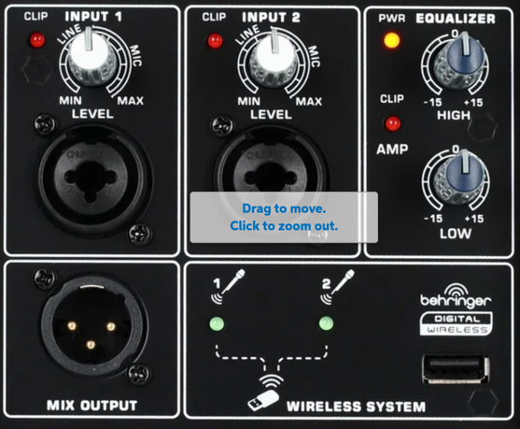
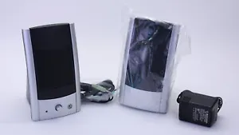
Speakers
Gateway G-MAX 2000 - surprisingly good and cheap buy at ebay.com
Behringer Eurolive B112D 1000W 12 inch Powered Speaker buy at Sweetwater.com
Inputs - 2 x XLR/TRS Combo
Output - XLR

