Slide 1
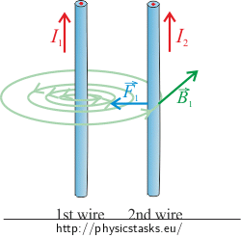
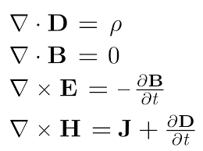
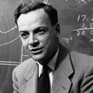
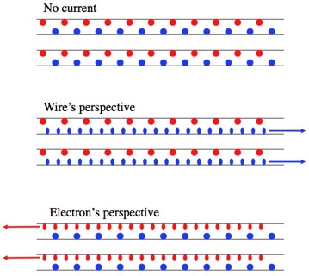
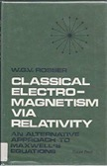
Magnetism as Relativity Effect
Two parallel wires with current flowing in the same direction attract each other.
Some history:
1785 - Coulomb's inverse-square law for force between two electrically charged particles
1873 - Maxwell equations
1895 - Lorentz force (electromagnetic force)
1940 – Leigh Page - charge density in electrostatics becomes proper charge density and generates a magnetic field for a moving observer
1964 - Richard Feynman’s textbook "The Feynman Lectures on Physics. 2. Section 13-6."
1968 - Rosser, W.G.V. Classical Electromagnetism via Relativity. Plenum Press.
Standard explanation: moving charges in 1st wire create magnetic field which act on moving charges in 2nd wire.
Relativity explanation: Lorentz length contraction along the wire causes density increase for charges moving relative to each other – thus increasing Coulomb forces between positive (p) and negative (n) charges. This changes the balance between repelling forces (p-p & n-n) and attracting forces (p-n & n-p ).
"... what happens to two charges moving in space, both at the same speed and parallel to each other. Because they are moving, they will behave like two currents and will have a magnetic field associated with them ...
An observer who was riding along with the two charges, however, would see both charges as stationary, and would say that there is no magnetic field. ... What we are saying, then, is that magnetism is really a relativistic effect.
The magnetic force is ~ v²/c² ~ 10⁻²⁵ of the “normal” electrical force. The electrical force is perfectly balanced (wires have the same number of protons as electrons). ... magnetic force ... becomes the dominant term." – Feynman, 1964
- https://www.feynmanlectures.caltech.edu/II_01.html#Ch1-S5

Slide 2
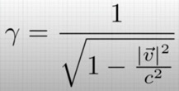

Magnetism as Relativity Effect - continued
Lorentz factor
We derived Lorentz factor from electrodynamics !!
From this video:
https://www.youtube.com/watch?v=j2AQAVIzx70

