Slide 1


Open Source
ERP / Accounting Systems
Rushabh Mehta
2008: ERPNext
Fabien Pinckaers:
2005: TinyERP
2008: OpenERP
2014: ODOO

Slide 2

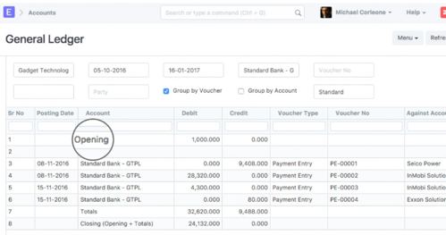
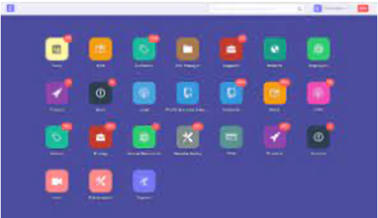
ERPNext
ERPNext is 100% Open Source ERP System
Developed by Frappe Technologies Pvt. Ltd.
Released in 2008
Autor - Rushabh Mehta
Technologies: Python, Javascript, MariaDB database
https://en.wikipedia.org/wiki/ERPNext -
https://erpnext.com -
https://docs.erpnext.com/docs/v13/user/manual/en/accounts -
https://github.com/frappe/erpnext -
Independent Review: https://www.youtube.com/watch?v=s6zISBBRSQg -
"""ERPNext is an alternative to NetSuite and QAD, and similar in function to Odoo (formerly OpenERP), Tryton and Openbravo. ERPNext was included in the ERP FrontRunners List by Gartner as a Pacesetters"""
Rushabh Mehta
Founder, Frappe and ERPNext

Slide 3
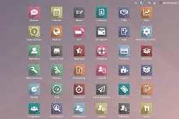
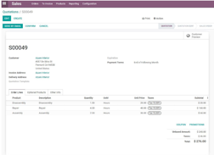
OpenERP = ODOO
Odoo used to be called OpenERP (Open Source Enterprise Resource Planning Software)
ODOO = On Demand Open Object
It is a suite of business management software tools (CRM, e-commerce, billing, accounting, manufacturing, warehouse, project management, and inventory management) https://en.wikipedia.org/wiki/Odoo https://www.odoo.com (Belgium-based company) https://github.com/odoo/odoo
There are two versions – Community (Free, open source) and Enterprise. Odoo is available for both on-premise and as online SaaS (Software as a Service) https://www.odoo.com/page/editions
The Enterprise version has proprietary extra features and services
Written in Python, uses standard SQL database and web interface
Fabien Pinckaers
Founder & CEO
History
2005: Fabien Pinckaers, the founder and current CEO of Odoo, started TinyERP
2008: renamed to OpenERP
2010: 100+ employees
2013: company won a Deloitte award for fast growth
2014: renamed as "Odoo" to diversify itself from the term "ERP"
2019: the company raised a $90 million investment
2021: Odoo products were used by more than 5 million customers. Odoo expects to hire 1,000 new employees

