Slide 1
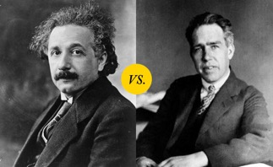
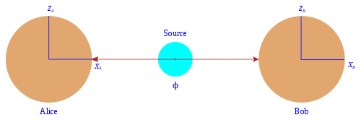
Quantum Entanglement
Quantum entanglement occurs when a group of particles are generated in a way such that the quantum state of each particle of the group cannot be described independently of the state of the others
.. https://en.wikipedia.org/wiki/Quantum_entanglement
EPR paradox (Einstein–Podolsky–Rosen, 1935)
.. https://en.wikipedia.org/wiki/EPR_paradox
EPR paradox is a simple thought experiment in which a pair of particles are created in "entangled state" – moving in oposite directions, same mass, same speed, oposite spins.
If the position of particle A were measured, we thus can predict the position of B. This action taken on A particle could not instantaneously affect the B, since this would involve information being transmitted faster than light.
If we also measure the momentum of "B", then we know both position and momentum of B. This contradicts the Heisenberg uncertainty principle, according to which the position and the velocity of an object cannot both be measured exactly, at the same time, even in theory.
Einstein vs. Bohr
Bohr's interpretation was that the particles can not be considered independent. They constitute a system described by one wave function.

Slide 2
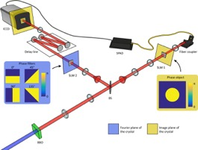
Quantum Entanglement – Experimental Proof
Quantum entanglement has been demonstrated experimentally with photons, neutrinos, electrons, molecules as large as buckyballs, and even small diamonds. The utilization of entanglement in communication, computation and quantum radar is a very active area of research and development.
1964 – Bell's paper on possibility of experimental testing of EPR paradox .. https://en.wikipedia.org/wiki/Bell%27s_theorem
1982 - the first good test
2000 - improved test
2002 - testing the inequality was feasible in undergraduate laboratory courses.

Slide 3
Communication Devices Prevent Eavesdropping
Quantum secure direct communication (QSDC) – research into methods of sending unhackable messages.
Error rates and limited distances have prevented its practical application.
Most recent demo - 63.5 miles via optical fiber.
https://www.iflscience.com/secure-quantum-communications-over-100-kilometers-breaks-records-for-accuracy-and-distance-63360

