Slide 1
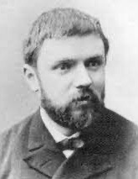
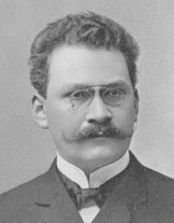
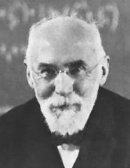
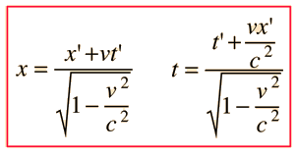
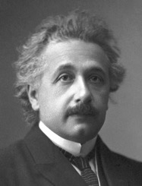
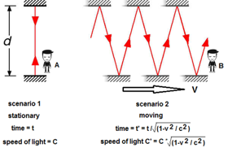
Special Relativity Theory
Einstein is famous for his General Relativity theory, and he has received the Nobel prize for explaining the photoelectric effect (emission of electrons cause by light) - an experimental proof of quantum nature of light.
But (!!) Einstein was NOT the author of Special Relativity Theory.
He has read the works of
Minkowski - https://en.wikipedia.org/wiki/Hermann_Minkowski
Poincare - https://en.wikipedia.org/wiki/Henri_Poincar%C3%A9
Lorentz - https://en.wikipedia.org/wiki/Hendrik_Lorentz
and then published the summary in scientific journal (1905).
Note: even the famous E = mc² was taken from Poincare (1900).
Henri Poincaré
1854-1912
Hermann Minkowski
1864-1909
Hendrik Lorentz
1853-1928
Two main ideas of Special Relativity theory:
There is no absolute frame of reference. The laws of physics are the same in all inertial frames of reference.
The speed of light c is a constant, independent of the relative motion of the source.
Measuring the length of a moving object requires detecting both ends simultaneously. But how you sync the clocks on both ends?
If you do a thought experiment sending beam of light back and forth along a moving train, you will realize that events which are simultaneous in one system of coordinates will not be simultaneous in the other.
So in resting and moving frames the results of measuring the length and time will be different. This is the essence of space and time dilation of Special Relativity. Watch this good illustrative videdo:
- https://www.youtube.com/watch?v=Xrqj88zQZJg
Lorentz Transformation
Albert Einstein
1879-1955

Slide 2
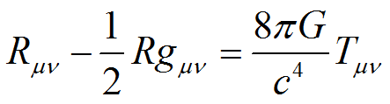
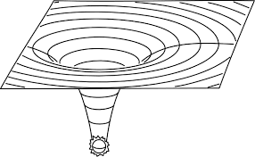
General Relativity Theory (Einstein, 1915)
A geodesic generalizes the notion of a "straight line" to curved spacetime. A freely moving or falling particle always moves along a geodesic.
Geodesic Equations
https://en.wikipedia.org/wiki/Geodesics_in_general_relativity
The equivalence principle - the equivalence of gravitational and inertial mass.
It is Albert Einstein's observation that the gravitational "force" as experienced locally while standing on a massive body (such as the Earth) is the same as the pseudo-force experienced by an observer in a non-inertial (accelerated) frame of reference (elevator).
Gravity is regarded as not a force but a consequence of a curved spacetime geometry described by the stress–energy tensor T_{μν} (representing matter or energy)
Einstein field equations (EFE):
where s is a scalar parameter of motion (e.g. the proper time), and gamma are Christoffel symbols. Indices may take values 0, 1, 2, 3, and the summation convention is used for repeated indices.
The quantity on the left-hand-side of this equation is the acceleration of a particle, so this equation is analogous to Newton's laws of motion, which likewise provide formulae for the acceleration of a particle.
https://en.wikipedia.org/wiki/Einstein_field_equations
where
R_{μν} - Ricci curvature tensor
R - scalar curvature.
where
G_{μν} - Einstein tensor,
g_{μν} - metric tensor
T_{μν} - stress–energy tensor
Λ - cosmological constant (expanding/contracting universe), negligible
κ - Einstein gravitational constant.
where
G - Newtonian constant of gravitation
c – speed of light

