Slide 1
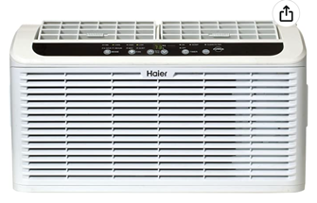
Air Conditioner
Haier ESAQ406T Serenity Series 6, 000 BTU 115V Window Air Conditioner
with Ultra Quiet Sound Package
Dimensions for side curtains:
hight 1 ft
hole ¾" x ¾"
website: https://www.repairclinic.com
ordered for Haier ESAQ406T Serenity Series 6,000 BTU:
Curtain frame Left, OEM Part # WJ86X22905 RC Item # 4813847
Curtain frame Right, OEM Part # WJ86X22904 RC Item # 4813785
Window Side Curtain (2 in box), OEM Part # WJ86X22903 RC Item # 4813901

