Slide 1


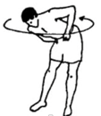
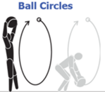
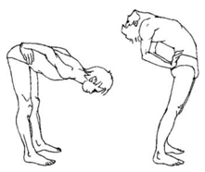



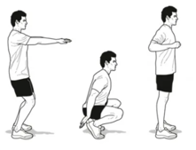


Exercises to train blood vessels
Body circles – 4 breathing cycles in each direction
short wall handstands - 20
Stand, bend forward, bend back – 20 reps
berezka exercise: stand – rollback, roll forward – stand – 10 times
Giraffe head up down
Squats – fast light "Hindu" squats – 20 reps
cartwheel 10 times
tumbling (stand-tumble-stand) – 10 times

