Slide 1
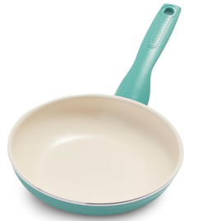
Healthy Kitchen Pan
Avoid:
.. Damaged or scratched non-stick pots and pans
.. cookware older than 2013 made with perfluorooctanoic acid (PFOA)
Healthy:
Ceramic (Greenpan, Caraway)
Aluminum
Stainless steel
Nonstick - Cast Stainless Steel with Silicone (note: PFOA and PTFE are not healthy)
Cast iron
Copper
Granite, glass, and clay

