Slide 1
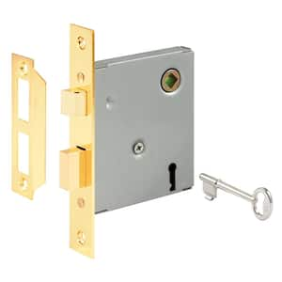
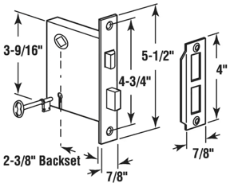
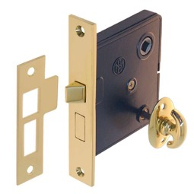
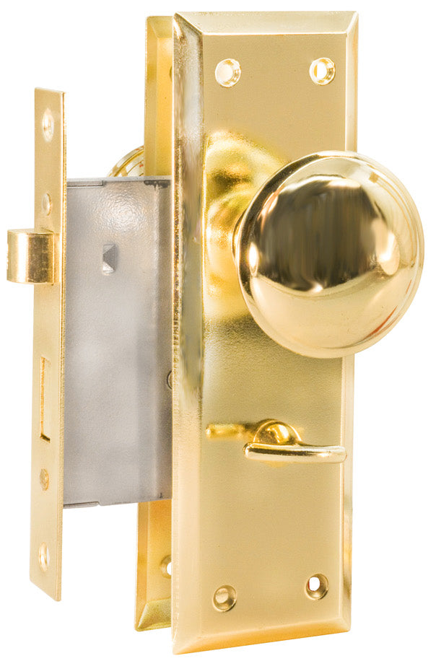
interior mortise lock thumb turn
Privacy Mortise Lock
with key – at Home Depot
Privacy Mortise Lock
with Thumbturn
Thumbturn Mortise Lockset with Knobs
https://hardwickandsons.com/products/brass-finish-mortise-lockset-with-knobs

