Slide 1
Medical Topics
Medicare & Medicaid
Tooth – cleaning and flossing
Cracked heels treatment

Slide 2
Medicare & Medicaid
Medicare is a medical insurance program for .. people over 65 .. younger disabled people .. dialysis patients .. https://www.medicare.gov
when you turn 65 y.old. (+/- 3 months) - go online and sign for Medicare Part A (Hospital Insurance) .. https://www.medicare.gov/basics/get-started-with-medicare Then they will instruct you about next steps – probably go to the Social Security Office to demonstrate the original birth certificate, SS card, etc. Then in a month or two you will receive a card.
Generally, there are risks to signing up later, like a gap in your coverage or having to pay a penalty. However, in some cases, it might make sense to sign up later.
Medicare Part A (Hospital Insurance) - hospitals, nursing homes, hospice, home health care.
Medicare Part B (Medical Insurance) – doctors, outpatient care, home care, equipment (wheelchairs, walkers, hospital beds, etc. ), preventive services (screenings, shots/vaccines, annual “Wellness” visits)
Medicare Part D (Drug coverage) - prescription drugs - run by private insurance companies
Medicare Supplemental Insurance (Medigap) - Extra insurance you can buy from a private company. Policies are standardized, and in most states named by letters, like Plan G or Plan K. The benefits in each lettered plan are the same, no matter which insurance company sells it.
Medicaid is an assistance program for low-income patients' medical expenses. .. https://www.medicaid.gov

Slide 3
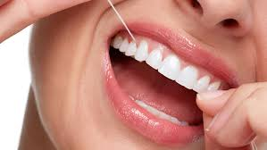
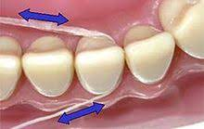
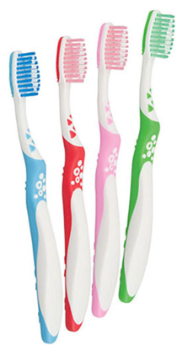

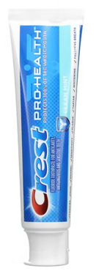
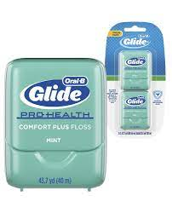
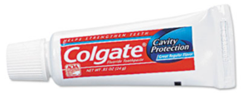
Tooth – cleaning and flossing
Modern processed sugary foods promote bacteria growth in your mouth, causing destruction of your teeth
Using anti-bacterial washing liquids doesn't work – create opposite effect (killing some bacteria causes other bacteria to grow)
What works:
You need to brush teeth regularly using tooth paste
You need to floss religiously at least twice per day, especially at night

Slide 4
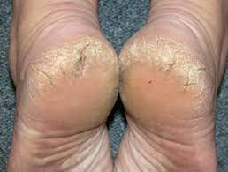
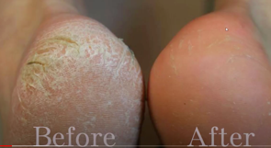
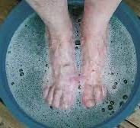
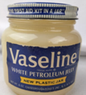
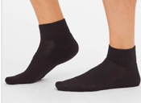
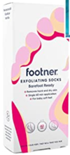
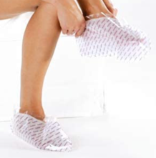

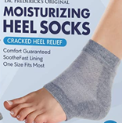

Healing/Avoiding Cracked Heels
Dry thick skin can crack under pressure forming painful tears (fissures), which can become infected if not treated
This may happen in Winter when the air is very dry
It may be caused by wearing open-heeled shoes (sandals)
It may be caused by using harsh soaps
It may be caused by some medical conditions, such as Obesity, Diabetes, Eczema, Hypothyroidism, etc.
Most cases of cracked heels can be treated at home:
soak your feet for 20 min (water + epsom salt)
scrub to remove thick skin
apply a heavy moisturizer at least 2/day, especially overnight (petroleum jelly, vaseline, Aquaphor Healing Ointment, etc.)
to keep the moisturizer in place use kitchen Cling Wrap or search amazon for silicone socks, then put regular socks over.
https://www.webmd.com/skin-problems-and-treatments/what-to-know-cracked-heels
https://www.amazon.com/gp/product/B071GDT8NR/
https://www.amazon.com/gp/product/B003O85T3I/

