Slide 1
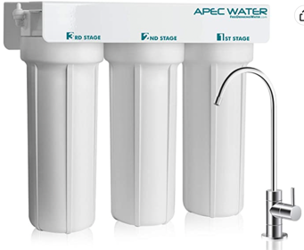
Water Filter
High quality, designed, engineered and assembled in the USA
System built with US MADE super capacity filters for long lasting dependable filtration
Effectively remove chemicals (i.e. chlorine), taste and odors. NOT designed for TDS removal (TDS = Total Dissolved Solids, mostly inorganic salts)
Premium long-lasting filters used to treat tap water, well water.
Feed Water Pressure 20-85 psi
APEC Water Systems WFS-1000
3 Stage Under-Sink Water Filter System
$140

