Slide 1
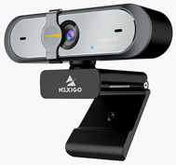
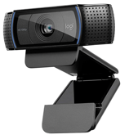
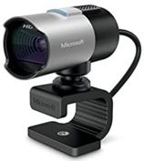
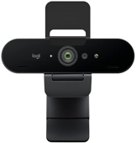
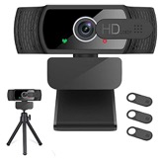
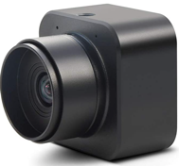
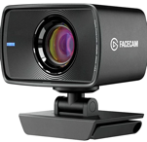
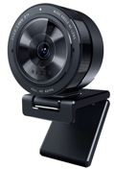
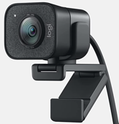
Choosing a webcam camera
NexiGo N660P
$65, green-ish
Microsoft LifeCam Studio
$61
Samcorn
$40
Logitech Brio
$160
Logitech C922x Pro
$74
MOKOSE 4K
$85
Elgato Facecam
$170, great
no microphone
Razer Kiyo Pro, no microphone,
$100
Logitech StreamCam
no microphone
$170

