Slide 1


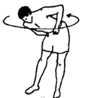
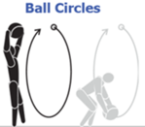
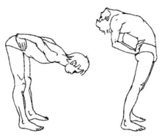



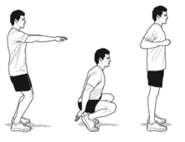


Exercises to train blood vessels
Body circles – 4 breathing cycles in each direction
short wall handstands - 20
Stand, bend forward, bend back – 20 reps
berezka exercise: stand – rollback, roll forward – stand – 10 times
Giraffe head up down
Squats – fast light "Hindu" squats – 20 reps
cartwheel
10 times
tumbling (stand-tumble-stand) – 10 times

Slide 2
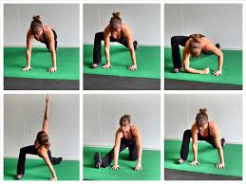
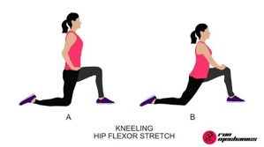
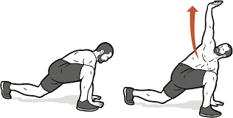

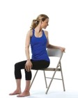
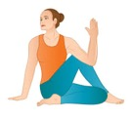
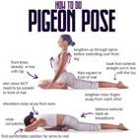
Anti Back Pain Exercises
Hip flexor stretch: Stand with one foot forward in a lunge position, keeping your back leg extended behind you, and gently push your hips forward while keeping your back upright; hold for 20-30 seconds per side
Hip twist stretch: Lie on your back with knees bent, cross one leg over the other so knees are stacked, and let both legs drop to one side while keeping shoulders flat; hold for 10-30 seconds
Seated spinal twist: Sit up straight with feet flat, place one hand on the backrest of your chair, and gently twist your torso to that side; hold for 15-30 seconds per side
Walking and standing breaks every 30-60 min

