Slide 1
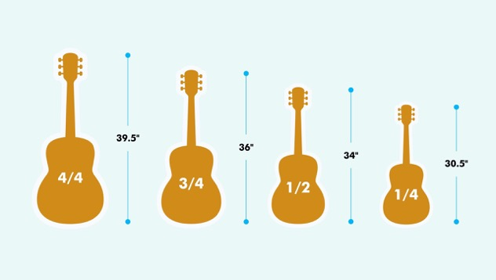
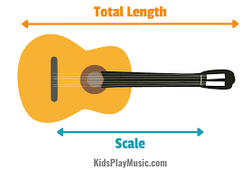
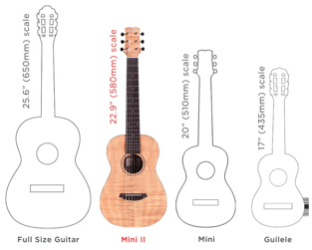
Guitar
Lev's small guitar:
35" total length
23" scale
so it is ½ .. ¾ size
Very similar size:
Cordoba Mini II FMH, Flamed Mahogany, Small Body, Nylon String Guitar ($200) https://www.hermesmusic.com/products/cordoba-mini-ii-fmh-flamed-mahogany-small-body-nylon-string-guitar
Good Guitar: Cordoba Protege Line
https://www.youtube.com/watch?v=2xjMA-Qqcas
More: https://www.youtube.com/watch?v=vgI8mzUlvPg
Tanglewood Enredo Madena EM-C2: https://bit.ly/3xGdIgN
Yamaha CS40 MkII: https://bit.ly/3I7fVqI
Yamaha FG Junior JR1: https://bit.ly/3ljyyxS
Yamaha APXT-2: https://bit.ly/3D3Qxy5
Taylor Baby BT-1: https://bit.ly/3G4iyr8
Faith Nomad Mini Neptune: https://bit.ly/3rikWGS

