Slide 1


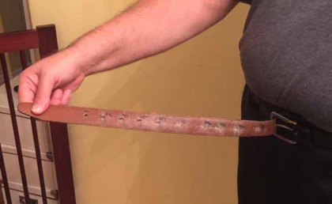
Almost everyone is on a diet – but most people fail to lose weight long term.
According to the data of American National Weight Control Registry, the probability of losing 30+ lbs and keeping it off for just 1 year is less than 1 in 10,000.
For 15 years I was failing too. I tried different approaches. Finally I started to succeed.
I slowly lost more than 60 lbs - I am definitely in “1 in 10,000” category mentioned above.
This presentation describes what really works (and what doesn’t).
And how to be healthy and live longer (like people in “Blue Zones” – later in this presentation).
268 lbs in 2010
208 lbs in 2017

Slide 2
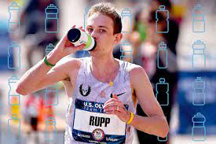

Marathoner and sweet water
Should a marathon runner add sugars into water in the middle of the race to get more energy?
No, No, No !!!
The drink will not contain enough energy and will not be metabolized fast enough.
But the sugar in it will be interpreted by the body as a signal to shut down the process of getting energy from internal sources (fat).
The marathoner will feel more tired and can crash.

Slide 3



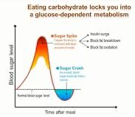
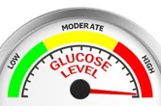

Vicious Circle
You feel tired / hungry
You eat “modern” food (something sweet, bread, burger, etc.), it causes strong spike of sugars in your blood, you feel better
Big insulin level causes decreasing of sugar levels to normal – and then below (over-regulation)
Pancreas releases insulin to send signal to all cells to absorb sugar from blood.

Slide 4


What to eat when you tired, nervous, hungry?
Do not eat to get energy from food when you feel tired.
Instead do something to give your body time to switch gears to start using your internal energy.
Like marathoner.
Drink water (or salt water ?), walk, breathe, wait 15 min.
Do not eat because you are tired.
Do not snack for energy.
Eat on schedule:
- three times a days works for most people.
Even better use intermitting fasting:
- Eat 2 times a day within 6-h window
- skip food completely on Monday, Wednesday, Friday,
Lion is sleepy after eating
Lion alert and focused when hungry
You need to avoid spikes of insulin, because they cause sugar level to go below normal and cause “Vicious Circle”.
So avoid:
sweet foods or drinks
big meals
highly-processed foods
animal products
combinations of processed carbs with animal products

Slide 5

Here's a summary of the video: The Glucose Expert: The Only Proven Way To Lose Weight Fast! Calorie Counting Is A Load of BS! - Dr. Robert Lustig - https://www.youtube.com/watch?v=4DWKf5RqU-s
High sugar intake increases the risk of diabetes, mental health issues, cognitive decline, and even early death. Sugar is addictive and pervasive in processed foods
Pleasure is short-lived and dopamine-driven, while happiness is long-lasting and serotonin-driven. Seeking excessive pleasure can lead to addiction and reduce overall happiness
Fructose in high doses is toxic and metabolized similarly to alcohol
Added sugars are hidden in most processed foods, leading to consumption levels far exceeding the recommended limits
Studies demonstrate the negative effects of sugar on children's behavior and metabolic health
Consuming one sugar-sweetened beverage a day significantly increases the risk of diabete
Different types of sugars have varying effects on the body’s metabolism and mitochondrial function
Managing insulin levels, rather than just counting calories, is crucial for weight loss
Practical Advice: Eat "real food" - foods that come from the ground or animals that ate from the ground - to avoid hidden sugars and maintain metabolic health
The food industry is accused of deceptive advertising and mislabeling
Environmental Obesogens - chemicals that can cause weight gain by affecting fat cell development
Fiber's Importance: Fiber is essential for feeding the gut microbiome
Personal Responsibility vs. Societal Factors: The addictive nature of sugar and the pervasive presence of unhealthy foods limit individual control
The Four C's for Contentment:** Connect, contribute, cope, and cook are presented as ways to improve mental and metabolic health
The Root Cause of Multiple Crises: A dysfunctional amygdala, driven by factors like stress and poor diet, underlies many of today's health and societal crises
The "only proven way" to lose weight fast
is to lower your insulin levels by reducing
the consumption of refined carbs and sugars
- Dr. Robert Lustig
Some Poisons:
processed vegetable oils
margarin (trans-fats)
cheese (cheddar)
bread
hot dog, bacon, salami (processed meat)
soda drinks

Slide 6
Social eating may be a big problem for some people.
Give yourself permission not to eat during the meetings.
Nobody will notice.
Nobody will care.
Use magic phrases like "Not yet", "No more, please",
"I have eaten too much already", "I feel full", etc.
Don’t be afraid of not eating.
In fact your body needs to get rest from eating for 12-16 hrs every day. This allows your body to clean itself.
Body can use its own storage for energy.
Remember that the longest fast was 382 days !
So:
Eat natural whole foods, mostly plants.
Drink water.
Have enough sleep.
Walk and exercise every day.
Be social.
Think good thoughts, love yourself, reduce stress.
Easy ☺
382 days fast
from June 1965 to July 1966

Slide 7
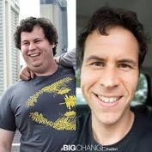
I highly recommend to listen to some episodes of the
"Big Change the Film" series by Jason Cohen.
You can find it on youtube or iTunes:
on YouTube: - https://www.youtube.com/channel/UCzFwW-13NfNBAtGbJxvJsQQ/videos
on iTunes: - https://itunes.apple.com/us/podcast/big-change-the-film-podcast/id1093956175?mt=2
As of June 2018 there were 96 interviews.
They are stories of people who lost weight - and kept it off.
And have become much healthier.
After multiple attempts they all converge to the same approach.
It is NOT about dieting (eating less to reduce calories).
It is NOT about exercising to reduce calories.
It is about switching to more nutritious foods (whole foods, mostly plant-based) and removing dead and toxic foods.
It is about switching from standard American diet to diet close to that used by people living in "Blue Zones" and staying healthy for much longer than average Americans.
It is about removing mostly or completely:
all animal products (no meats, chicken, eggs, dairy)
all highly processed products (sugars, sodas, oils, etc.).
The most difficult for me was
removing milk and cheese.
The strangest for me was removing oils.
Yes, no oil, not even olive oil, etc.
Good foods are greens, beans, berries, vegetables, nuts and seeds, rice, oats, buckwheat, etc.

Slide 8
There are many scientists describing how to live this way.
Main famous names:
Dr. John McDougall
Dr. Joel Fuhrman
Dr. Caldwell Esselstyn - and his son Rip Esselstyn
Dr. Michael Greger
Dr. Neal Barnard
Dr. Dean Ornish
Dr. Robert Lustig
You can find their lectures and interviews on youtube.
There are also many books by those authors.
Many websites and communities joining people.
Also there are great documentaries (look at Netflix and Google):
Forks Over Knives (2011) - https://www.forksoverknives.com/ , also on youtube
What The Health (2017) - https://www.youtube.com/watch?v=KPD1oIKnnjs
The Human Longevity Project (2018) - https://humanlongevityfilm.com/, also on youtube
The Game Changers (2019) - https://www.youtube.com/watch?v=ove9b16OeR4
etc.

Slide 9
Here is a short list of most effective things people do to lose weight:
- keep insulin low
- remove some "dead or toxic" foods, increase amounts of fresh nutritious whole foods
1. no sugar and no flour – only whole natural foods.
Avoid all sweet taste (no sugar, no juices or sodas, etc.). Avoid all flour-containing foods (no bread, pasta, chips, etc.)
Avoid all highly-processed food, “empty” calories, fatty foods and oils. Yes, not even olive oil in salad 2. intermitting fasting.
Eat 1-3 times/day – and avoid snacking between meals to give time to allow insulin to go down.
Make longer fasting periods every day (12-16 hrs) to allow body to burn fat.
Example: 8/16 (eat in a 8 hrs window, fast in 16 hrs window), for example, skip breakfast, start eating in the afternoon
Example: eat one time a day (~ 23 hrs fast daily)
Example: skip a day completely (7pm Monday -> 11am Wed = 40 hrs fast).
Example: skip 3 days/week completely (Tuesday, Thursday, Saturday) – and do 8/16 on other days.
3. Eat lots of greens, vegetables, beans, fruits & berries.
Eat mostly Low-Calorie-Density natural foods (vegetables and fruits, fresh or minimally processed).
You may have huge meals - and still lose weight very fast. Example: 1000 calories = 9 lbs of raw lettuce salad or spinach or other green leaves or cabbage or cauliflower,
or 6 lbs of raw broccoli
or 5 lbs of carrots,
or 4 lbs of apples.
Attention – do not use oily dressing, because it can easily quadruple calories.
4. Reduce (or completely eliminate) animal products and oils
no meat, no chicken, no eggs, no dairy: no milk, no cheese, etc
and no oils (not even olive oil)
My son's intermitting fasting protocol:
eat a bowl of lentil soup in the morning
Vitamin B12 – 1 tab 2,000 mcgr/week

Slide 10
Notes: -- losing weight on "will power" doesn't work long term
-- "eat less, exercise more" formula doesn't work long term: -- eating less - causes metabolism slowdown and doesn't work long term for 95% of people
But ... intermitting fasting does NOT cause metabolism slowdown -- exercise - contributes less than 5% (if any) if you consider long term -- eat lots of vegetables. Find a way to add a big serving of salad / vegetables to each meal. You can eat lots of cabbage, spinach, etc. -- you don’t need extra protein from meat, etc. You get it from vegetables and beans.
-- you don’t need milk for calcium. In fact you should stay off milk products (or use only goat or sheep milk).
-- you don’t need vitamin pills – you will get everything from food. (you do need some sun for vitamin D, and you need vitamin B12 supplements)
-- eating snacks between meals is bad. You should eat at maximum 3 times per day. Snacks are more harmful than eating big meals. It is very important to avoid snacking between meals - to allow insulin levels to decrease. - https://intensivedietarymanagement.com/perils-snacking-hormonal-obesity-xiii/ - intermittent fasting works (make long pauses between meals)
intermittent fasting does NOT cause metabolic slowdown.
It doesn’t make you hungry. You feel energetic, alert, and focused.
- Note (important!) - the world record in long fasting is 382 days ! - http://www.ncbi.nlm.nih.gov/pmc/articles/PMC2495396/ - - https://www.ncbi.nlm.nih.gov/pmc/articles/PMC2495396/pdf/postmedj00315-0056.pdf -
You need to have long periods of not-eating to allow body to lose weight. Recommended lengths of regular fasting are anywhere between 12 hours to several days. - https://intensivedietarymanagement.com/fasting-regimens-part-6/ - - https://intensivedietarymanagement.com/longer-fasting-regimens-part-7/ -

Slide 11
Notes: - damaged metabolism (even type-2 diabetes) can be reversed in just 2 weeks using natural eating (no sugar, no flower, etc. - only natural foods)
plus some fasting - removing stress and oscillating between activity and rest is very important - inner work
I took the course "Bright Line Healing", which is associated with "Bright Line Eating". Basic approach - remove judgement and shame, love yourself unconditionally as you are.
Talk to your compulsion as it is a small child inside of you. No accusations, no blame, no guilt, no war. Instead - love, care, game, humor, patience.
Awareness, surrender, forgiveness, connection. This is best explained by Mary O'Malley
Search for her on youtube and on amazon

Slide 12

What am I doing ?
I removed sugar almost completely (and removed all sweet taste). I removed bread, pasta, and all other products made of flour. I try to eat mostly Low-Calorie-Density foods (salads, vegetables)
I try to reduce amount of High-Calorie-Density foods (oils, cheese, nuts, raisins, etc.)
I try to reduce portions at night. I weigh myself daily and keep records with phone app "MyFitnessPal",
this helps me to keep track and make adjustments.
Here are the top links describing the methods I am using:
- Youtube – “NutritionFacts.org” - Dr. Michael Greger, books "How Not to Die", "How Not to Diet", etc.
- Youtube – “Mic the Vegan”
- Youtube - “Dr. Jason Fung” - https://www.drmcdougall.com - (book “The Starch Solution” - by John McDougall (vegetables and starches))
- https://thefastingmethod.com/blog/ - (Jason Fung – books ( "Obesity Code", etc.), youtube) - http://www.leangains.com - (intermitting fasting) - http://www.eatstopeat.com - (intermitting fasting)
- http://www.ariwhitten.com - (weight loss and energy) - https://brightlineeating.com/ - (Susan Peirce Thompson - book and BLE program)
- http://www.maryomalley.com - (about loving and accepting yourself) - https://bluezones.com - eye-opening wisdom from Earth longest-living people (book “Blue Zones Solution”)
- https://www.youtube.com/watch?v=0CdwWliv7Hg - Jeff Novick - Calorie Density - https://www.youtube.com/watch?v=B6fcMML8-6Q - PTs about - Calorie Density - https://www.youtube.com/watch?v=6PkJ1MO-LNQ - What The Health Documentary 2017

Slide 13
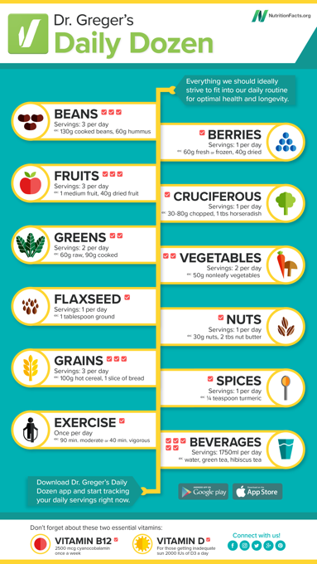
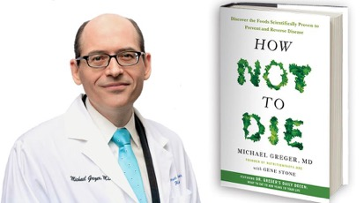
Dr. Greger's "Daily Dozen" checklist.
What to eat every day.
How not to die.
2018:
- https://www.youtube.com/watch?v=MqmSMunAtss
- https://www.youtube.com/watch?v=g0UmVKA-4F8
Updated 2020:
- https://www.youtube.com/watch?v=MXx14Fu_UYc
Daily Dozen Challenge:
- https://nutritionfacts.org/daily-dozen-challenge/

Slide 14
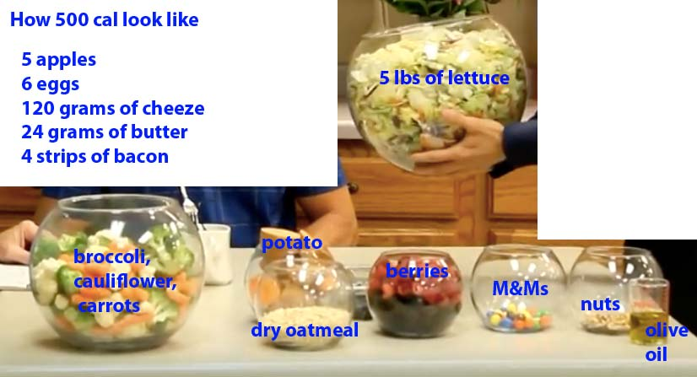

Slide 15
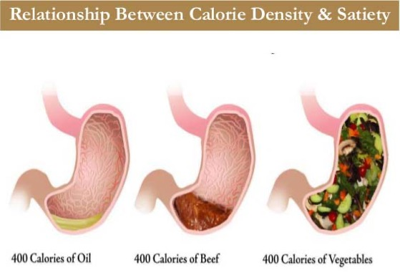
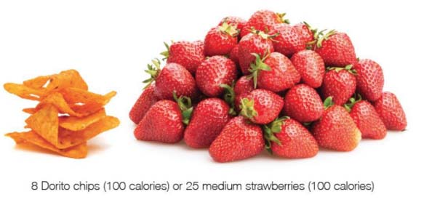
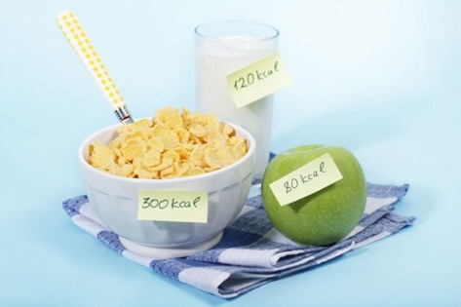
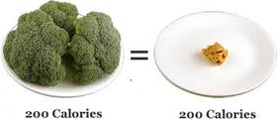
Bad
Good

Slide 16
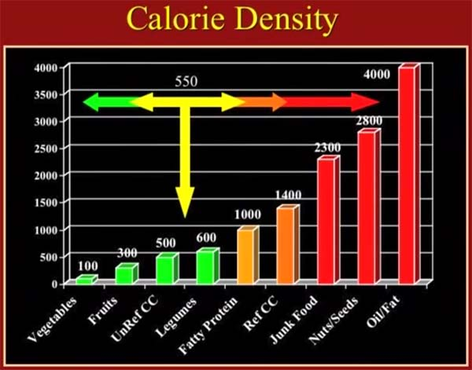
From Jeff Novick
Healthy
Unhealthy

Slide 17

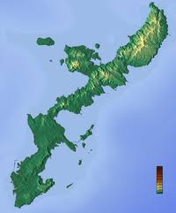
Okinawa Diet
- https://en.wikipedia.org/wiki/Okinawa_diet
Okinawa is one of “Blue Zones” – famous places with
highest concentration of healthy 100+ year old people.
People from the Ryukyu Islands (of which Okinawa is the largest) have a life expectancy among the highest in the world.
Also they have low mortality from cardiovascular disease
and certain types of cancers. Compared age-adjusted mortality of Okinawans versus Americans (1995) average Okinawan was:
- 8 times less likely to die from coronary heart disease,
- 7 times less likely to die from prostate cancer,
- 6.5 times less likely to die from breast cancer,
- and 2.5 times less likely to die from colon cancer
Recently numbers got worse because young people shift to Western diet.
What is the magic of the “old diet?
In short, the Okinawans circa 1950 ate
mostly sweet potatoes, with some rice, legumes, and other grains.
Of the 1262 grams of food per day:
849-sweet potato,
154-rice,
71-legumes,
38-grains,
150-everything else
Comparing to other Japanese, Okinawans consumed fewer total calories, less polyunsaturated fat, less rice, significantly less wheat, barley and other grains, less sugars, more legumes, significantly less fish, significantly less meat and poultry, less eggs and dairy, much more sweet potatoes, less other potatoes, less fruit, and no pickled vegetables (0g vs. 42g). [4]

Slide 18
Support Groups
About 12-step programs - there are many of them, for example:
• 1939 – Alcoholics Anonymous (AA) • 1960 – Overeaters Anonymous (OA) - Food Addicts Anonymous (FAA) (1987) - Anorexics and Bulimics Anonymous (ABA) (1993) - Compulsive Eaters Anonymous-HOW (CEA-HOW) (1996) - Food Addicts in Recovery Anonymous (FA) (1998) - Eating Disorders Anonymous (EDA) (2000) - GreySheeters Anonymous (GSA) - Recovery From Food Addiction, Inc. (RFA) - Food Compulsions Anonymous (FCA) The 12-step groups work well for some people because they provide personal support which is very important for people who are high on susceptibility scale (a.k.a. food addicts).
Note that results will depend on specific group. You need a group where people achieve results. If people just meet to wine and complain - this will not be effective.
Also you need a group where people use modern scientific-based approach.
Some people achieve good results using support groups.
If you want to be a part of some program, I highly recommend Susan Peirce's program ”Bright Line Eating” (BLE).
It grew from Food Addicts Anonymous (FAA) 12-step program, but it is more flexible, scientific, provides support via internet, and at this point in time it is the most effective program in existence: - https://brightlineeating.com/
You can buy Susan’s books on amazon.
Also subscribe to her weekly video (vlog).
And check out her youtube videos.

Slide 19
How to eat at different places:
Chinese – “Buddha's Delight” – steamed vegetables, no oil, with sauce on the side + rice + tofu
- http://www.eatthis.com/8-diet-experts-order-chinese-restaurants
McDonalds - Basic Side Salad, Fruit (Apple Slices and Cuties), Fruit & Maple Oatmeal
Generic restaurant - ask to make a plate of greens, vegetables, berries, and fruits, no oil, no dressing
Mexican restaurants – I usually order salad without dressing, salsa without chips, coffee, some fruits or berries for dessert
Coffee shops – I take 1-shot espresso + oat or soy milk + cold water
Calories in Coffee (8oz - small):
- Cappuccino with half & half – 330
- Cappuccino with whole milk – 113
- Latte with 2% milk – 95
- Americano – 8
Calories in some products:
- Hazelnuts (12) – 100
- brazil nut (1) - 33
- Raisins (50) - 80
- Apple or similar size fruit (1 medium) - 90
- Potato (1 medium) - 160
- banana (1 medium) - 105

Slide 20
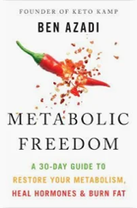

Ben Azadi – YouTube channel
Nutrition
Exercise
Sleep
Stress Management
https://www.youtube.com/@KetoKamp
Book "Metabolic Freedom" - https://www.amazon.com/dp/B0DMTSL5XG –
Main factors: https://www.youtube.com/watch?v=r8TpBblCqF8
remove sugars and other processed stuff
walk 10K steps
sleep more (deep sleep, sleep mask, cold temperature)
5 fruits for Keto diet:
Berries: Blueberries, raspberries, blackberries, and cranberries
Pomegranate; Avocado; Grapefruit; Coconut
The book: "Metabolic Freedom: A 30-Day Guide to Restore Your Metabolism, Heal Hormones & Burn Fat" by Ben Azadi offers a 30-day plan to reset metabolism, focusing on:
Keto fasting
Improved sleep
Cutting-edge bio-hacks
Mindset shifts (health first, self-compassion, seek support group, ...)
Smart exercise routines
Specific food swaps
The book also explores how hormones affect metabolic processes differently in men and women
30-day protocol: https://www.youtube.com/watch?v=rPRDbZDTGyI
7 Day Protocol To Burn Fat - https://www.youtube.com/watch?v=zBMVq97Hzrg
Intermitting fasting: 6 days with 6h eating window, then one 24h fast.
Eat no more than 3 meals, no snacks between them
Remove sugar and artificial sweeteners, avoid foods that spike insulin and contain anti-nutrients: wheat, grains, pasteurized cow dairy, almonds, and peanuts
Remove vegetable and seed oils, and artificial sweeteners
Consume cauliflower rice, eggs, red meat, and seafood
Consume a morning drink containing coffee, African mango, exogenous ketones, L-Carnitine, green tea leaf extract, and forscolin extract
Aim for 90 minutes of deep and REM sleep each night to support fat loss and overall health
Consider banana tea, a cooler bedroom temperature (63-67°F), a sleep mask, and mouth taping to improve sleep quality
Cooling cooked starchy foods like potatoes, rice, and pasta overnight in the refrigerator converts some of the regular starch into resistant starch
Reheating these foods after cooling increases the amount of resistant starch even further
Drinking lemon or lime juice, or vinegar mixed with water with starchy foods decreases blood sugar
Combine Carbs with Protein, Fats, and Fiber
Walk After Eating 10-20 min to help muscles to remove glucose from blood without needing insulin

Slide 21
More links:
- https://www.veghealth.com - Discover How to Thrive on a Vegetarian Diet
- https://youtu.be/LkXwfTsqQgQ - muscles matter
- https://youtu.be/0z03xkwFbw4 - custom diets for different people (depends on microbiome)
- http://www.npr.org/sections/thesalt/2015/04/11/398325030/eating-to-break-100-longevity-diet-tips-from-the-blue-zones -
from the book “The Blue Zones Solution” by Dan Buettner, National Geographic explorer
Stop eating when your stomach is 80 percent full to avoid weight gain
Eat the smallest meal of the day in the late afternoon or evening
Eat mostly plants, especially beans.
Eat meat rarely (once a week, small portion of 3 to 4 ounces)
Drink alcohol moderately and regularly, i.e. 1-2 glasses a day.
Five Blue Zones:
Ikaria, Greece - potatoes, goat's milk, honey, legumes (especially garbanzo beans, black-eyed peas, and lentils), wild greens, some fruit and relatively small amounts of fish, feta cheese, lemons and herbs like sage and marjoram. Rarely goat meat
Okinawa, Japan - seaweed, turmeric and sweet potato, bitter melons, tofu, garlic, brown rice, green tea and shitake mushrooms.
Sardinia, Italy - goat's milk and sheep's cheese, flat bread, sourdough bread and barley, plenty of fennel, fava beans, chickpeas, tomatoes, almonds, milk thistle tea and wine from Grenache grapes.
Loma Linda, Calif - Seventh-day Adventists - mostly plant-based diet (grains, fruits, nuts and vegetables, and drink only water. Some of them eat small amounts of meat and fish.) Sugar is taboo. Their top foods include avocados, salmon, nuts, beans, oatmeal, whole wheat bread and soy milk. Pesco-vegetarians in the community, who ate a plant-based diet with up to one serving of fish a day, lived longer than vegan Adventists
Nicoya Peninsula, Costa Rica - beans, corn and squash. papayas, yams, bananas and peach palms (fruit).

Slide 22
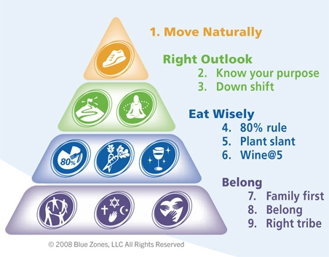
Blue Zones – 9 principles.
People who live in a Blue Zone have nine characteristics in common.
For the Blue Zones Project, these are called "Power 9 Principles.”
Move naturally - Get more physically active by walking in the community, do manual labor around the house and yard, and grow gardens.
Know your purpose - People who know why they get up in the morning live up to seven years longer than those who don't.
Down shift - To reverse inflammation related to every major age-related disease, find time each day to meditate, nap, pray or enjoy a happy hour.
80 percent rule - It takes the stomach 20 minutes to tell the brain it is full, causing most people to accidentally overeat. Stop eating when 80 percent full.
Plant slant - Eat a mostly plant-based diet heavy on beans, nuts and green plants. This is consistent with U.S. Department of Agriculture recommendations.
Wine at 5 - For those who have a healthy relationship with alcohol, 1-2 glasses of wine daily can add years to a life, especially when combined with a healthy diet.
Family first - Living in a thriving family is worth six extra years of life expectancy.
Belong - Recommit, reconnect or explore a faith-based community. No matter which faith, studies show that people who show up to their faith community four times a month live an extra four to 14 years.
Right tribe - Friends have a long-term impact on well-being. Expand a social circle to include healthy-minded, supportive people. This could be the most powerful way to add years to a life.

Slide 23

Plant Based Keto Diet
Good to eat:
Start day with water with lemon, drink lots of water during the day, clean your body with green juices, make your body more alkaline
lots of greens: celery, lettuce, mustard greens, spinach, kale (chips), cucumbers, tomatoes
avocado, lemon
seeds and nuts (soak in water over-night), chia seeds, hemp seeds
string beans (steamed), peppers, cruciferous vegetables (radish, Kale, cabbage, Brussels sprouts, black radish, daikon (long radish), sprouts, asparagus, broccoli, garlic, onion, ocra, lemon, beets (raw), zucchini, bok choy, (eggplant + nuts)
fish oil (1-2 spoons/day)
black seed oil ( 1-2 tea spoon/day)
spices: black pepper, turmeric, lemon
green juices, smoothy with nuts, almond milk
B12 - 2,000 mcgr/week
multivitamins (A, E, D, B) https://www.amazon.com/NOW-His-Vita/dp/B0063G0PWI/
sesame seeds, tahini
some watermelon, blueberries, strawberries
A friend of mine used this diet to lose 140 lbs in 1 year.
It is healthy and easy to follow.
A Plant Keto Diet is a very good, easy to follow and healthy way of eating
which makes it easy to lose weight and maintain weight while being healthy.
Ketones are produced when your body breaks down fat.
The main idea of this diet is to avoid glucose (sweet taste, glycogen), thus forcing body to start using its own fat as energy source.
It is similar to Atkin's diet, but without meat.
You eat mostly plant foods (and some fish).
No meat, chicken, eggs, all milk products
No sweet taste, no sugar/glycogen rich products
No bread/wheat, rice, oats, grains (quinoa, buckweat, Amaranth, cereals, ...)
No starchy vegetables (potato, yams, carrots, squash,, ...)
No fruits
No beans and lentils, no tempeh, no soy, no tofu, no edamame
No peanuts or peanut butter
No nutritional yeast
No Vegan Feta (it has carbs)
Also:
Reduce salt, no soy sauce, ...
Use coconut oil, avocado oil, walnut oil, flaxseed oil
use grill instead of frying, do not fry on olive or sunflower oil
NOW Foods - ADAM Superior Men's Multi
180 Softgels

Slide 24







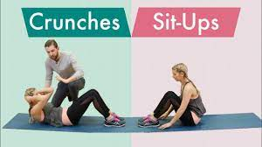



Move.
Move every 20 minutes.
Use treadmill desk.
Walk/run/play, play outside.
30-90 min/day.
The more – the better.
Here are some links about exercising:
Flexibility - Tom Merrick - https://youtu.be/hoQbrx955-8 - https://www.youtube.com/watch?v=QT4hvcIjKtc Flexibility - Emmet Louis - https://www.youtube.com/watch?v=askyPISMogs - https://www.youtube.com/watch?v=3HVsDRjOHqU
- https://www.youtube.com/watch?v=2KDJdDfaEHM
Strength max load (1-4 reps, 4 sets/day):
- https://www.youtube.com/watch?v=q0bo-kDHT7Y Strength – endurance (more pullups)
(3 variations, 3 sets each – 9 sets total at ~70% of max
or go to max. number of sets. At the end – hold and slow release):
- https://www.youtube.com/watch?v=gROqn53az2g
- https://www.youtube.com/watch?v=nj_bOz2aigQ
- https://www.youtube.com/watch?v=NnN8ksvVRIQ
Yoga - yogaglo: https://www.youtube.com/user/yogaglo Yoga for surfers (17 min): https://www.youtube.com/watch?v=oX6I6vs1EFs Yoga with Adriene: https://www.youtube.com/watch?v=v7AYKMP6rOE

Slide 25
Burning Calories
1 lb of fat = 3500 Kcal So a caloric deficit 500/day = 3500/wk = 1 lb/wk weight loss.
This caloric deficit may be achieved by eating less & exercising more
1 hr of exercising burns 300..500K (+200 after-burn). So 1hr in gym EVERY DAY burns ~500/day, or 1 lb/wk.
Exercising 1 hr 3 times per week will cause ~0.5 lbs/wk loss.
========================================
Daily Daily Weekly (monthly)
Food Exercise weight loss
(Kcals) (hours) (lbs)
========================================
1700 0 0 (0/mo)
1200 0 1 (4/mo)
800 0 2 (8/mo)
800 0.5 2.5 (10/mo) gym 3/week
800 1 3 (12/mo) gym daily
800 2 4 (16/mo) hero
800 3 5 (20/mo) super-hero
========================================
By being really consistent with the plan, and by doing some extra fasting or exercises, you can reasonably lose ~10 lbs/month.
When you start (your first month) - you will lose more, but then it slows down.
It is important to find what you like to do and can do LONG TERM.
For example walking (100 KCal/mile), running (150 KCal/mile), ...
Eating is still the most important factor.
For example, you can sweat for an hour in the gym, burn 500 Kcal, and then out-eat your workout by eating just one burger (560 Kcal).
We know that exercises don't contribute much to weight loss long term. The "burning stove" theory doesn't work long term.
But when people want to lose weight fast, they love to count calories.
So here are some numbers.
Note - if you don't sleep enough, or under stress, or eat very unhealthily, these numbers will not work. Note:
Speed of losing weight is SLOW (unless you do something heroic)
Speed mostly depends on total caloric intake. Exercising can help, but eating contributes more. You can easily "out-eat" any exercise.
How many calories you burn without exercise?
Suppose your weight = 222 lbs,
and your LBW = 140 lbs (Lean Body Weight = weight without excess fat). Your Basal Metabolism ~1700 Kcal/day. - http://www.bodybuilding.com/fun/bmr_calculator.htm LBW for 140 lbs : 1500 Kcal LBW for 233 lbs : 2100 Kcal

Slide 26
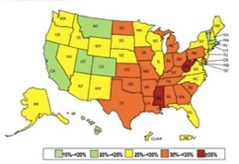
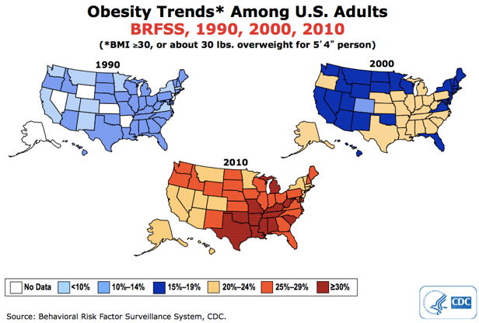
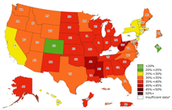
Obesity Epidemic in USA
Dramatic changes in last 30 years
New maps (CDC changed methods in 2011)
2013
2019
2023
Green State: Colorado !
Official CDC data and maps: - https://www.cdc.gov/obesity/data/prevalence-maps.html
- https://www.cdc.gov/obesity/data-and-statistics/adult-obesity-prevalence-maps.html

Slide 27
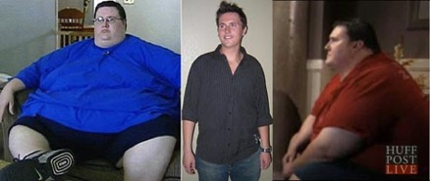
Motivation – and TV Lies
Search youtube for phrases like "lost 100 lbs", "lost 400 lbs", "lost 800 lbs", etc.
You will find multiple examples.
What you will learn from these stories:
People gained weight mostly because they have used food to distract themselves from some sort of pain (stress, emotional problems, etc.)
They were eating junk (sugar and flour based foods and drinks).
There is no magic in what people were doing to lose weight: diet and exercise.
People have used different regimens, and it was mostly simply based on will power and discipline.
But most of these regimens are not designed for long-term maintenance. Thus you should NOT use them as role models.
TV mostly concentrates on drama, emotions, and amazing stories of fast and dramatic fat loss. (20-30 lbs/month, 100..500 lbs loss). But the winners of those shows ("The Biggest Loser", "Extreme Weight Loss", etc.) frequently gain their weight back. Because they lost weight not by creating new good effective habits, but by using will power, which never works long term.
- https://healthyeater.com/biggest-loser-then-now -
- http://www.dailymail.co.uk/femail/article-2927207/We-fat-Former-Biggest-Loser-contestants-admit-controversial-regained-weight-endure-lasting-health-issues.html -
"We are all fat again ..." https://www.youtube.com/watch?v=DTlvDMBDIxQ - David Smith (trainer Chris Powell)
The methods used on those TV shows are not healthy (LiveScience.com): "... physicians and nutritionists worry the (Biggest Loser) show's focus on competitive weight loss is, at best, counterproductive and, at worst, dangerous". Contestants on the show lose upwards of 10 pounds per week (... some contestants have lost 20–30+ pounds in that one week alone)
David Smith's story:
650 lbs
>> lost more than 400 lbs
>> gained a lot back

Slide 28
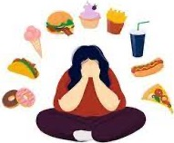
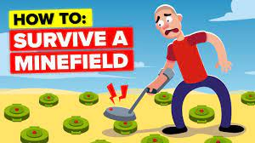
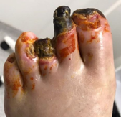

Some Final Thoughts
Food Addiction is Real
Food Addictions can be as strong as drug addiction or alcoholism – as was proven by multiple scientific studies.
Eating in modern society is like walking across a minefield.
Probably 90% of foods which are being sold in supermarkets are not good for you.
Some foods (like sugar or flour) are extremely potent at promoting FA (Food Addiction) and changing brain chemistry (down-regulation of dopamine receptors).
If you will be doing what is considered "normal" - you will get fat and sick like the rest of Americans.
To stay healthy (and lean) you must do something different from what is considered "normal".
Every year more than 100,000 people in America lose their limbs or go blind because of type 2 diabetes. Which could've been prevented and cured in few weeks by simply changing their eating habits.
But those people struggled and failed to do this.

