Slide 1
Azure ML
DevOps & CI/CD

Slide 2

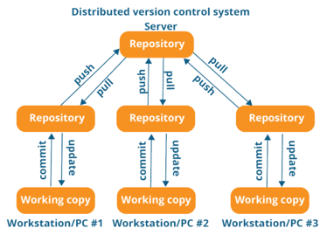

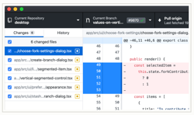



Git, GitHub
Git is a free and open source distributed version control system
Linus Torvalds has developed Git in 2005 to use in Linux development community. (before Git they used BitKeeper).
Git is fully distributed, fast, simple, can efficiently handle large projects like the Linux kernel (speed and data size, thousands of parallel branches)
Linus Torvalds
Linux - https://www.linux.org
Git - https://git-scm.com - https://github.com
GitHub
.. 2008 - founded
.. 2018 - acquired by Microsoft for $7.5 Bln
.. 2020 - 40 Mln users, 190 Mln Repos, 2.5K employees
GutHub
Desktop
Git
Linux
GutHub

Slide 3
Git in Azure ML DevOps
Git (software) - https://git-scm.com , https://git-scm.com/doc , GitHub (company) - https://github.com
Azure ML – Git integration https://docs.microsoft.com/en-us/azure/machine-learning/concept-train-model-git-integration
Lev's Git docs – several files .. https://github.com/lselector/python_tutorials .. https://github.com/lselector/python_tutorials/blob/master/g01_git_procedures.txt
Source Control in Azure - Use Git (distributed) or Team Foundation Version Control (TFVC) .. https://docs.microsoft.com/en-us/azure/devops/user-guide/source-control?view=azure-devops
Git Docs (MSFT) .. https://docs.microsoft.com/en-us/azure/devops/repos/git/?view=azure-devops
Azure ML Studio and Git/AzureDevOps .. https://docs.microsoft.com/en-us/answers/questions/355882/azure-ml-studio-and-gitazuredevops.html
Best practices for version control with Azure Machine Learning .. https://social.msdn.microsoft.com/Forums/azure/en-US/2e0beb55-c4cd-47db-84f9-66693e5405d5/best-practices-for-version-control-with-azure-machine-learning?forum=MachineLearning
Version control Azure ML workspaces with custom environments and pipelines? .. https://stackoverflow.com/questions/60523435/how-do-i-version-control-azure-ml-workspaces-with-custom-environments-and-pipeli

Slide 4
Git – continued …
.gitconfig. (example)
git config --global user.name "Last, First"
git config --global user.email FLast@example.com
# Some files to know:
~/.git-completion.bash
~/.gitconfig
~/.gitexcludes
mkdir ~/workdir
cd ~/workdir
git clone git@github.com:myuser/repo1.git
git clone git@github.com:myuser/repo2.git
cd repo1
edit .gitignore
git add .
git commit -m'some comment'
git remote add origin git@github.com:myuser/repo1.git
git push -u origin master
git fetch
git pull
git log
...
Check your remote:
git remote -v (base)
origin git@github.com:lselector/ml_ai_doc.git (fetch)
origin git@github.com:lselector/ml_ai_doc.git (push)
(base)
[filter "lfs"]
process = git-lfs filter-process
required = true
clean = git-lfs clean -- %f
smudge = git-lfs smudge -- %f
[user]
name = Lev Selector
email = lev.selector@gmail.com
[credential]
username = lselector
[color]
ui = auto
[alias]
st = status
ci = commit
co = checkout
staged = diff --cached
unstage = reset HEAD --
amend = commit --amend
unci = reset --soft HEAD^
oneline = log --oneline
unstaged = diff
both = diff HEAD
lg = log --graph --pretty=oneline --abbrev-commit --decorate
wdiff = diff --word-diff
[log]
decorate = short
[push]
default = tracking
[branch]
autosetuprebase = always

Slide 5
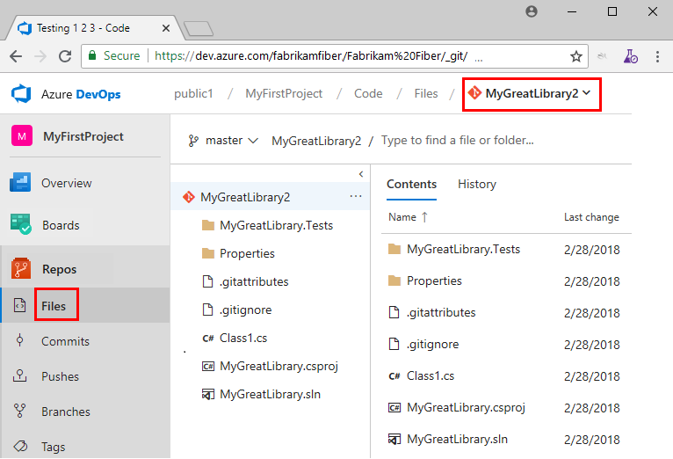
Git in Azure DevOps
In ML Studio terminal you can:
.. generate ssh keys – and add them to your repo
.. clone your repo to the terminal
.. add your notebooks, python scripts, etc. to the repo
Azure ML – Git integration https://docs.microsoft.com/en-us/azure/machine-learning/concept-train-model-git-integration
ssh-keygen -t rsa -b 4096 -C "your_email@example.com"
cat ~/.ssh/id_rsa.pub
git clone git@example.com:GitUser/azureml-example.git

Slide 6
Save Pipeline as Code
Azure ML Studio has storage account which has File share and Blob Containers.
If you explore File Shares - you can see user directories with code.
In blob containers you can find files with information about all pipelines, experiments, logs files. Unfortunately these files are not convenient to use
In ML Studio:
Pipeline "Save as code" is no longer available.
So we need to write scripts to create pipelines
in a portable manner (to be able to deploy them in DEV and in PROD).
In ML Studio:
Save Job Run as JSON:
Jobs
click on specific pipeline to open it
clic on "Job Overview" on top-right
scroll down to
See all properties:
Raw JSON
this will give you JSON for the specific run of the pipeline

Slide 7
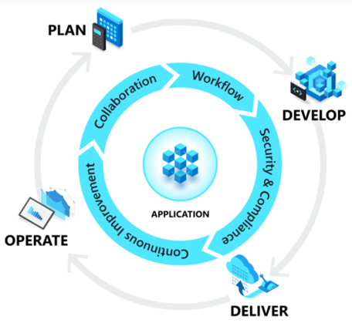

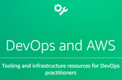
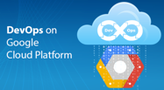
DevOps
What is DevOps
DevOps = Development (Dev) + Operations (Ops)
DevOps is the union of people, process, and technology.
DevOps enables formerly siloed roles
development
IT operations
quality engineering
security
to coordinate and collaborate to produce better, more reliable products.
By adopting a DevOps culture, practices and tools,
teams gain the ability to better respond to customer needs, increase confidence in the applications they build, and achieve business goals faster
Azure DevOps Server - a Microsoft product that provides version control, reporting, requirements management, project management, automated builds, testing and release management capabilities. It covers the entire application lifecycle, and enables DevOps capabilities
AWS
Google

Slide 8
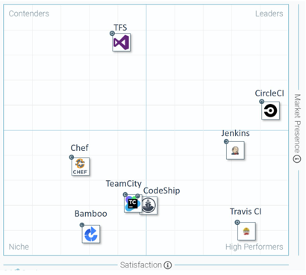
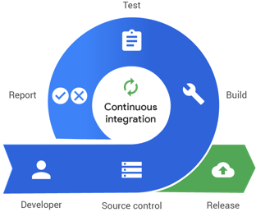
Continuous Integration / Continuous Delivery CI/CD
CI Software for DevOps
Review - https://www.guru99.com/top-20-continuous-integration-tools.html
Leaders:
CircleCI - free and commercial, good for small projects - https://circleci.com/
Jenkins - open source, java, need dedicated server, good for big projects - https://www.jenkins.io/
Travis CI - similar to CircleCI (more options, but also more expensive, no free options) - https://travis-ci.org/
Others:
CodeShip - https://codeship.com/
TeamCity – from JetBrains, $300+, has many features - https://www.jetbrains.com/teamcity/
Bamboo CI – commercial - https://www.atlassian.com/software/bamboo
Chef - https://www.chef.io/
Ansible - RedHat - https://www.ansible.com/
GitLab CI - https://about.gitlab.com/
AirFlow - https://airflow.apache.org/
Azure devops - https://azure.microsoft.com/en-us/services/devops/
Jenkins X - https://jenkins-x.io/
OpenShift - Red Hat - Enterprise Kubernetes container platform to automate hybrid cloud and multi-cloud deployments - https://www.openshift.com/

Slide 9
Pipelines as Code with YAML
Many teams prefer to define their build and release pipelines using YAML (YAML Ain’t Markup Language).
This allows them to access the same pipeline features as those using the visual designer, but with a markup file that can be managed like any other source file.
YAML build definitions can be added to a project by simply adding their source file to the root of the repository.
Azure DevOps also provides default templates for popular project types, as well as a YAML designer to simplify the process of defining build and release tasks.

Slide 10




YAML
YAML Example:
YAML = YAML Ain't Markup Language (original name was Yet Another Markup Language)
serialization language, mostly used for config files, DevOps
human-friendly
since 2001 (20+ years)
by Clark Evans, Ingy döt Net, Oren Ben-Kiki
rhymes with “camel”
unicode based
uses indentation (like python) to indicate nesting
uses [...] for lists and {...} for maps
JSON files are valid YAML
uses "#" for comments (benefit in comparison with JSON)
https://yaml.org -
https://en.wikipedia.org/wiki/YAML -
http://ben-kiki.org/oren - https://github.com/orenbenkiki -
https://github.com/ingydotnet -
https://github.com/clarkevans -
---
# Employee records
- martin:
name: Martin D'vloper
job: Developer
skills:
- python
- perl
- pascal
- tabitha:
name: Tabitha Bitumen
job: Developer
skills:
- lisp
- fortran
- erlang
Ingy döt Net
YAML in Python:
Clark Evans
# https://pyyaml.org/wiki/PyYAMLDocumentation
# pip install pyyaml
import yaml
with open(myfile) as fh:
data = yaml.load(fh, Loader=yaml.FullLoader)
print(data)
data = [ ... ]
with open('myfile.yaml', 'w') as fh:
out = yaml.dump(data, fh)
The reason why we like working with YAML
is because it is optimized for data serialization, formatted dumping, configuration files, log files, Internet messaging and filtering.
There are many advantages of localizing files in YML file format: Files are easy to work in a text editor.
Oren Ben-Kiki

Slide 11






MLOps WorkFlow
Prepare
Experiment(build)
Deploy
Prepare Data
Build Model
Train & Test Model
Register and Manage Model
Build Image
Deploy Service
Monitor Model
Orchestrate
Boards
(Azure DevOps)
Repos
(Azure DevOps)
Pipelines & Test Plans
(Azure DevOps)
Artifacts & Pipelines
(Azure DevOps)
Model monitoring
(Azure Machine
Learning Service)
Application
Insights

Slide 12






Continuous Integration in MLOps
How to package a registered model with Docker .. https://docs.microsoft.com/en-us/azure/machine-learning/how-to-deploy-package-models
Training Pipeline
ML/DevOps Team
Create Scoring Docker Image Or Deploy model
Tests
Launch training
Evaluate models
Register model
Experiment
Packaged model
Data Scientist Team
Notes:
CI pipeline captures:
Create sandbox
Run unit tests and code quality checks
Attach to compute
Run training pipeline
Evaluate model
Register model
Package model into container image

Slide 13




Continuous Deployment in MLOps
Based on Azure Architecture Recommendation:
"Organize and set up Azure Machine Learning environments"
.. https://docs.microsoft.com/en-us/azure/cloud-adoption-framework/ready/azure-best-practices/ai-machine-learning-resource-organization?branch=pr-en-us-1541
CD Pipeline
Artifacts & Pipelines
(Azure DevOps)
Deploy model in DEV
Deploy model in PROD
Tests
. . .
Approval (manual or automatic)
Webservice
(development environment)
Webservice
(production environment)
ML/DevOps Team
Prod Team
Notes:
CD pipeline captures:
Validate and profile model
Deploy model to DevTest (ACI)
If all is well, proceed to rollout to AKS or any other service in prod
Everything is done via the CLI

Slide 14
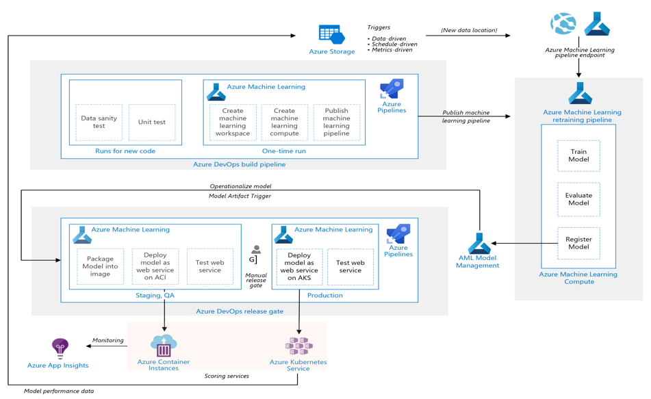
MLOps Reference Architecture

Slide 15
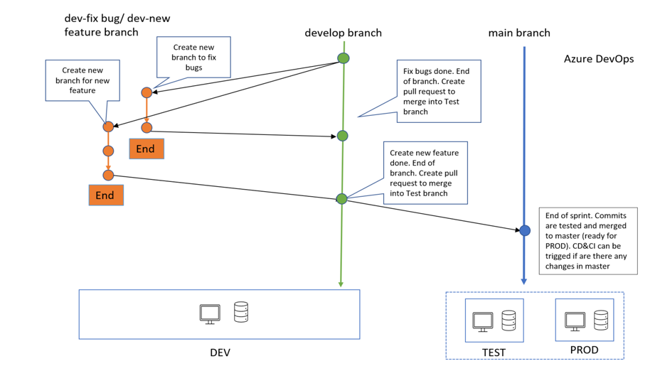
Branching Strategy for MLOps

Slide 16

Azure DevOps Templates & Tutorials
Azure ML MLOps Template
.. https://github.com/microsoft/dstoolkit-mlops-base
Azure ML Service Tutorials by Sascha Dittmann (2019):
.. https://github.com/SaschaDittmann/MLOps-Lab
Videos (Sascha Dittmann, 2019):
Train Your Model
.. https://www.youtube.com/watch?v=nVjNBKLCMKE
DevOps for Machine Learning (Part 1)
Getting Started with MLOps with Azure DevOps
.. https://www.youtube.com/watch?v=YAqTt4DYIbw
DevOps for Machine Learning (Azure MLOps Part 2)
Setup Azure Machine Learning Services
.. https://www.youtube.com/watch?v=mZUdYu345dg
DevOps for Machine Learning (Azure MLOps Part 3)
Train and Version Your Model
.. https://www.youtube.com/watch?v=hQkbKhwOH7Q
DevOps for Machine Learning (Azure MLOps Part 4)
Deploy Your Model to Azure Container Instances
.. https://www.youtube.com/watch?v=vNoon1TmLuw
DevOps for Machine Learning (Azure MLOps Part 5)
Deploy Your Model to Azure Kubernetes Service
.. https://www.youtube.com/watch?v=fhNMRfBByDc
Azure DevOps
.. https://azure.microsoft.com/en-us/services/devops/#overview
Azure ML
.. https://azure.microsoft.com/en-us/services/machine-learning/

