Slide 1
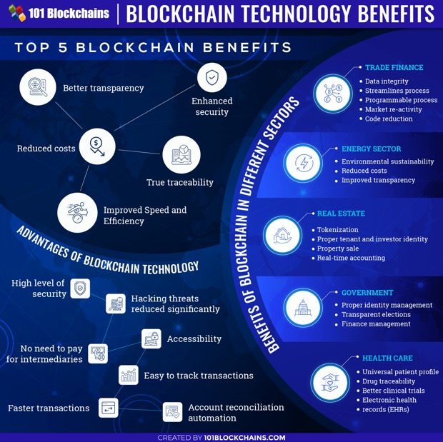
Blockchain Technology
A blockchain - a system to make digital records of transactions.
The name comes from its structure, in which blocks of individual records are linked together in single list, called a chain.
This chain is stored in huge network of millions of computers around the world. No one owns this network. No one can manipulate historic records.
A blockchain is a decentralized ledger. Using this technology participants can confirm transactions without a need for a central clearing authority.
Applications - fund transfers, settling trades, voting, contracts, etc.
Benefits:
Protecting rights through immutable records
Creating a true sharing economy
Enabling direct pier-to-pier transactions without intermediaries (banks, etc.)
Enabling citizens to own and monetize their data (and protect privacy)
Ensuring compensation for the creators of value
Don Tapscott (2016) TED Talk
How the blockchain is changing money and business
https://www.youtube.com/watch?v=Pl8OlkkwRpc

Slide 2
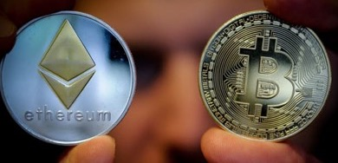
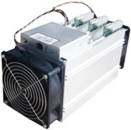
Cryptocurrency
Some stats(2021):
4,000+ cryptocurrencies
2 Trillion $ - total market
https://coinmarketcap.com/
Bitcoin , Ethereum, Binance Coin, Tether, XRP, Cardano, Dogecoin, Polkadot, Uniswap, Litecoin, Bitcoin Cash, etc.
A cryptocurrency (Bitcoin, Ethereum, etc.):
digital medium of exchange (currency)
uses blockchain as a ledger
security achieved via two mechanisms:
massive distributed redundance of blockchain
uses cryptography
to secure its transactions
to control the creation of additional units
to verify the transfer of assets
https://www.simplilearn.com/bitcoin-mining-explained-article
GitHub:
Bitcoin (C++ mostly):
https://github.com/bitcoin
Simple blockchain in python:
https://github.com/dvf/blockchain
Ethereum in Golang:
https://github.com/ethereum/go-ethereum
https://github.com/ripple
Mining Bitcoins
ASICs Miner (Application Specific Integrated Circuits).
Transactions in blockchain cryptocurrencies are slow
(except for Ripple – which has centralized architecture)
Total transactions per second:
Visa: 24,000
Ripple: 1,500
PayPal: 193
Bitcoin: 7
Ethereum: 12
https://alephzero.org/blog/what-is-the-fastest-blockchain-and-why-analysis-of-43-blockchains/
https://coinsutra.com/transaction-speeds/
Ethereum
decentralized, open-source blockchain
with smart contract functionality
- https://en.wikipedia.org/wiki/Ethereum

Slide 3
Numerai
- https://numer.ai/
- new type of a hedge fund launched in 2015:
- make competitions to do financial predictions
- pay winners in cryptocurrency (their own currency - Numeraire).
Hyperledger
Hyperledger is an umbrella project of open source blockchains and related tools,
started in December 2015 by the Linux Foundation.
Hyperledger Fabric - a blockchain framework.
Hyperledger Sawtooth - modular platform for building, deploying, and running distributed ledgers

