Slide 1
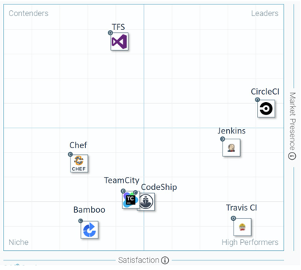
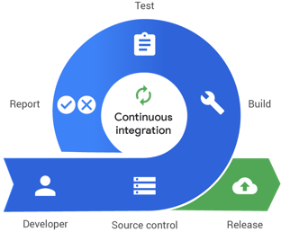
Continuous Integration ( C I ) – software for DevOps
Review - https://www.guru99.com/top-20-continuous-integration-tools.html
Leaders:
CircleCI - free and commercial, good for small projects - https://circleci.com/
Jenkins - open source, java, need dedicated server, good for big projects - https://www.jenkins.io/
Travis CI - similar to CircleCI (more options, but also more expensive, no free options) - https://travis-ci.org/
Others:
CodeShip - https://codeship.com/
TeamCity – from JetBrains, $300+, has many features - https://www.jetbrains.com/teamcity/
Bamboo CI – commercial - https://www.atlassian.com/software/bamboo
Chef - https://www.chef.io/
Ansible - RedHat - https://www.ansible.com/
GitLab CI - https://about.gitlab.com/
AirFlow - https://airflow.apache.org/
Azure devops - https://azure.microsoft.com/en-us/services/devops/
Jenkins X - https://jenkins-x.io/
OpenShift - Red Hat - Enterprise Kubernetes container platform to automate hybrid cloud and multi-cloud deployments - https://www.openshift.com/

