Slide 1

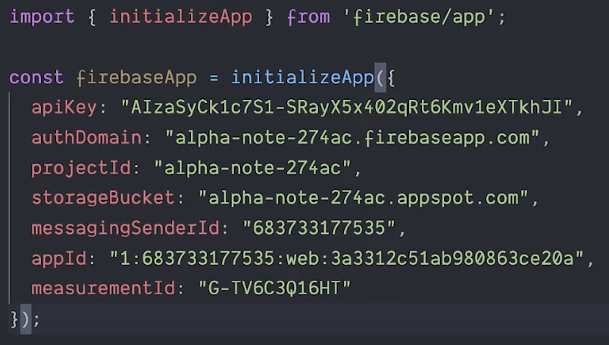
Google Firebase – getting started - 1
Google Firebase is an app development platform.
Most apps need identity management.
Firebase provides "Firebase Authentication"
.. https://firebase.google.com/docs/auth
.. https://github.com/firebase/firebaseui-web
The encrypted info is stored in Google firebase platform.
Docs: https://firebase.google.com/docs/web/setup
index.js
import { initializeApp } from 'firebase/app'
const firebaseApp = initializeApp ({
apiKey: "...",
authDomain: "...",
projectId: "...",
storageBucket: "...",
messagingSenderId: "...",
appId: "...",
measurementId: "..."
});
We will follow youtube tutorials to set up Firebase
Download and install node.js / npm .. https://nodejs.org/en/ which node # /usr/local/bin/node which npm # /usr/local/bin/npm
Getting started with Firebase for the web .. https://www.youtube.com/watch?v=rQvOAnNvcNQ npm init –y # creates package.json npm i firebase mkdir src cd src code index.js

Slide 2
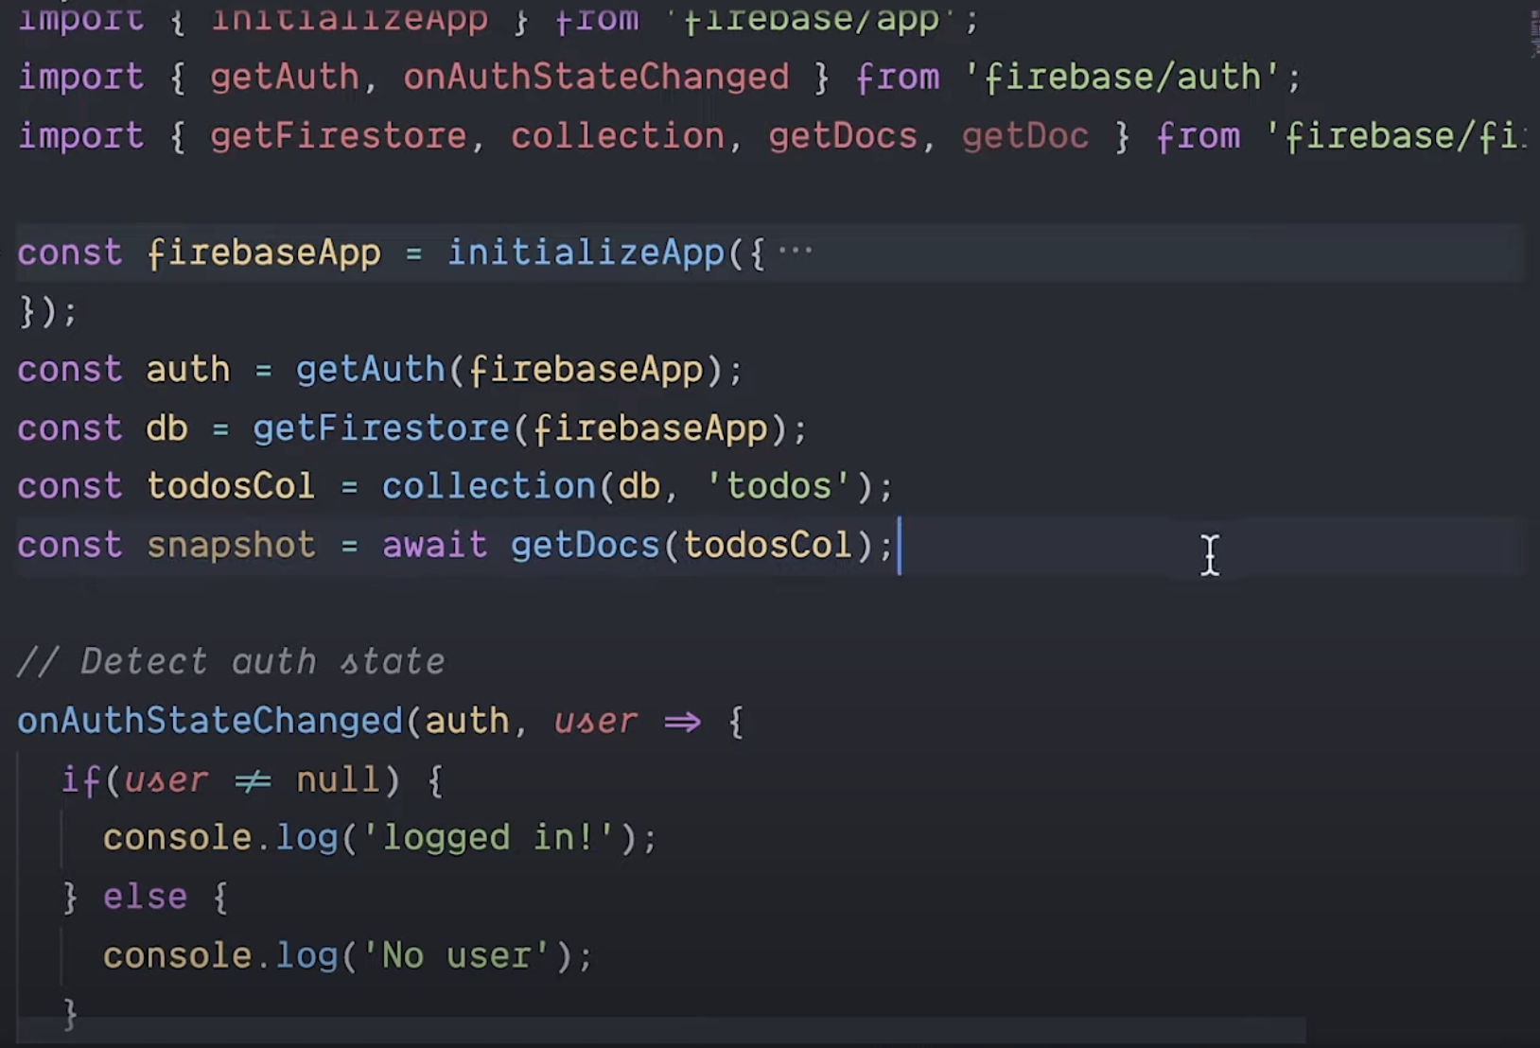
Google Firebase – getting started - 2
index.js
After you init the app, you can use getter functions or some other functions as needed
We can not run this code in browser because browser doesn't understand imports
So we can use https urls instead, like this:
import { ...} from 'https://www.gstatic.com/firebasejs/9.0.0/firebase-app.js'

Slide 3
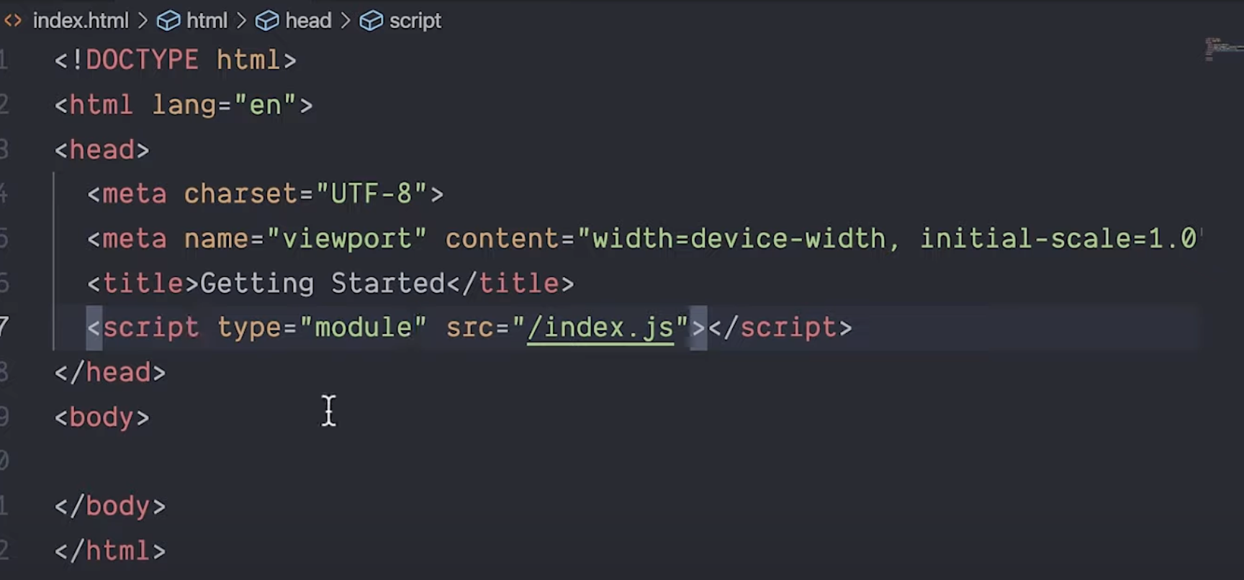
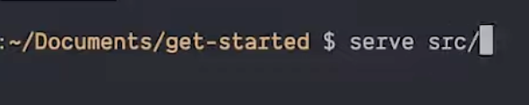
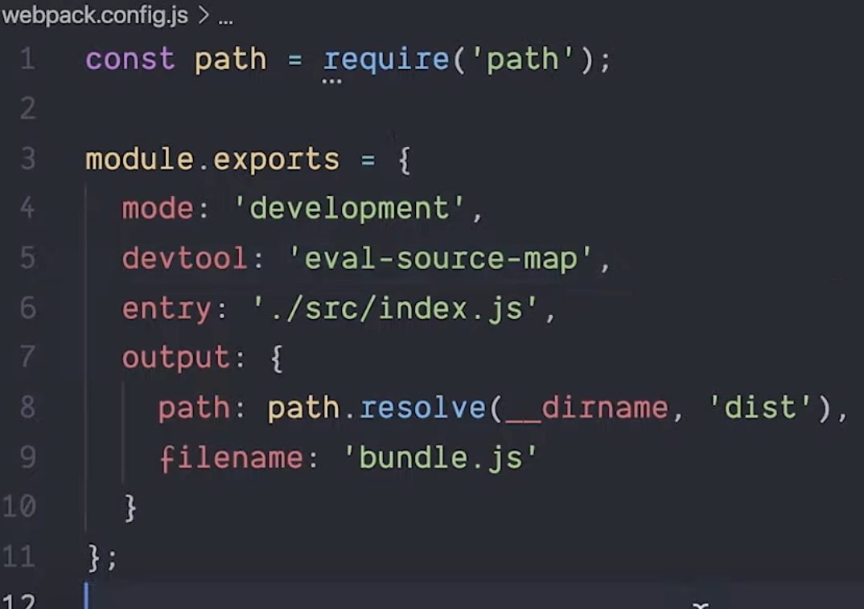
Google Firebase – getting started - 3
index.html
Now you can "serve" directory (from unix prompt)
This will open localhost:5000 in the browser
To deploy the code, you need to "web pack" it. React and other frameworks do it for you under the hood. But you can also do it yourself:
npm i webpack webpack-cli –D
node_modules/.bin/webpack –entry ./src/index.js -o dist. # creates dist/main.js
Edit file webpack_config.js
node_modules/.bin/webpack. # creates dist/bundle.js

Slide 4
Google Firebase Authentication – getting started
Getting started with Firebase Authentication on the web .. https://www.youtube.com/watch?v=rbuSx1yEgV8

Slide 5
ChatGPT answer to prompt: "how can I build a user authentication and authorization service for web application on Linux server using MySQL and Firebase ?"
ChatGPT answer to prompt: " How to set up Firebase Authentication for my web application ?"
Create a Firebase project and configure your web app in the Firebase console. To create a Firebase project, go to the Firebase console: https://console.firebase.google.com Make sure you are logged into correct Google account Click "Add project," and follow the prompts. Once you have created your project, click "Add app" and choose "Web" to configure your web app.
Enable Firebase Authentication. In the Firebase console, go to the "Authentication" section and click "Get started." Follow the prompts to enable Firebase Authentication for your project.
Choose authentication providers (one or more: email and password, Google, Facebook, Twitter, etc.)
Configure the authentication providers. (follow the prompts in the Firebase console, this may involve creating API keys or OAuth credentials).
Add Firebase Authentication to your web app. In the Firebase console, go to the "Authentication" section and click "Set up sign-in method." Choose the authentication provider you want to add and follow the prompts to configure the provider.
Implement Firebase Authentication in your web app. Use the Firebase Authentication SDK to implement authentication in your web app (search docs for examples).
Test your authentication flow.
Create a MySQL DB tables to store user information such as usernames, passwords, and roles.
Set up Firebase Authentication for your web application. This will allow you to authenticate users with Firebase's pre-built UI components and APIs.
Integrate Firebase Authentication with your web application using Firebase's JavaScript SDK.
Write server endpoint (in Python) working as authentication service. Secure it against attacks (SQL injection, ...).
Test your service to ensure that it works as intended and is secure.

