Slide 1
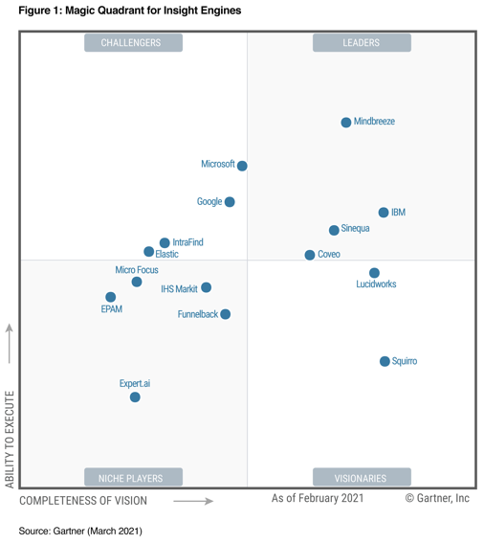
Insight Engines
The term "Insight Engine" was proposed by Gartner. Gartner's definition:
" Insight engines combine search capabilities with artificial intelligence to deliver actionable insights derived from the full spectrum of content and data sourced within and external to an enterprise. "
An insight engine, is also called cognitive search or enterprise knowledge discovery and management. It is a platform that combines search with machine learning capabilities to provide information for users and data for machines in a timely manner.
https://www.gartner.com/en/documents/3999454-magic-quadrant-for-insight-engines
Coveo - https://www.coveo.com -
iFinder elastic - https://intrafind.com/en/ifinder -
EPAM
Expert.ai
Funnelback
Google Cloud Search
IBM Watson Discovery - https://www.ibm.com/cloud/watson-discovery -
IHS Markit
IntraFind
Fusion by Lucidworks - https://lucidworks.com/products/fusion -
IDOL by Micro Focus
Microsoft Cognitive Search, Symantic Search
Mindbreeze inSpire - https://inspire.mindbreeze.com -
Sinequa - https://www.sinequa.com -
Squirro
Also:
Yext Answers - https://www.yext.com/platform/answers -
Attivio Cognitive Search and Insight Platform
Cogito Intelligence Platform
EXALEAD
Goldfire
InfoNgen
https://www.elastic.co/explore/improving-digital-customer-experiences/gartner-magic-quadrant-for-insight-engines-report

Slide 2
How do Insight Engines Work?
To Extract Information:
Insights engines use a combination of technologies:
Data integration – using data from various data sources
NLP (Natural Language Processing) – understand language in text, video, image, etc.
ML (Machine learning) – analyze data to identify trends, make predictions and suggest recommendations
To match insights with users’ search queries:
ML Algorithms (collaborative filtering, clusterization and similarity calculation) to identify relevance between search results and match insights to search queries.
Semantically enhanced Logical Data Warehouse (LDW): Logical data warehouses store semantic information (information about the meaning of the stored data) along with the data itself. For example, this enables LDW systems to identify synonyms and deal with user search queries involving synonyms.
To enable alternative forms of query:
Conversational UI: Queries that are formed as sentences can be processed by insight engines and responses can be served in a conversational way, facilitating human understanding of insights.
- https://research.aimultiple.com/insight-engine/ -
The insight engine proactively searches databases
to deliver information when needed
rather than start searching on-demand.
Insight engines extract needed information from large volumes
of complex (structured/unstructured)
and diverse (internal/external) data sources.

Slide 3


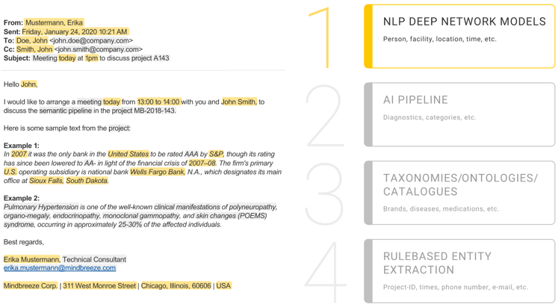
Mindbreeze Inspire
In German:
- https://de.wikipedia.org/wiki/Mindbreeze -
https://inspire.mindbreeze.com/
Mindbreeze InSpire:
understands the semantics of your content
recognizes entities automatically
gleans (collects) and leverages user behavior and user intent to understand you as a user and cater specifically to your needs.
customizable to individual user/department needs
450+ connectors to integrate with data sources
Daniel Fallmann
founded Mindbreeze in 2005
First products (Mindbreeze Enterprise Search, 2005) was searching in Microsoft Exchange Server and Microsoft Outlook, also in files and documents in the local file system and central file shares.
In 2006 started a partner program for developers (offered SDK) and added a web client.
In the years that followed, the focus was on usability, maximum scalability and understanding and analyzing content.
The connectors (for connecting data sources) developed by Mindbreeze itself have been continuously developed and expanded since 2005.
Additional products such as the Mindbreeze InSpire (formerly: Fabasoft Mindbreeze Appliance) and Fabasoft Mindbreeze Mobile were created.
Mindbreeze Enterprise Search was renamed as Fabasoft Mindbreeze Enterprise.

Slide 4

Yext Answers
.. https://www.yext.com/platform/answers
160+ videos:
.. https://www.youtube.com/c/yext –
.. https://en.wikipedia.org/wiki/Yext -
Yext:
a public software company traded on NYSE
1,200 employees
was founded in 2006 as a lead generation company, later switched to online brand management and AI search tools
founders: Howard Lerman, Brent Metz, Brian Distelburger
Headquarters in New York City
Users of Yext's search tool include the U.S. State Department and the World Health Organization, Verizon, Marriott, and Samsung.
In September 2021, the company launched an artificial intelligence tool for health care organizations. "Find-a-Doc" helps patients identify healthcare professionals by using NLP (NAtural Language Processing).

