Slide 1
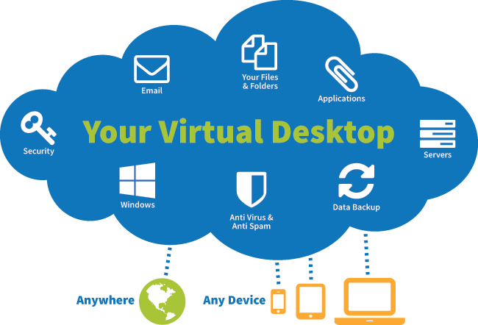
VDI – Virtual Desktop Infrastructure
VDI is a desktop virtualization technique to use VMs to provision and manage applications and virtual desktops.
VDI hosts the desktop environments—including the OSs, applications and desktops—on servers in a datacenter and deploys them to end-users on request.
https://www.parallels.com/blogs/ras/vdi-vs-vm/
Persistent VDI (a.k.a. stateful VDI) - end-users maintain their personalized settings, store data and even configure instances that they can retrieve each time they log in. So persistent VDIs act exactly as physical PCs.
Non-persistent VDI (a.k.a. stateless VDI) - where end users cannot retain their data and configurations because they get destroyed after each session.
Benefits of VDI:
simplifies administration – via central location. Deploy app in just one place
enhances security (everything stored centrally)
enhances productivity (can work from anywhere, easy to collaborate)
saves money (reduce hardware expenses)
highly scalable

