Slide 1
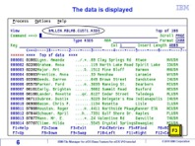

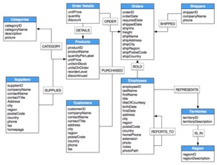

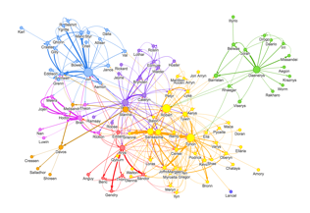

VSAM files => SQL DB => Graph DB
Indexed VSAM file is a file of records with primary key.
It is the basis of database tables.
Nowadays when people need indexed storage – they simply
use RDBMS (Relational Database Management System).
The SQL (Structured Query Language) was first developed in the 1970s
by IBM researchers Raymond Boyce and Donald Chamberlin.
- https://en.wikipedia.org/wiki/SQL
They first created programming language "SEQUEL", then renamed it into "SQL".
They used ideas in Edgar Frank Todd's paper
"A Relational Model of Data for Large Shared Data Banks" (1970).
First Commercial Databases:
1979 – IBM System/38
1979 - Oracle V2 for VAX computers.
1981 - IBM SQL/DS
1983 - IBM DB2
Over the years the relations between tables
have become more and more important.
Recent trend is to move from RDBMS to GraphDB,
where relationships become 1st class citizens.
There are now new query languages for Graph data (Graph languages).
Donald Chamberlin
Raymond Boyce
Edgar Frank Todd

Slide 2
VSAM = Virtual Storage Access Method
VSAM was introduced by IBM in 1970’s.
It is a collection of file storage/access methods used in OS/390,
MVS (Multiple Virtual Storage), and now in z/OS operating systems.
VSAM offers faster access than flat files because it uses an inverted index (B+tree)
based on embedded prime key field, that you define.
VSAM records can be of fixed or variable length.
IBM now promotes DB2, a relational database management system,
although VSAM linear datasets are still used to contain tablespaces
and index spaces within the system.
VSAM supports four data set organizations:
- Key Sequenced Data Set (KSDS)
- Relative Record Data Set (RRDS)
- Entry Sequenced Data Set (ESDS)
- Linear Data Set (LDS).
The KSDS, RRDS and ESDS organizations contain records,
while the LDS organization (added later to VSAM) simply contains a sequence of pages
with no intrinsic record structure, for use as a memory-mapped file.

