Slide 1
IT support - helpdesk & remote access
zendesk
https://www.helpscout.com/blog/zendesk-alternatives/
https://www.helixstorm.com/blog/best-remote-it-support-tools/
service now - open source - tickets + remote access
https://www.capterra.com/sem-compare/remote-support-software/
https://www.lifewire.com/free-remote-access-software-tools-2625161

Slide 2

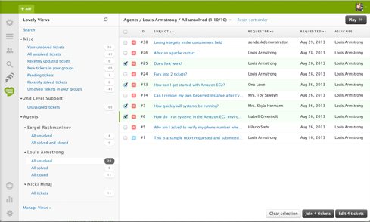
Zendesk
zendesk – customer support, sales SaaS
https://www.zendesk.com
https://en.wikipedia.org/wiki/Zendesk
https://www.helpscout.com/blog/zendesk-alternatives/
Zendesk’s base plan starts at $49/agent per month

Slide 3
Zendesk Alternatives
https://www.helpscout.com/blog/zendesk-alternatives/
Help Scout - https://www.helpscout.com
Zoho Desk - https://www.zoho.com/desk/
ServiceNow - https://www.servicenow.com
Freshdesk - https://www.freshworks.com/freshdesk/
Gorgias - https://www.gorgias.com – eCommerce helpdesk (shopify)
HubSpot Service Hub - https://www.hubspot.com/products/service – for HubSpot
Kustomer - https://www.kustomer.com - CRM
Front - https://front.com
HappyFox - https://www.happyfox.com

Slide 4
https://www.helixstorm.com/blog/best-remote-it-support-tools/
RemotePC
ZohoAssist
BeyondTrust
ConnectWise Control
Parallels RAS
Amazon WorkSpaces
GoToMyPC
Splashtop
VNC Connect
LogMeIn
TeamViewer
Dameware Remote Everywhere
https://www.capterra.com/sem-compare/remote-support-software/
https://www.lifewire.com/free-remote-access-software-tools-2625161

Slide 5
https://www.capterra.com/sem-compare/remote-support-software/
GoTo - https://www.goto.com/it-management/solutions/remote-support
FixMe.IT - https://www.techinline.com
Rescue - https://www.logmeinrescue.com
ManageEngine Remote Access - https://www.manageengine.com/remote-desktop-management/
ConnectWise Control
Pulseway
Zoho Assist
NinjaOne
dualmon
ISL Light

Slide 6
https://www.lifewire.com/free-remote-access-software-tools-2625161

