Slide 1
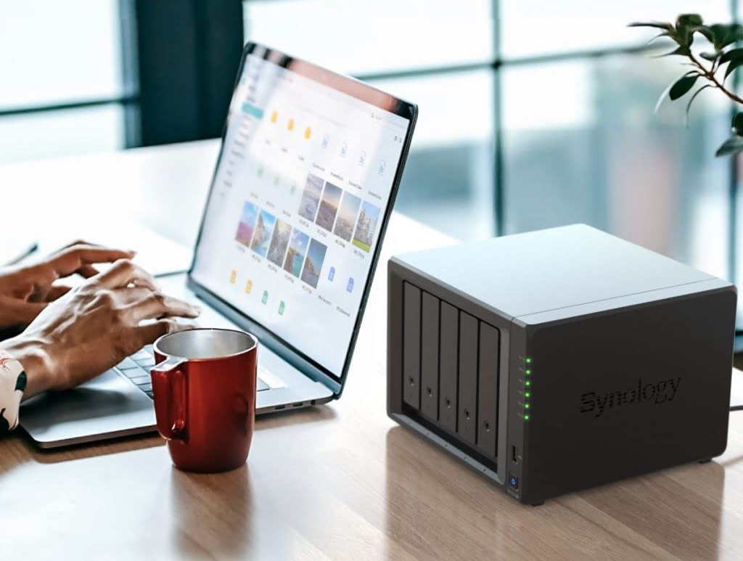
Network Attached Storage (NAS) at Home
https://www.zdnet.com/article/best-network-attached-storage/
https://www.pcmag.com/picks/the-best-nas-network-attached-storage-devices
Synology 5-bay DiskStation DS1522+

