Slide 1
Plane Engines

Slide 2
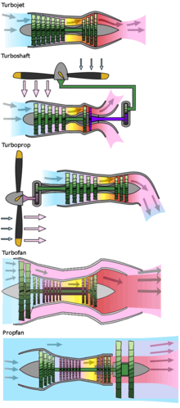
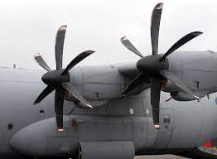
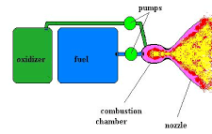
Turbojet
Turboshaft
Propeller Engine
Turboprop
Turbofan - most common type of jet engine
Rocket Engine
Propfan

Slide 3
Types of Plane Engines
https://en.wikipedia.org/wiki/Aircraft_engine
Jet engines: compressor, combustor, and turbine, but no fan; most efficient at high speeds, but not at low speeds
Turbojet engines: similar to jet engines, but also have a fan which is rotated from the turbine; fan accelerate the air before it enters the combustor. This makes turbojet engines more efficient at low speeds than jet engines. The bypass ratio is 1:1
Turbofans are the most common type of jet engine. They are similar to turbojet, but have much bigger fan. The bypass ratio is 5:1. Which make them very efficient at low speeds
Fan or fanjet engines are a type of turbofan engine with a very large fan. The fan is so large that it is not enclosed in a cowl, like a traditional turbofan engine. This makes fanjet engines more efficient at low speeds than turbofans, but they are not as efficient at high speeds
Propfans are a type of jet engine that uses a propeller instead of a fan. The propeller is powered by the turbine and it helps to accelerate the air before it is exhausted from the back of the engine. Propfans are more efficient at low speeds than turbofans, but they are not as efficient at high speeds

Slide 4
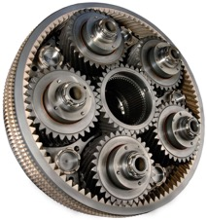
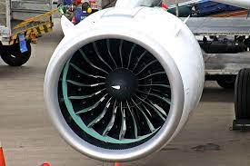
Geared Turbofan
A geared turbofan is a type of turbofan engine that uses a gearbox to slow down the fan – this reduces noise and vibration, allows to use larger fan to increase thrust. The slower fan speed also improves fuel efficiency.
The first commercial geared turbofan was the Pratt & Whitney PW1000G (2016, on Airbus A220).

Slide 5
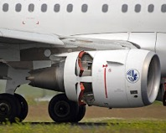
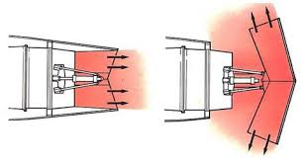
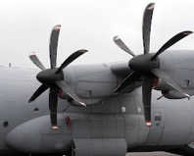
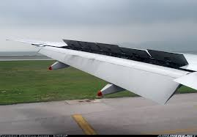

Slowing Down After Landing
Planes use a combination of braking, reverse thrust, and spoilers to slow down after landing
Braking is the primary way
Reverse thrust in propeller-driven aircrafts is accomplished using a feathering system – rotating the propeller blades to reverse the direction of airflow
Reverse thrust in jet aircraft is accomplished by so called "thrust reversers" - a set of doors in the engine nacelles that re-direct the exhaust gases
Spoilers are panels that are extended from the wings and fuselage of an aircraft to create drag

