Slide 1
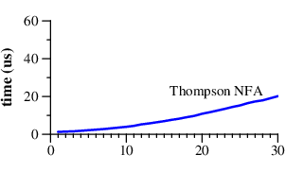
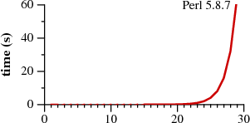
Regular Expressions:
"Regular Expression Matching Can Be Simple And Fast
(but is slow in Java, Perl, PHP, Python, Ruby, ...)"
by Russ Cox (2007) - https://swtch.com/~rsc/regexp/regexp1.html
also
- https://swtch.com/~rsc/regexp/regexp2.html
- https://swtch.com/~rsc/regexp/regexp3.html
- https://swtch.com/~rsc/regexp/regexp4.html
Two classes of RegEx engines:
not using backtracking (Thompson NFA, awk, grep, Google re2) NFA (NFDA) = Non-Deterministic Finite Automata
those using backtracking PCRE = Perl Compatible Regular Expressions
Notice (on the graphs) that Perl requires over 60 seconds to match a 29-character string.
Thompson NFA algorithm requires only 20 microseconds to match the same string.
That's not a typo. It is million times faster.
And the trend continues!
For a 100-character string:
Thompson NFA - under 200 microseconds
Perl would require over 10¹⁵ years
Python, PHP, Ruby algorithms are similar to Perl.
micro-seconds
seconds
Graphs of the time to match a?^{n}a^{n} against a^{n}

Slide 2
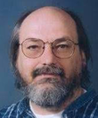
Thompson NFA
Ken Thompson (the creator of Unix OS) has created his regular expression algorithm in 1968:
"Regular expression search algorithm" http://doi.acm.org/10.1145/363347.363387
The machine uses multi-state approach moving forward over all possible paths in parallel.
This results in (at worst) a constant amount of work growing in linear time with the length.
This is a dramatic improvement over the exponential time required by the backtracking approach.
In an NFA with n nodes, there can only be n reachable states at any step, but there might be 2^{n} paths!
"... each character in the text to be searched is examined in sequence against a list of all possible current characters. During this examination a new list of all possible next characters is built. When the end of the current list is reached, the new list becomes the current list, the next character is obtained, and the process continues."

Slide 3
Regular Expressions - continued
RE2
re2 was implemented and is used by Google
re2 does not use backtracking, uses finite-state machine .. https://en.wikipedia.org/wiki/RE2_(software) .. https://github.com/google/re2
There are may be problems using re2 on a Mac: .. https://pypi.org/project/re2/ .. https://github.com/conda-forge/re2-feedstock .. https://pypi.org/project/google-re2/
PCRE = Perl Compatible Regular Expressions
uses backtracking
has more features .. https://en.wikipedia.org/wiki/Perl_Compatible_Regular_Expressions
Alternative: regex module
.. https://pypi.org/project/regex/

