Slide 1
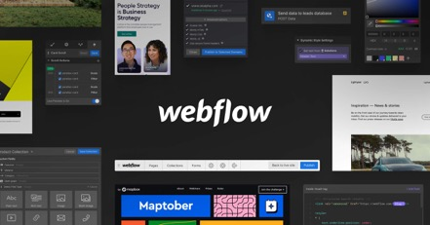
Website Builders
Website builders are tools for building websites without manual coding
https://en.wikipedia.org/wiki/Website_builder
Tow types: online & offline tools
Forbes top 10 website builders for 2023:
https://www.forbes.com/advisor/business/software/best-website-builders/
Weebly $6/mo
GoDaddy $10/mo
1&1 IONOS $1-$5/mo
Squarespace $16/mo
HostGator $3-$7/mo
Wix $11/mo
Shopify $29/mo
Zyro $3/mo
WordPress.org Free
Duda $14/mo
The Best 10 Website Builder of 2023: (researched and tested more than 50)
https://www.websitebuilderexpert.com/website-builders/
Wix – Best overall website builder
Squarespace – Best value for money
Shopify – Best for scaling your online store
GoDaddy – Fastest way to build a website
Hostinger – Best for uptime reliability
Weebly – Good free plan
WordPress.com – Best for experienced builders
IONOS – Best pricing deals from $1
Site123 – Best for hobby websites
Jimdo – Very cheap pricing plans
Webflow - San Francisco based SaaS online website builder and hosting - https://webflow.com

