Slide 1
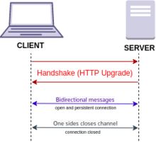
Websockets
WebSocket is a computer communications protocol, providing full-duplex communication channels over a single TCP connection – developed in 2008-2011
.. https://en.wikipedia.org/wiki/WebSocket
.. https://websockets.readthedocs.io/en/stable/howto/nginx.html
Nginx Configuration for Websocket Applications
https://maximorlov.com/tips/nginx-configuration-for-websocket-applications/
location / {
# websocket app listening on port 3000
proxy_pass http://127.0.0.1:3000;
proxy_http_version 1.1;
# forward
proxy_set_header Upgrade $http_upgrade;
proxy_set_header Connection $http_connection;
proxy_set_header Host $host;
}
# python on server
from websocket_server import WebsocketServer
PORT = 9001
def new_client(...): ...
def client_left(...): ...
def message_received(...): ...
server = WebsocketServer(port = PORT, host='0.0.0.0', loglevel=logging.DEBUG)
server.set_fn_new_client(new_client)
server.set_fn_client_left(client_left)
server.set_fn_message_received(message_received)
server.run_forever(threaded=False)
// Javascript on client side
ws = new WebSocket("ws://localhost:9001/");
ws.onopen = function() {
// do something
ws.send(JSON.stringify({Request:"GetClients"}));};
ws.onmessage = function(e) { ... };
ws.onclose = function(e) { ... };
ws.onerror = function(e) { ... };

