Slide 1


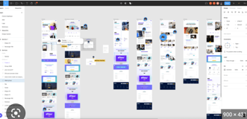
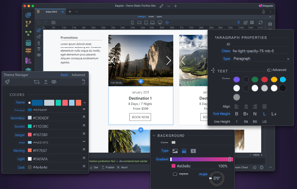
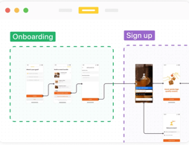

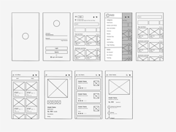
Website Wireframes
The 6 best wireframe tools in 2022 - https://zapier.com/blog/best-wireframe-tools/
Sketch for detailed, vector-based design
Adobe XD for beginners (mobile app)
Figma for a free wireframe app
UXPin for handing off design documentation to developers
MockFlow for project organization
Justinmind for interactive wireframes
https://en.wikipedia.org/wiki/Website_wireframe
A website wireframe (a.k.a. page schematic or screen blueprint) is a visual guide that represents the skeletal framework of a website.
The term wireframe is taken from other fields that use a skeletal framework to represent 3-dimensional shape and volume.
Wireframes can be pencil drawings or sketches on a whiteboard, or they can be produced by means of a broad array of free or commercial software applications.
Wireframes are generally created by business analysts, user experience designers, developers, visual designers, and by those with expertise in interaction design, information architecture and user research.
Adobe Xd
Figma: https://www.figma.com
Wappler: https://wappler.io
Zeplin: https://zeplin.io
Studio for Windows: https://www.invisionapp.com/studio
Sketch: https://www.sketch.com

