Slide 1
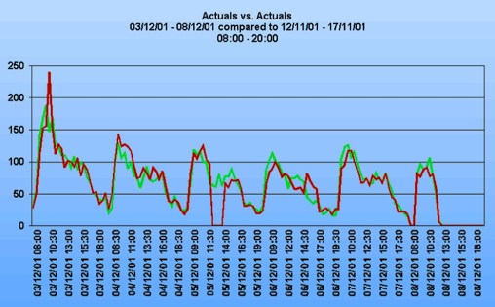
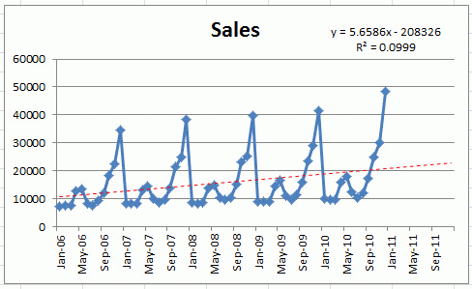
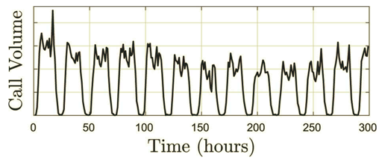
Call volume predictions
Forecasting calls volume is a common problem:
- Customer service call volume by day (or part of day)
- EMS (Emergency Medical Services) calls
- Sales calls volume
- Virtual Machine Usage in the cloud
- predictions in investments & insurance
- etc.
Balance between service quality (short waiting times, few
abandonments) and service efficiency (utilization of agents).
variations and trends in call volume depend on various parameters - like time of day, day of week, seasonal, trends (within year and growth between years), special events (holidays, promotions, legal changes, sport events, etc.). Number of calls can vary dramatically between days (x5 times or more)
Variations within one month
Seasonal variations repeating year after year

Slide 2
"""If you've ever stepped into a call center the morning after an unannounced marketing campaign, you likely came to the painful realization that the marketing folks need to be tightly integrated into this process.
So, too, the people in legal who change terms and conditions; the people in IT who make system changes; and anybody else who impacts the call center's work load.
A cross-functional meeting (minimum once per week) is essential.
The motto of this team: No surprises! """
from "Improving Your Call Center's Workload Forecast" (2003)
- https://www.eetimes.com/document.asp?doc_id=1196835

Slide 3
Call volume predictions
variations in call volume depending on:
- time of day
- day of week
- special outliers (holiday, elections, sport, competitive actions, strikes, promotions, etc.)
- seasonality - cyclical patterns that repeat any two or three years or more.
- trends in the data (within year, between years).
- growth rates of these trends.
How number of calls is measured? Corrections on dropped calls
oscillations (auto-regression)
ARMA models (Auto Regressive Moving Average)
Time-series approach:
- apply corrections for trends, outliers, variations (listed above)
- calculate regression (logistic better than linear)
- revert corrections, apply known events (promotions, ...)
which may have effect going forward
Data: raw observations, hourly totals, 3-point moving average smoothing, trends
Types of calls: sales, customer service, troubleshooting, etc.
Columns for multivariate forecasting:
- date
- hour (or part of day: overnight, early morning, prime time, etc.)
- Holiday (yes / no)
- Day of the week
- Season (Fall, Winter, Spring, Summer)
- Month
- Calendar Week (instead of Season?)
- billing cycle (or/and day within cycle)?
- new services/promotions introduced recently (several columns)
- legal term changes (confuse people)
- website changes (confuse people)
=======
- Number of calls category 1, category 2, etc.
- Number of emails, website traffic, calls for automatic service
(IVR = Interactive Voice Response), other platforms
- Numbers from previous years (increase over years for this particular day, week, season, etc.)
- Number of new clients signed in previous 1-2 weeks
- DJIA (Dow Jones Industrial Average, S&P 500, VIX, etc.)
- unemployment rate, rate on personal loans
- volume of news, tweets, google searches, Wikipedia views
- volume of calls in other companies or gov. organizations
- demographics (number of people entering certain age groups in certain income categories)
- Investor Sentiment analysis
- tax events, cash-flow budget(s)
- competitive pricing, events, merges, etc.
- expert opinion column (manual adjustment)

Slide 4
Forecasting methods
1. qualitative
2. time series analysis (linear regression (Ridge, LASSO, ElasticNet), ARMA, ARMA)
trends, auto-correlations, ivariate cross-correlation, etc.
multivariate time series analysis
seasonality in the model using Fourier decomposition over 4+ years
3. causal (cause-effect) - modeling specific causes/events that can influence call volume (promotion, legal change, website redesign, sport event, new law, election, etc.), for example, a promotion usually causes predictable call volume increase over some time. We can learn the shape of this increase from historic data - and apply adjusted versions going forward
4. simulation (Monte-Carlo, etc.)
5. Machine Learning - LSTM (also multivariate LSTM), Random Forest, etc.
===================================================
- See also multivariate forecasting in investment, insurance, etc.
Misc notes:
using a method like MAPE (Mean Absolute Percentage Error) based on intervals) rather than comparing total calls for the whole day. This article gives some guidance - https://www.callcentrehelper.com/calculate-forecast-accuracy-113808.htm
Arithmetic means of each hour of the number of calls received, say in week with three-point moving average smoothing will yielded the most accurate forecasts. At this point, Autoregressive Integrated Moving Averages (ARIMA) model (check if the forecast errors are normally distributed), autocorrelation function (ACF) with residual and time series (ts) plots for the series ...
Build several models or methods, such as the random walk, the exponential smoothing, ARIMA, or regression, depending on the data you have. Select the best model (which generate the lowest RSMFE, for example). Important is to build a benchmark model. Usually, it is the random walk model. If all models do not outperform the random walk, then there is no point to use other models.

Slide 5
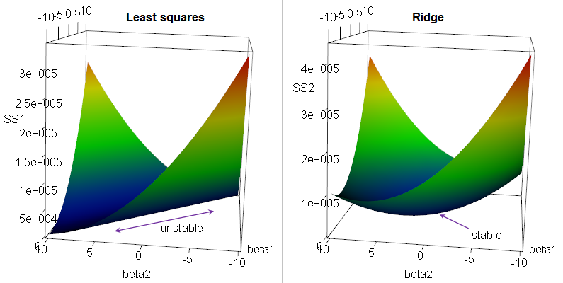

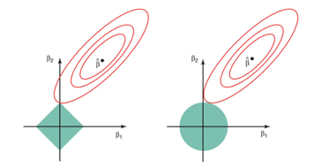
Regression: Ridge, LASSO, Elastic Net
Multivariate (multiple) Linear Regression Regularization.
Suppose we have a OLS (Ordinary Linear Squared) regression where two parameters x1 & x2
are not orthogonal, but in fact highly correlated.
Then there may be is infinite number of coefficients which will fit the model.
For example, (x1 - x2), (10*x1 - 10*x2), (100*x1 - 100*x2), etc.
If we are trying to minimize the cost function in the multidimensional
space of coefficients, we will get an infinite diagonal groove (ridge) for x1=x2.
Any place at the bottom of this ridge is equally good for us.
So we will get a big variability in possible values of coefficients for x1 & x2.
The solution will be unstable.
We can reduce this variability by adding additional regularization factor like this:
Why Ridge Regression is called Ridge ...
When we minimizing this expression, bigger "lambda" value will cause smaller "beta" values, thus keeping the coefficients "beta" from becoming too large.
This is called "Ridge Regression". It changes the infinitely long ridge into a local minimum.
In Ridge Regression we add a "regularization" term as sum of squares (L2 norm).
If instead we use L1 norm (sum of abs values) - it is called "LASSO Regression",
where LASSO = Least Absolute Shrinkage and Selection Operator.
LASSO favors solutions on the tips of the bounding surface for coefficients, where some of coefficients are zero. Thus it favors "sparse" solutions.
A combination of Ridge Regression and LASSO Regression is called "Elastic Net"
Why LASSO favors sparse solutions

Slide 6
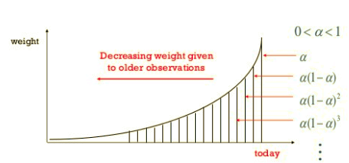
Time Series Analysis Tehniques
Exponential Smoothing - smoothing using exponential window.
It is a weighted moving average, where weights decline exponentially for older events
s(t+1) = a*x(t) + (1-a)*s(t)
Holt-Winters = Triple Exponential Smoothing
1st smoothing (level) -exponential smoothing for value
2nd smoothing (trend) - exponential smoothing for slope
3rd smoothing - exponential smoothing comparing to previous cycle
ARMA (Auto-Regressive Moving Average) - tries to describe a process as a sum of two processes - signal (AR) and noise (MA) - and then extrapolate signal into the future.
- https://people.duke.edu/~rnau/411arim.htm
ARMA(t) = AR(t) + MA(t), where AR is a weighted sum of "P" previous values,
and MA is weighted average of "Q" previous (white noise) errors:
AR : Y(t) = a0 + a1*Y(t-1) + ... + aP*Y(t-P) +
Z(t) -b1*Z(t-1) - ... -bQ*Z(t-Q)
ARIMA(p,d,q) (Auto-Regressive Integrated Moving Average)
p - number of autoregressive terms,
d - number of nonseasonal differences needed for stationarity
q - number of lagged forecast errors
ARIMA(1,0,0) - 1st order autoregressive model
ARIMA(2,0,0)) - oscillations
ARIMA(0,1,0) - random walk
ARIMA(1,1,0) - differenced first-order autoregressive model
ARIMA(0,1,1) - simple exponential smoothing:
ARIMA(0,1,1) - simple exponential smoothing with growth
ARIMA(0,2,1) - linear exponential smoothing
ARIMA(0,2,2) - linear exponential smoothing

Slide 7
Some Links
Workload Forecasting For A Call Center: Methodology And A Case Study (2009)
- https://arxiv.org/pdf/1009.5741.pdf
How to Choose the Right Forecasting Technique (1971)
- https://hbr.org/1971/07/how-to-choose-the-right-forecasting-technique
Example of an Excel youtube demo of forecasting,
- https://www.youtube.com/watch?v=IKwl6CEwQxQ
How to Calculate Forecast Accuracy (2017)
- https://www.callcentrehelper.com/calculate-forecast-accuracy-113808.htm
Daily volume of cases in emergency call centers: construction and validation of a predictive model (2017)
- https://www.ncbi.nlm.nih.gov/pmc/articles/PMC5576313/
Neural networks for algorithmic trading. Multivariate time series
- https://medium.com/machine-learning-world/neural-networks-for-algorithmic-trading-2-1-multivariate-time-series-ab016ce70f57
Energy Demand Time Series Forecasting
- https://github.com/Azure/MachineLearningSamples-EnergyDemandTimeSeriesForecasting

Slide 8
Code examples
Prophet: Automatic Forecasting Procedure
- https://github.com/facebook/prophet
forecasting time series data based on an additive model where non-linear trends are fit with yearly, weekly, and daily seasonality, plus holiday effects. It works best with time series that have strong seasonal effects and several seasons of historical data. Prophet is robust to missing data and shifts in the trend, and typically handles outliers well.
========================================
Multivariate Time Series Forecasting with LSTMs in Keras
- https://machinelearningmastery.com/multivariate-time-series-forecasting-lstms-keras/
Time Series Prediction With Deep Learning in Keras
- https://machinelearningmastery.com/time-series-prediction-with-deep-learning-in-python-with-keras/
========================================

