Slide 2


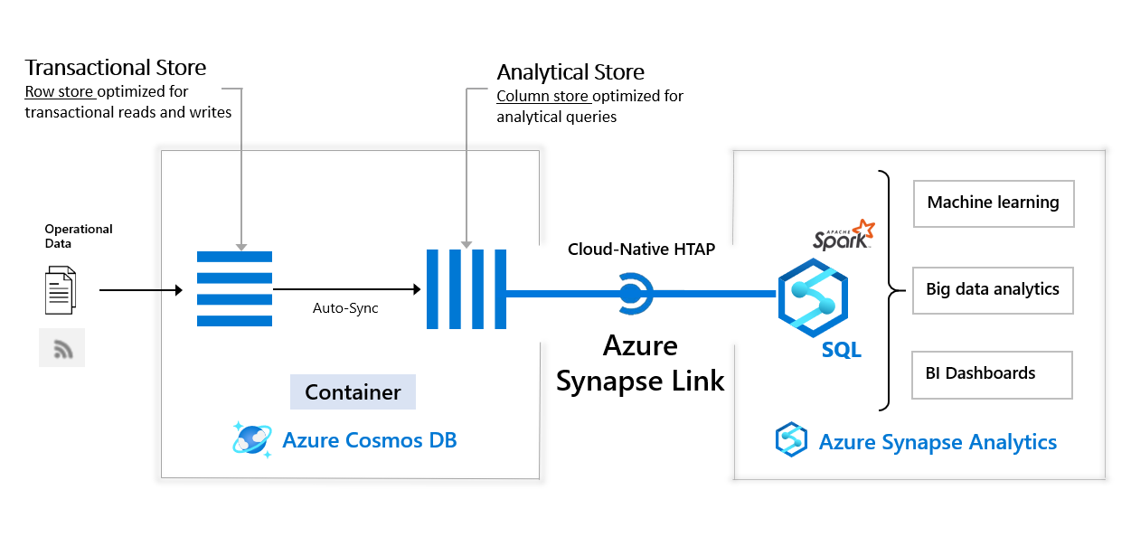
Cosmos DB – Synapse Integration
Azure Cosmos DB:
fast NoSQL multi-model database (key-value, documents, graphs and columnar)
low order-of-millisecond response times
global scaling
- https://docs.microsoft.com/en-us/azure/cosmos-db/analytical-store-introduction
- https://docs.microsoft.com/en-us/azure/cosmos-db/use-cases
- https://docs.microsoft.com/en-us/azure/cosmos-db/synapse-link

