Slide 1
Optimization
In Machine Learning and AI

Slide 2
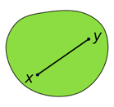
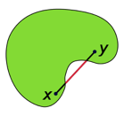
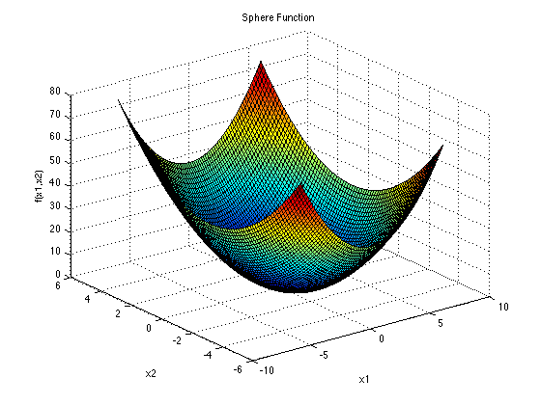
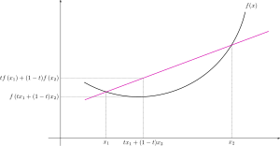
Convex Optimization
Convex Set
Non-Convex Set
Convex optimization studies the problem of minimizing convex functions over convex sets.
- https://en.wikipedia.org/wiki/Convex_optimization
Stephen Boyd (Stanford):
- https://www.youtube.com/watch?v=U41e7hKAAPQ
Convex Set S: For any x,y in S : θx + (1-θ)y ∈ S
Convex Function F: F( θx + (1-θ)y ) <= θF(x) + (1-θ)F(y)
The empty set and the whole space are convex.
The intersection of any collection of convex sets is convex.
The union of a sequence of convex sets is convex, if they form a non-decreasing chain for inclusion
The union of two convex sets need not be convex
The sum of two convex functions is convex
If f(x) is convex, then exp(f(x)) is convex
Convex Function
Convex Function

Slide 3
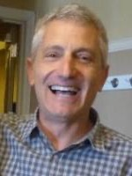
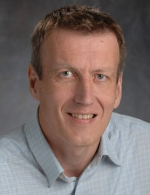
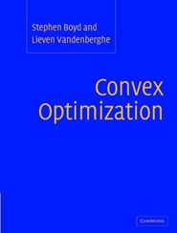
Formulation
Lagrangian
Multi-dimensial, Hessian
Stephen Boyd
Stanford University, CA
Lieven Vandenberghe UCLA, Los Angeles, CA
It is possible to find optimal solutions in microseconds !
Real-time convex optimization - Stephen Boyd, Stanford University
- https://www.youtube.com/watch?v=uhGMnT12zOg
Working Definition of NP Hard
- https://www.youtube.com/watch?v=7hRLOnTn7o4
Stephen Boyd's tricks for analyzing convexity
- https://www.youtube.com/watch?v=ijD2KSXWDyo

Slide 4
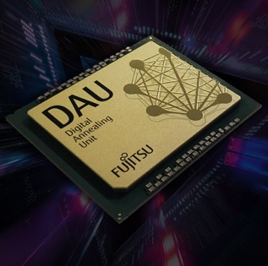
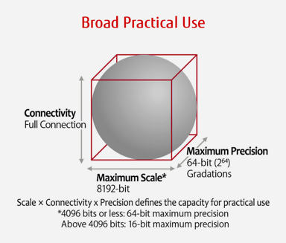
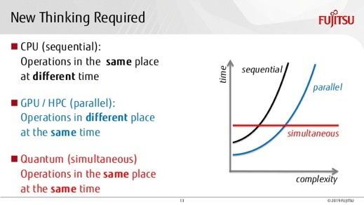
Fujitsu Digital Annealer
A specialized chip to solve massive combinatorial optimization problems.
Parallel, real-time optimization calculations.
Faster than GPUs.
https://www.fujitsu.com/us/services/business-services/digital-annealer/what-is-digital-annealer/
Fujitsu developed a “digital annealing unit” (DAU), a custom CMOS chip (similar to FPGA) with an architecture designed for efficient solving large-scale optimization problems.
It uses a version of classical simulated annealing method.
But for marketing purposes they say that it is “quantum-inspired”,
because “quantum annealing” is a variant of "simulated annealing".
But of course DAU is not "quantum".
Execution
time

