Slide 1
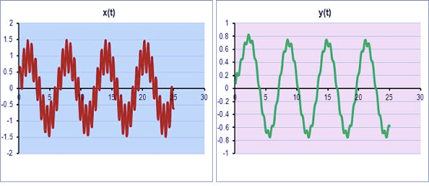
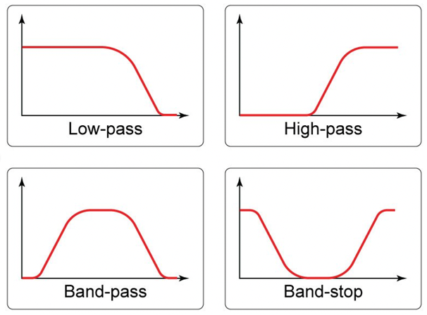
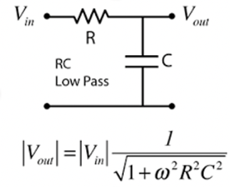

Time Series Filtering
Low-Pass Filtering
Filtering in Analog Electronics
(Amplitude vs Frequency)

Slide 2
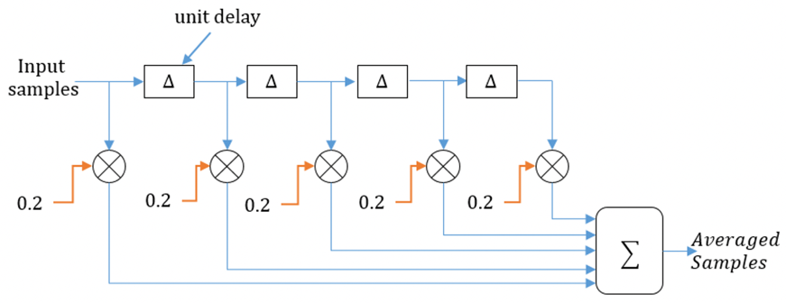
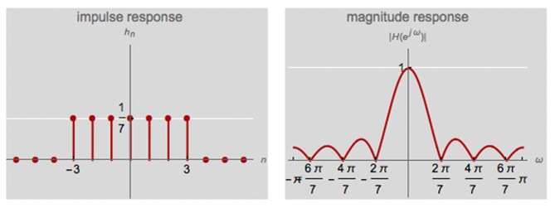
Moving Average Filter (low-pass)

Slide 3
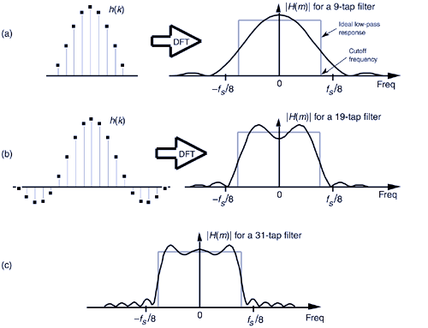
Low-Pass Filter – weghted averaging
"Hat"
Shape
Frequency
Response

Slide 4
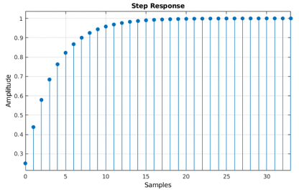
Low-Pass Filter – Exponential Smoothing
Exponential Moving Average
f_{t} = kX_{t} + (1-k)f_{t-1}
Step Response

Slide 5
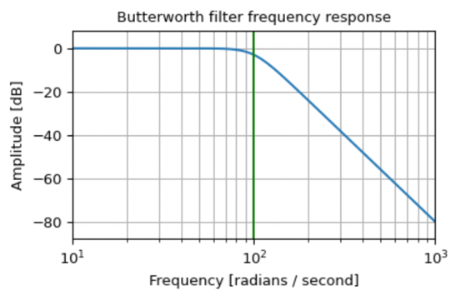
Digital Filtering in Python
scipy.signal
https://docs.scipy.org/doc/scipy/reference/signal.html
scipy.signal.butter()
Butterworth digital and analog filter design
https://docs.scipy.org/doc/scipy/reference/generated/scipy.signal.butter.html
from scipy import signal
import matplotlib.pyplot as plt
b, a = signal.butter(4, 100, 'low', analog=True)
w, h = signal.freqs(b, a)
plt.semilogx(w, 20 * np.log10(abs(h)))
plt.title('Butterworth filter frequency response')
plt.xlabel('Frequency [radians / second]')
plt.ylabel('Amplitude [dB]')
plt.margins(0, 0.1)
plt.grid(which='both', axis='both')
plt.axvline(100, color='green') # cutoff frequency
plt.show()

