Slide 1
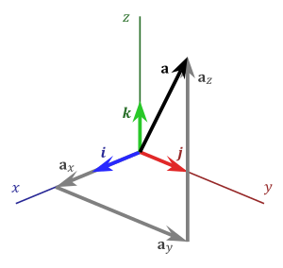
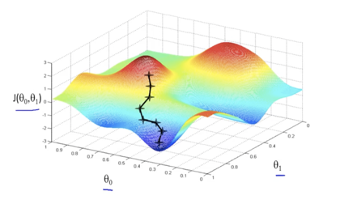


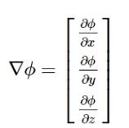
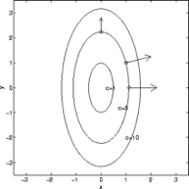
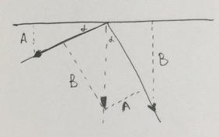
Gradient Descent
Unit Vectors
i = (1,0,0)
j = (0,1,0)
k = (0,0,1)
Gradient Operator
Gradient Vector
Partial derivatives along three unit vectors
Gradient vector is perpendicular to level curves
Understand gradient vector

