Slide 1





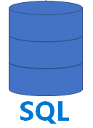





Cosmos DB
Link for Cosmos DB
Azure Synapse Analytics
Operational Data
Cosmos DB
Link for Cosmos DB
Auto-Sync
SQL Query
Power BI
Transactional Store,
massive inserts,
key-value (JSON doc)
Analytical Columnar Store
Configuring Synapse Link for Cosmos DB means enabling Analytical Store in Cosmos DB and enabling automatic sync of data into it. So you can use SQL to query data from Analytical Store without slowing down the Transactional Store.
ML Studio
Azure Data Lake Storage (Files)
Azure Cosmos DB:
fast NoSQL multi-model database (key-value, documents, graphs and columnar)
low order-of-millisecond response times
global scaling
- https://docs.microsoft.com/en-us/azure/cosmos-db/analytical-store-introduction
- https://docs.microsoft.com/en-us/azure/cosmos-db/use-cases
- https://docs.microsoft.com/en-us/azure/cosmos-db/synapse-link

Slide 2
Link for Cosmos DB – how it works
Question:
How Link manages to do real-time replication?
It is interesting because inserts into analytical DBs are usually very slow.
Answer: (from a Microsoft architect):
In a nutshell this is achieved using the combination of micro-batch jobs and mass parallel ingestion. As you know, Synapse doesn't perform well under transactional load due to variety of factors, but using Polybase removes these limitations.
Think about repointing Polybase to some other source (other than ADLS for example). Some ideas around the actual implementation you can figure out using the Polaris public paper (2020, 50 authors, 13 pages) :
- http://www.vldb.org/pvldb/vol13/p3204-saborit.pdf
Here is the video walking through this Polaris paper explaining how the Azure Synapse serveless SQL engine works:
- https://www.youtube.com/watch?v=IqjVZexHCcE

Slide 3
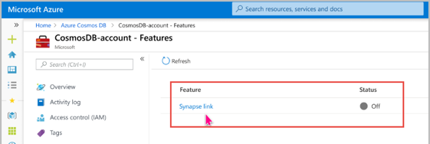
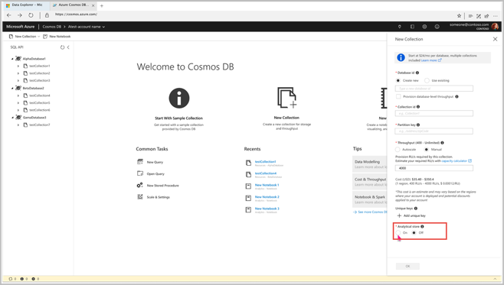
Link for Cosmos DB – how it works
Here is a video showing how to configure Link in Azure interface:
- https://www.youtube.com/watch?v=UcYMgKpbdPk
Configuring the "Link" is is simply enabling "Analytical Store" inside Cosmos DB, thus enabling replication from transactional to analytical parts of Cosmos DB.
Then you can simply query the Analytical part using SQL from Synapse.
Official docs:
- https://docs.microsoft.com/en-us/azure/cosmos-db/analytical-store-introduction
- https://docs.microsoft.com/en-us/azure/cosmos-db/synapse-link
- https://docs.microsoft.com/en-us/azure/cosmos-db/configure-synapse-link
Analytical Store

Slide 4

.NET Framework
Note – Synapse servers run Linux OS and .NET
.NET = FCL + CLR
FCL = Framework Class Library
CLR = Common Language Runtime (virtual machine)
VS GUI = Visual Studio
VS Code = light open source editor for all platforms
- https://code.visualstudio.com/
2002 - .NET began as proprietary software
2016-2018 – open-sourced most of it
- https://github.com/dotnet
it runs on Windows, Linux, and Mac:
- https://dotnet.microsoft.com/download
-rw-r--r-- 1 myuser staff 258B Jul 14 18:10 Program.cs
drwxr-xr-x 3 myuser staff 96B Jul 14 18:09 bin/
-rw-r--r-- 1 myuser staff 171B Jul 14 18:03 myApp.csproj
drwxr-xr-x 8 myuser staff 256B Jul 14 18:09 obj/
// Program.cs
// C# programming in .NET
// to run it use command: dotnet run
using System;
namespace myApp
{
class Program
{
static void Main(string[] args)
{
Console.WriteLine("Hello World!");
Console.WriteLine("The current time is " + DateTime.Now);
}
}
}

Slide 5
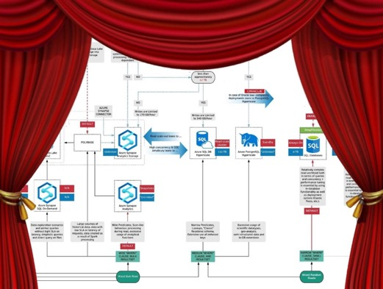


Link for Cosmos DB – Continued
Very interesting article about Cosmos DB
and different architectures. - https://www.linkedin.com/pulse/how-select-proper-data-backend-technology-azure-andrei-zaichikov/
Good people to connect:
Andrei Zaichikov (Luxembourg, Europe) - https://www.linkedin.com/in/zaychikov/
Aleksey Savateyev - https://www.linkedin.com/in/aleksey-s-7b0918/ - https://www.youtube.com/watch?v=8RiHSDf7xBs - https://azure.microsoft.com/en-us/blog/gain-insight-into-your-azure-cosmos-db-data-with-qlik-view-and-qlik-sense/
Kirill Gavrylyuk - director of Cosmos DB development:
- https://www.linkedin.com/in/kirillgavrylyuk/ - https://www.youtube.com/watch?v=27SN1eyVn5k - https://www.youtube.com/watch?v=2gydxodDS_I - https://www.youtube.com/watch?v=rIjH24x19pQ

Slide 6
Cosmos DB & Multiple Regions
Transactions
replicated
Analytical store(s) can be set up in one or more regions
Link (Sync)
Region1
Region1
Region2
See also:
Change feed in Azure Cosmos DB
https://docs.microsoft.com/en-us/azure/cosmos-db/change-feed
Region3

