Slide 1
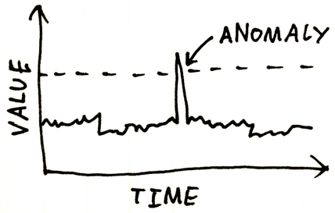
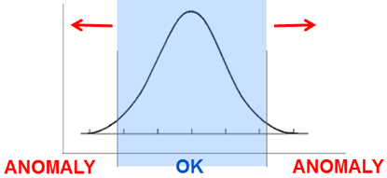
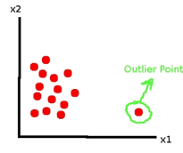
Anomaly Detection, Fraud Detection
Anomalies a.k.a. outliers, novelties, noise, deviations, exceptions.
Examples: fraud, a structural defect, medical problems or errors in a text.
Anomaly detection techniques:
1. Unsupervised 2. Supervised
3. Semi-supervised
Anomalies may be not rare, for example, bursts of intrusion activity.
Unsupervised methods may fail in these cases.
Examples of methods:
- clustering (SVM, etc.)
- represent state as image, use ConvoNet to detect anomaly "visually"

Slide 2
Outlier Detection methods:
Density-based techniques (k-nearest neighbor, local outlier factor, isolation forests, etc.).
Subspace- and correlation-based outlier detection for high-dimensional data.
One-class support vector machines.
Replicator neural networks.
Bayesian Networks.
Hidden Markov models (HMMs).
Cluster analysis-based outlier detection.
Deviations from association rules and frequent itemsets.
Fuzzy logic-based outlier detection.
Ensemble techniques, using feature bagging, score normalization, and different sources of diversity.
Benford's law - https://en.wikipedia.org/wiki/Benford%27s_law - first-digit law, is an observation about the frequency distribution of leading digits in many real-life sets of numerical data.
Application to data security:
intrusion detection systems using threshold statistics
based on profiles of users, workstations, networks,
remote hosts, groups of users, and programs based
on frequencies, means, variances & covariances.
The counterpart of anomaly detection in intrusion detection is misuse detection.

Slide 3
How to select features to train anomaly-detection model.
- remove features with a lot of missing data (we don't want to impute missing data)
- remove features which have no variance (no relation to events)
- look at collinearity of features
# find which columns' values change their distribution the most
# when we change from rows with Class=0 to Class==1.
# To compare two distributions we will use Kolmogorov-Smirnov test.
# - https://en.wikipedia.org/wiki/Kolmogorov%E2%80%93Smirnov_test
# Note - this is just one of many tests, for example, read this discussion:
# - https://stats.stackexchange.com/questions/1001/is-spearmans-correlation
#
# function ks_2samp(array1, array2)
# compares distributions of values in two arrays and returns p_value
# p_value > 0.4 - distributions are very similar (identical)
# p_value very small - distributions differ
Practical Machine Learning: New Look at Anomaly Detection - by Ted Dunning and Ellen Friedman (2014)
- https://mapr.com/practical-machine-learning-new-look-anomaly-detection/assets/practical-machine-learning-new-look-anomaly-detection.pdf
How to: Execute Anomaly Detection at Scale (Dataiku.com. 2020)
- https://pages.dataiku.com/hubfs/Guidebooks/Anomaly%20Detection/anomaly-detection-guidebook.pdf
How to prepare/construct features for anomaly detection (network security data)
- https://stats.stackexchange.com/questions/141017/how-to-prepare-construct-features-for-anomaly-detection-network-security-data
Kaggle Credit Card Fraud Data Set - https://www.kaggle.com/mlg-ulb/creditcardfraud -
Features for Credit Card Fraud Detection - https://towardsdatascience.com/how-to-create-good-features-in-fraud-detection-de6562f249ef
Feature Engineering for Fraud Detection - https://github.com/dachosen1/Feature-Engineering-for-Fraud-Detection
A Feature Extraction Method for Credit Card Fraud Detection - https://ieeexplore.ieee.org/document/8782457
etc.

Slide 4
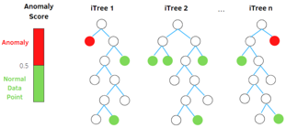
Isolation Forest (IF) & RRCF for Anomaly Detection
(RRCF = AWS Robust Random Cut Forest)
https://en.wikipedia.org/wiki/Isolation_forest -
https://stackoverflow.com/questions/63115867/isolation-forest-vs-robust-random-cut-forest-in-outlier-detection – Isolation Forest:
https://cs.nju.edu.cn/zhouzh/zhouzh.files/publication/icdm08b.pdf – paper
https://towardsdatascience.com/outlier-detection-with-isolation-forest-3d190448d45e – tutorial RCF:
http://proceedings.mlr.press/v48/guha16.pdf – paper
https://freecontent.manning.com/the-randomcutforest-algorithm/ - tutorial
Both algorithms are ensemble methods based on decision trees.
Both aim to isolate every single point.
Ouliers tend to require less steps to get isolated.
Isolation Forest (IF) is open source (sklearn), whereas AWS RRCF is closed source (although look at https://github.com/kLabUM/rrcf )
RRCF can work on streams (in streaming analytics service Kinesis Data Analytics) – it has partial_fit() method.
RRCF is more scalable, can be parallelized between multiple machines. It also supports Pipe mode (streaming data via unix pipes) which makes it able to learn on much bigger data than what fits on disk
RRCF performs better in high-dimensional space because it gives more weight to dimension with higher variance (according to SageMaker doc), while Isolation Forest samples at random
Anomaly score is calculated differently. IF's score is based on distance from the root node. RRCF is based on how much a new point changes the tree structure (i.e., shift in the tree size by including the new point). This makes RRCF less sensitive to the sample size

