Slide 1
Attention
Transformers
BERT

Slide 2
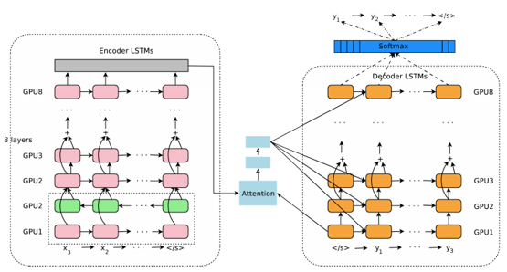

Google Translate
Google
GNMT (2016, Google Neural Machine Translation).
"Google’s Neural Machine Translation System: Bridging the Gap between Human and Machine Translation" (2016)
https://arxiv.org/pdf/1609.08144v2.pdf - 31 authors
Main ideas:
deep LSTM network, 8 encoder and 8 decoder layers
parallelism - decreasing training time
using Attention and residual connections
attention mechanism - connects the bottom layer of the decoder to the top layer of the encoder
low-precision arithmetic for inference computations
Quoc Le qvl@google.com
Past: PhD Student – under Andrew Ng, Stanford
http://cs.stanford.edu/~quocle/

Slide 3
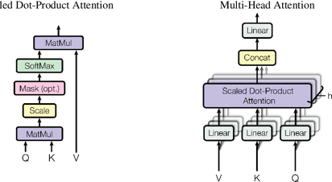
From Word2Vec to Attention
Word2Vec (2013)
Tomas Mikolov published word2vec in 2013.
Typically word2vec maps each word to a vector of ~100 numbers.
This mapping is found iteratively (starting with random vectors). The process approximates a word from the words before and after it in text. Similar words would have similar "neighbours".
Once vectors are found, they represent the meaning of words. SO you can do vector operations with them, for example: V(King) – V(Man) + V(Woman) ~ V(Queen)
Attention Mechanism (2016-2017)
Words are represented by vectors based not only on the word, but also on its position and neighbours in specific phrase/text.
Not just nearest neighbours – but from the whole text!
Positionall encoding is done using sin()/cos() functions.
We encode words into a list of those vector representations.
Then we process this memory of vectors while putting attention on
the content of one or few memory element(s),
and finaly decode to generate the translated sentence.
"Attention Is All You Need" (2017) – Google, eight authors
.. https://arxiv.org/pdf/1706.03762.pdf
.. https://medium.com/data-science-in-your-pocket/attention-is-all-you-need-understanding-with-example-c8d074c37767

Slide 4
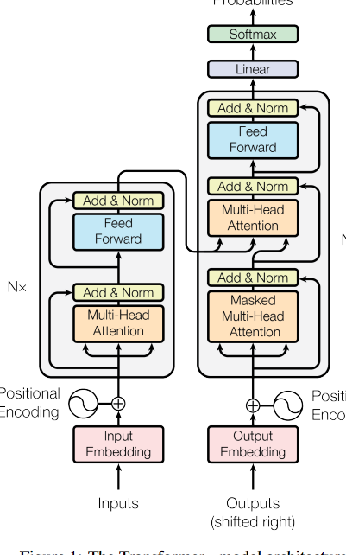

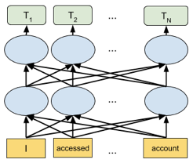
Transformers, BERT
Transformer (Google, 2017):
Deep Neural Network for language models
replaces sequential models (like RNN,LSTM),
allows parallel processing
multi-head Attention.
encoder: self-attention + Feed-Forward Network
decoder: self-attention, attention over encodings, and a feed-forward Network
BERT (Google 2018):
"Bidirectional Encoder Representations from Transformers"
a language representation model
designed to pre-train deep bidirectional representations from unlabeled text
Bert
(Sesame Street)

Slide 5


What is a Transformer Model
Very Good NVIDIA article: https://blogs.nvidia.com/blog/2022/03/25/what-is-a-transformer-model/
"A transformer model is a neural network that learns context and thus meaning by tracking relationships in sequential data like the words in this sentence."
"Transformer models apply an evolving set of mathematical techniques, called attention or self-attention, to detect subtle ways even distant data elements in a series
influence and depend on each other."
Some videos explaining transformers:
.. https://www.youtube.com/watch?v=4Bdc55j80l8
.. https://www.youtube.com/watch?v=TQQlZhbC5ps
Short videos (AI Coffee Break with Letiția Pârcălăbescu): .. https://www.cl.uni-heidelberg.de/nlpgroup/person/parcalabescu .. history - https://www.youtube.com/watch?v=iH-wmtxHunk .. transformers explained: - https://www.youtube.com/watch?v=FWFA4DGuzSc

Slide 6

RNNs > Transformers > BERT > GPT
RNNs - vanishing gradient problem
Gated RNN (LSTM) + Attention
Transformer (Google, 2017) – multi-head attention, encoder/decoder with self-attention and feed-forward network
BERT - pre-train deep bidirectional representations from unlabeled text
GPT (Generative Pre-trained Transformer) – Open AI, 2018 2019 - GPT-2, 1.5 Billion parameters 2020 - GPT-3, 175 Billion parameters 2022 – GPT-3.5, ChatGPT
- Hugging Face - open source NLP models: https://huggingface.co/transformers/ (note: .co, not .com)
Benefits of Transformers over RNNs/LSTMs:
process the entire input all at once (unlike RNNs)
this allows for more parallelization (faster training)
Benefits of BERT ("Bidirectional Encoder Representations from Transformers")
faster (parallel) training
ability to process larger amounts of text
ability to use pre-trained models (transfer learning)
Foundation models (e.g., BERT, GPT-3, CLIP, Codex)
are models trained on broad data at scale
such that they can be adapted to a wide range of downstream tasks
BERT (2018) - NLP
GPT-3 (2018-2020) NLP, 175 Bln parameters, Open AI
CLIP (Contrastive LanguageImage Pre-training) – Open AI – describe images using text
Codex = translates from natural language to software code, Open AI
Many classes of Deep Learning systems:
CNN (Convolutional Neural Network),
RNN (Recurrent Neural Network),
LSTM (Long Short-Term Memory),
GRU (Gated Recurrent Unit),
GAN (Generative Adversarial Network),
Transformers
BERT (Bidirectional Encoder Representations from Transformers),
GPT-3 (Generative Pre-trained Transformer)
RL (Reinforcement Learning),
and many others.
GPT-3 Language Model
175 Billion Parameters
GPT = Generative Pre-trained Transformer

Slide 7
Neural Machine Translation
Natural Language Processing - short video from Siraj (March 2019)
- https://www.youtube.com/watch?v=bDxFvr1gpSU
Siraj talks about different language models
(terms like Seq2Seq, Attention, Transformer, BERT).
Here is a good textual explanation by Maxime Allard:
- https://medium.com/inside-machine-learning/what-is-a-transformer-d07dd1fbec04
And here are two "classical" papers to know:
(2017) Attention Is All You Need
- https://arxiv.org/pdf/1706.03762.pdf
(2018) BERT: Pre-training of Deep Bidirectional Transformers for Language Understanding
- https://arxiv.org/pdf/1810.04805.pdf

Slide 8
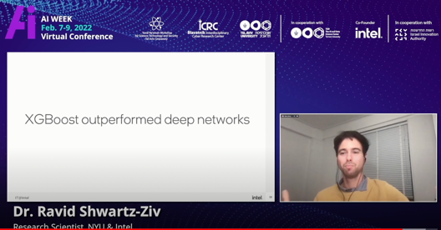
Transformers with Tabular Data
For tabular data transformers and other Deep Learning Models
don't give any advantages in comparison with regular models like XGBoost.
Regular XGBoost is better.
Here is an interesting recent work doing such a comparisons.
.. https://www.youtube.com/watch?v=vHufWWgDYTI
The most common models for tabular data are (linear) regression and classification.
From trivial OLS (Ordinary Least Squares) linear regression,
to more interesting models using Random Forest and XGBoost.
Random Forest is easier to start with, stable, gives feature importance.
Boosting is usually better in production (can handle nulls, more accurate, etc.)
I personally prefer HistGradientBoosting models – they are essentially the same as XGBoost, but much faster for large number of rows:
HistGradientBoostingClassifier
HistGradientBoostingRegressor
If you need to find a trend to extrapolate into the future,
then you can use linear or polynomial regression (quadratic or cubic), or sometimes approximate with one or two exponential functions.
Transformers-with-Tabular-Data - https://towardsdatascience.com/transformers-for-tabular-data-b3e196fab6f4 - https://medium.com/@tunguz/about-those-transformers-for-tabular-data-116c13c36a5c - https://blog.ml6.eu/transformers-for-tabular-data-hot-or-not-e3000df3ed46 -------------------------------------------------------- .. Multivariate Time Series Forecasting with Transformers - https://towardsdatascience.com/multivariate-time-series-forecasting-with-transformers-384dc6ce989b

