Slide 1
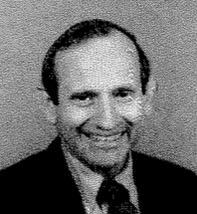
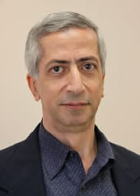
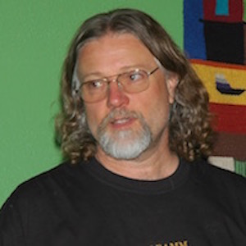

Ed Posner,
CalTech,
First conference
President, founded NIPS foundation.
Yaser Abu-Mostafa,
CalTech
James Bower
CalTech,
now Virtual Worlds, OR
NIPS = NeurIPS
NIPS Conference – held every December since 1987
NIPS = Neural Information Processing Systems
- https://nips.cc
- https://papers.nips.cc
- https://en.wikipedia.org/wiki/Conference_on_Neural_Information_Processing_Systems
-
2014 – 2,500 registered participants
2015 – 3,755 (~50% growth)
2016 – 5,680 (~51% growth)
2017 – 8,000+
2018 – 12K (2K tickets for main session sold in 12 minutes) 2019 ~ 13K, lottery was used to distribute tickets
2020 - online
2021
1987-2000 – in Denver, USA
2001-2010 – in Vancouver, Canada
2011 – Granada, Spain
2012-2013 – Lake Tahoe, US
2014-2015 – Montreal, Canada
2016 - Barcelona, Spain
2017 - Long Beach, California, US (Dec 4-9)
2018 - Montréal, Quebec, Canada
2019 - ?
2020 - online

Slide 2
Some Conferences / Events
NIPS = NeurIPS - https://nips.cc/
ICLR = International Conference on Learning Representations - https://iclr.cc/
ICMLR = International Conference on Machine Learning in Robotics -
IntelliSys - https://saiconference.com/IntelliSys
IJCAI = International Joint Conferences on Artificial Intelligence - https://www.ijcai.org/
ICML = International Conference on Machine Learning - https://icml.cc/
UAI = Uncertainty in Artificial Intelligence - http://www.auai.org/
ICAPS = International Conference on Automated Planning and Scheduling - http://www.icaps-conference.org/
ICDM = IEEE International Conference on Data Mining - http://icdm2019.bigke.org/
O'Reilly AI Conference - https://conferences.oreilly.com/artificial-intelligence/ai-ny
Open Data Science Conference (ODSC) - https://odsc.com
The European Conference on Machine Learning and Principles and Practice of Knowledge Discovery in Databases - https://www.ecmlpkdd2019.org/
ICIP = IEEE International Conference on Image Processing - http://2019.ieeeicip.org/
CoRL = Conference on Robot Learning - https://www.robot-learning.org/
AI & Big Data Expo - https://www.ai-expo.net/northamerica/
AAAI Conference on AI (AAAI = Association for the Advancement of Artificial Intelligence) - https://aaai.org/Conferences/AAAI-20/
CVPR = Conference on Computer Vision and Pattern Recognition - http://cvpr2020.thecvf.com/ - http://www.wikicfp.com/cfp/program?id=628

Slide 3
Kaggle
world's largest community of data scientists and machine learners
- since 2010
- acquired by Google in 2017
- more than 1 million registered users
- Kaggle Competitions
- Public Datasets
- Kaggle Kernels (Jupyter notebooks, code snippets)
Note:
Famous Netflix competition of 2009 was before Kaggle.
Netflix provided a training data set of 100,480,507 ratings
that 480,189 users gave to 17,770 movies.
Task was to improve recommendation engine.
Prize – 1 Mln $

