Slide 1
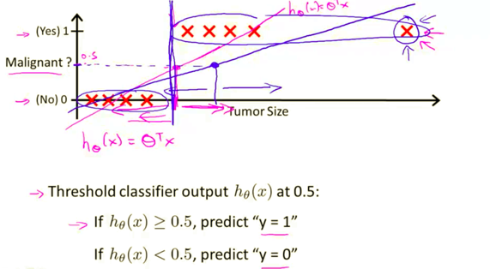
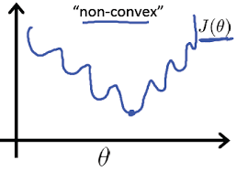
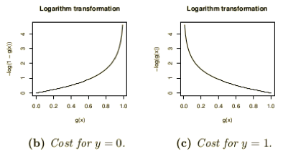
Why Cross-Entropy (CE) loss is better than
Min-Squared Error (MSE) loss
for classification?
(See Andrew Ng’s Machine Learning course on Coursera.)
First, MSE can force conversion to a wrong answer.
For example, suppose we are doing a medical diagnostics classifier based on a size of the abnormality. Big abnormalities usually mean cancer. We have a set of 100 samples with labels 0=healthy, 1=cancer.
Suppose we use MSE to train our model and find a threshold above which we say it is cancer.
Now suppose we add 20 more data points with very large sizes. They all have label 1 (cancer). Adding these points should not change the transition point. But if we use MSE, then it will shift the transition point toward larger sizes, thus changing diagnosis for some cases.
Second reason against MSE is that MSE loss function tend to be
non-convex - have multiple local minima, thus making it difficult to converge.
Third, Cross-Entropy gives bigger gradients and better conversion.

Slide 2
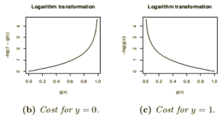
Cross-entropy loss = log loss
- https://www.youtube.com/watch?v=ErfnhcEV1O8
- http://neuralnetworksanddeeplearning.com/chap3.html
- http://ml-cheatsheet.readthedocs.io/en/latest/loss_functions.html
In machine learning (logistic regression, neural networks) cross-entropy (CE) is used to measure the difference between the actual and desired output. Note that this CE is different from CE used in information theory.
Suppose we have a network which solves classification problem and has one output node (neuron) which outputs a number “a” between 0 and 1. The desired output of binary classification (label y) should be either 0 or 1.
We define CrossEntropy() function as following:
def CrossEntropy(y_target, a):
if y_target == 1:
return -log(a)
return -log(1 - a)
Note how this function returns very big number if y and a differ.
For example, if y == 1 and a is close to 0, then –log(a) will be a very large positive number.
But when a is close to 1, then the output will be close to zero. So Cross-Entropy loss function gives big gradients – and makes learning faster.
Note that we can write the same logic without if/else:
def CrossEntropy(y, a):
return –( y*log(a) + (1-y)*ln(1-a) )

Slide 3


If we have “n” training samples, then the total Cross-Entropy will be simply a sum of them:
And if the output is several nodes (not just one) – then we sum over all of them:

Slide 4
Note that this formula:
C=−(1/n)∑( y*ln(a) + (1−y)*ln(1−a) )
can be also rewritten using notation (a1=a, a2=1-a, y1=y, y2=1-y) as:
C=−(1/n)∑( y₁*ln(a₁) + y₂*ln(a₂) )
or
C=−(1/n)∑∑ y_{j}*ln(a_{j})
where we sum by j (0,1) and by number of samples “n”.
In this form it looks the same as formula for log-likelihood or cross-entropy
in information theory (see next slides).
But note that in information theory the characters in the formula have different meaning
and the formula is used for different domain (probability distributions, likelihood,
independent variables, gaussian distribution, etc).
See also here:
https://stats.stackexchange.com/questions/223799/different-definitions-of-the-cross-entropy-loss-function/224491#224491

Slide 5


Log-likelihood
The likelihood (L) of a parameter value (or vector of parameter values), θ, given outcomes x, is equal to the probability (density) assumed for those observed outcomes given those parameter values.
For many applications, the natural logarithm of the likelihood function, called the log-likelihood, is more convenient to work with. Because the logarithm is a monotonically increasing function, the logarithm of a function achieves its maximum value at the same points as the function itself, and hence the log-likelihood can be used in place of the likelihood in maximum likelihood estimation and related techniques.
Finding the maximum of a function often involves taking the derivative of a function and solving for the parameter being maximized, and this is often easier when the function being maximized is a log-likelihood rather than the original likelihood function.
For example, some likelihood functions are for the parameters that explain a collection of statistically independent observations. In such a situation, the likelihood function factors into a product of individual likelihood functions. The logarithm of this product is a sum of individual logarithms, and the derivative of a sum of terms is often easier to compute than the derivative of a product.
L = P(x | θ)
ln(L)

Slide 6
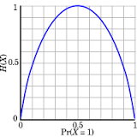
Shannon entropy
Claude Shannon (1916-2001)
American mathematician, electrical engineer, and cryptographer
known as "the father of information theory".
Landmark paper:"A Mathematical Theory of Communication" (1948)
- https://en.wikipedia.org/wiki/Claude_Shannon
- https://en.wikipedia.org/wiki/Entropy_(information_theory)
- https://www.quora.com/What-is-an-intuitive-explanation-of-the-concept-of-entropy-in-information-theory
Shannon entropy provides an absolute limit on the best possible average length
of lossless encoding or compression of an information source.
Simple way to understand the formula:
If "p" is probability of an event,
then we can use (1/p) as a measure of the information.
If event is common (the sun rose up as usual), it adds little information.
If event is rare (say, probability is 1/100), then messages about
this event carries more information.
So we can use (1/p) as a measure of information.
In practice we use log(1/p) because we do
binary encoding to compress our messages.
So we simply calculate
sum(probability*information) = sum(p*log(1/p)) = - sum(p*log(p))

Slide 7




Kullback–Leibler Divergence
The KL-divergence is the penalty (in bits) you'll have to pay
if you try to compress data from one distribution
using a scheme optimized for another.
- https://en.wikipedia.org/wiki/Kullback–Leibler_divergence
- https://en.wikipedia.org/wiki/Solomon_Kullback - https://en.wikipedia.org/wiki/Richard_Leibler
Solomon Kullback (1907-1994)
Richard Leibler
(1914-2003)
Example:
To report weather in Sahara desert it is optimal to use short encoding for sunny days, because they are most frequent.
To report weather in Seattle it is optimal to use shorter messages for rainy days.
If we would use the message encoding scheme optimized for Sahara to encode messages for Seattle, we would end up with messages which are longer than needed.
sunny Sahara
More precisely:
if your data really comes from probability distribution P,
but you use a compression scheme optimized for Q,
the divergence D(P||Q) is the number of extra bits you'll require
to store a record of each sample from P.
D(Q||P) ≥ 0 because, by definition, it's the number of bits required
compared to the best possible.
Note: generally there's no reason to expect D(P||Q) to be equal to D(Q||P) .
rainy Seattle

Slide 8



Cross Entropy
The entropy H(p) of a distribution p measures how many bits you need
on average to encode data from p with the code that is optimal for p.
The cross-entropy of a distribution p with respect to a distribution q
measures how many bits you need on average to encode data from p with the code that is optimal for q.
The cross entropy for the distributions p and q over a given set is defined as follows:
… the output vector represents a probability distribution, and cross-entropy indicates the distance between what the network believes this distribution should be, and what the teacher says it should be …
… You should use the cost function that matches your output units and your probabilistic modeling assumptions. For a multi-class classification, that means a softmax + cross entropy. For regression (assuming a Gaussian distribution) - squared error…
Cross-entropy
H(p) – entropy of p
Kullback–Leibler divergence of q from p
D(p||q) >= 0 , because it represents additional bits needed to encode data with distribution p using encoding optimal for distribution q
For discrete p & q:
Cross-Entropy is always greater than Entropy,
because D(p||q) >= 0
- https://en.wikipedia.org/wiki/Cross_entropy
- http://stats.stackexchange.com/questions/31985/definition-and-origin-of-cross-entropy
- https://www.reddit.com/r/MachineLearning/comments/3klqdh/q_whats_the_difference_between_crossentropy_and/
- https://jamesmccaffrey.wordpress.com/2013/11/05/why-you-should-use-cross-entropy-error-instead-of-classification-error-or-mean-squared-error-for-neural-network-classifier-training/

Slide 9

Entropy in Physics
Clausius invented the term in 1865. He had noticed that a certain ratio was constant in reversible, or ideal, heat cycles. The ratio was heat exchanged to absolute temperature. Clausius decided that the conserved ratio must correspond to a real, physical quantity, and he named it "entropy".
Rudolf Clausius
Entropy in Statistical Mechanics:
The summation is over all the possible microstates of the system.
p_{i} is the probability that the system is in the i-th microstate.
k_{B} is the Boltzmann constant, equal to 1.38065×10−23 J/K
The second law of thermodynamics states that
entropy never decreases spontaneously in an isolated system.
The total entropy of any system can't decrease
other than by increasing the entropy of some other system.
Ludwig Boltzmann
Josiah Willard Gibbs

