Slide 1
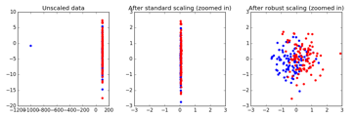

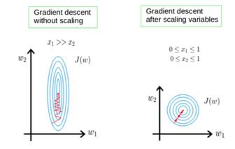
Do you need to Scale your Data?
Very good short video:
Should You Scale Your Data ??? : Data Science Concepts
https://www.youtube.com/watch?v=n9KeJLGwW0U
by ritvikmath ( Ritvik Kharkar, California)
http://ritvikmath.com/
https://github.com/ritvikmath
https://www.linkedin.com/in/ritvik-kharkar/
KNN Scaling
KNN in 2-dim (x1,x2) will work differently if x1 in meters, and x2 in centimeters
Decision Tree – each column is split the same regardless of the scale (m or cm)
Linear Regression – will work the same, but if you analyze feature sensitivity – it is easier to have all predictors having same scale.
Regularization term – need same (or similar) scaling
Gradient descent – works better with scaling
Generally, need scaling when features interact in same formula or being compared.
Linear Regression
Regularization
Gradient Descent

