Slide 1
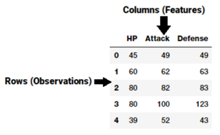

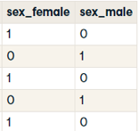
Feature Engineering
Cleaning Data and Feature Engineering typically take 80% of time of a Data Science Project!
A feature is typically
a column in a data set
"Feature engineering is the process of transforming raw data into features that better represent the underlying problem to the predictive models, resulting in improved model accuracy on unseen data." - Dr. Jason Brownlee
Typical Operations:
Removing obviously non-relevant data (empty or not-changing columns/rows, row_id, etc. )
Synthetic Features (Example: Income / Price)
Select relevant columns (Kolmogorov-Smirnov test, etc.)
Sparse features – consider converting/combining (Example: grouping penny-stocks together)
Impute missing data (with mean, median, most frequent, KNN, extrapolation or interpolation, MICE (Multivariate Imputation by Chained Equation), xgboost, etc.
Outliers (use box-plots and scatterplots to find), filter-out or change
Collinearity – reduce (combine features, use PCA (Principal Component Analysis)
Factor Analysis (finding underlying common factor for several features) – reduce number of features
Aggregating, Binning / Bucketing - df[col] = pd.qcut(df[col], 10)
Grouping of some features together (numeric - sum() or mean(), categorical – by frequency)
Transformations & Interactions (see H2O.ai Driverless AI as a good example)
One-hot Encoding ( use pd.get_dummies() function in pandas)
Split features (for example, split text)
Scaling (Normalization or Standardization)
Dates – convert to features (Day of week, Month, Year, Day of year, Quarter, diff between dates)
Feature Importance – training with different subsets of features (ex. Random Forest) allows to figure out feature importance – and helps to remove non-important features
Text - extract synthetic features (for example, sentiment (Positive, Neutral, Negative)
One-Hot Encoding

Slide 2
Feature Engineering Tools – part 1
6.4. Imputation of missing values
6.4.1. Univariate vs. Multivariate Imputation
6.4.2. Univariate feature imputation
6.4.3. Multivariate feature imputation
6.4.4. References
6.4.5. Nearest neighbors imputation
6.4.6. Marking imputed values
6.5. Unsupervised dimensionality reduction
6.5.1. PCA: principal component analysis
6.5.2. Random projections
6.5.3. Feature agglomeration
6.6. Random Projection
6.6.1. The Johnson-Lindenstrauss lemma
6.6.2. Gaussian random projection
6.6.3. Sparse random projection
6.7. Kernel Approximation
6.7.1. Nystroem Method for Kernel Approximation
6.7.2. Radial Basis Function Kernel
6.7.3. Additive Chi Squared Kernel
6.7.4. Skewed Chi Squared Kernel
6.7.5. Polynomial Kernel Approximation via Tensor Sketch
6.7.6. Mathematical Details
6.8. Pairwise metrics, Affinities and Kernels
6.8.1. Cosine similarity
6.8.2. Linear kernel
6.8.3. Polynomial kernel
6.8.4. Sigmoid kernel
6.8.5. RBF kernel
6.8.6. Laplacian kernel
6.8.7. Chi-squared kernel
6.9. Transforming the prediction target (y)
6.9.1. Label binarization
6.9.2. Label encoding
Pandas, NumPy, Matplotlib, Seaborn
Scikit-learn Dataset transformations: https://scikit-learn.org/stable/data_transforms.html
6.1. Pipelines and composite estimators
6.1.1. Pipeline: chaining estimators
6.1.2. Transforming target in regression
6.1.3. FeatureUnion: composite feature spaces
6.1.4. ColumnTransformer for heterogeneous data
6.1.5. Visualizing Composite Estimators
6.2. Feature extraction
6.2.1. Loading features from dicts
6.2.2. Feature hashing
6.2.3. Text feature extraction
6.2.4. Image feature extraction
6.3. Preprocessing data
6.3.1. Standardization, or mean removal and variance scaling
6.3.2. Non-linear transformation
6.3.3. Normalization
6.3.4. Encoding categorical features
6.3.5. Discretization
6.3.6. Imputation of missing values
6.3.7. Generating polynomial features
6.3.8. Custom transformers

Slide 3






Feature Engineering Tools - part 2
Kolmogorov-Smirnov test – helps to find essential features from scipy.stats import ks_2samp - https://en.wikipedia.org/wiki/Kolmogorov%E2%80%93Smirnov_test - https://stats.stackexchange.com/questions/1001/is-spearmans-correlation-coefficient-usable-to-compare-distributions
Featuretools - open source python framework for automated feature engineering - https://www.featuretools.com/
TSFRESH python package "Time Series Feature Extraction based on Scalable Hypothesis tests" - https://github.com/blue-yonder/tsfresh
autofeat (Automated Feature Engineering and Selection) - https://github.com/cod3licious/autofeat - https://arxiv.org/abs/1901.07329
PyFeat - A Python-based Effective Feature Generation Tool from DNA, RNA, and Protein Sequences - https://github.com/mrzResearchArena/PyFeat
Driverless AI from H2O.ai - https://www.h2o.ai/products/h2o-driverless-ai/
PyCaret - https://pycaret.org/

Slide 4
Feature Extraction from Documents – OCR
Google tesseract OCR (HP 1985-2005, Opensorced in 2005, then developed by Google) - https://github.com/tesseract-ocr/tesseract - https://tesseract-ocr.github.io/tessdoc/Command-Line-Usage - https://github.com/madmaze/pytesseract - https://www.pyimagesearch.com/2017/07/10/using-tesseract-ocr-python/
gvision - https://cloud.google.com/vision
Document AI - https://cloud.google.com/solutions/document-ai
AWS Textract - https://aws.amazon.com/textract/
Microsoft cognitive services - https://azure.microsoft.com/is-is/services/cognitive-services/form-recognizer/ - https://docs.microsoft.com/en-us/azure/cognitive-services/text-analytics/overview - https://azure.microsoft.com/en-ca/services/cognitive-services/text-analytics/
H2O Driverless AI: Mark Landry NYC 2019 - H2O.ai - OCR.ai: Creating AI to Read Documents - https://www.youtube.com/watch?v=LczYc2o0dNo
Open Source: https://www.softwareadvice.com/resources/easiest-to-use-free-and-open-source-text-analysis-software/
AYLIEN Text Analysis Software, Keatext Software, KNIME Analytics Platform Software, Refinitiv Intelligent Tagging
The Top 33 Information Extraction Open Source Projects - https://awesomeopensource.com/projects/information-extraction
Bloomberg - information extraction, David Rosenberg, 2018 - https://twimlai.com/twiml-talk-126-information-extraction-natural-document-formats-david-rosenberg/
Extract from chart images: - https://www.microsoft.com/en-us/research/wp-content/uploads/2017/02/ChartSense-CHI2017.pdf
Bloomberg - Information Extraction with Character-level Neural Networks and Free Noisy Supervision2017 - https://arxiv.org/pdf/1612.04118.pdf -
Best method to extract numerical data from product descriptions, 2018 - https://www.reddit.com/r/MachineLearning/comments/8f98z1/d_best_method_to_extract_numerical_data_from/
...

Slide 5
Extracting Features from Text - part 1
Text Cleaning:
Converting words into lowercase
Removing leading and trailing whitespaces, punctuation, stop words (a, an, the, ...)
Expanding contractions (don’t -> do not)
Removing special characters (numbers, emojis, etc), HTML/XML tags
Replacing accented characters (such as é)
Correcting spelling errors
Tokenizing - split text into tokens
Stemming & Lemmatization - convert word into base forms:
Stemming - essentially chops off letters from the end until the stem is reached
Lemmatization – more advanced: "was" → "be", "mice" → "mouse"
POS tagging (Part-Of-Speech). Careful – same word may get different POS tag in different contexts. For example: bear is an animal (noun), please bear with me (verb)
Sentiment analysis
Word Sense Disambiguation by asking questions (chatbot)
Name Entity Recognition - identify/categorize names of persons, organizations, locations, expression of times, quantities, monetary values, percentages, etc.
Bag of Words(BoW) – calculate frequency of each word (drawback - doesn't understand order of words)
N-gram - set of N sequential word tokens in a given document (BoW is basically a unigram model (N=1)) Problems with N-grams:
very high-dimensional and sparse set (difficult to train a model)
observation to appear equidistant from all the others
TF-IDF (Term Frequency-Inverse Document Frequency) – better than N-grams
Word embeddings – even better. Maps words into an n-dimensional vector space (using deep learning). Examples: Word2Vec by Google, Fasttext by Facebook, Glove by Standford

Slide 6






Extracting Features from Text - part 2
Common Libraries
Resources:
Continuous Numeric Data. Strategies for working with continuous … - by Dipanjan (DJ) Sarkar - https://towardsdatascience.com/understanding-feature-engineering-part-1-continuous-numeric-data-da4e47099a7b
Traditional Methods for Text Data - by Dipanjan (DJ) Sarkar - https://towardsdatascience.com/understanding-feature-engineering-part-3-traditional-methods-for-text-data-f6f7d70acd41
Text Vectorization: Bag of Words (BoW) - by Vaibhav Jayaswal - https://towardsdatascience.com/text-vectorization-bag-of-words-bow-441d1bfce897
Understanding NLP Word Embeddings — Text Vectorization - by Prabhu - https://towardsdatascience.com/understanding-nlp-word-embeddings-text-vectorization-1a23744f7223
The Curse of Dimensionality. Why High Dimensional Data Can Be So… - by Tony Yiu - https://towardsdatascience.com/the-curse-of-dimensionality-50dc6e49aa1e
5 Heroic Python NLP Libraries (elitedatascience.com) - https://elitedatascience.com/python-nlp-libraries
Sci-kit learn
NLTK
spaCy
Gensim
Textblob
Standford CoreNLP

Slide 7
H2O.ai – Automatic Feature Engineering
New features are created by doing transformations and/or interactions on the dataset columns.
Feature creation and selection is evolutionary (based on variable importance of previous iteration)
Feature creation uses genetic algorithm to find the best set of feature transformations and model parameters for an experiment/dataset. - https://docs.h2o.ai/driverless-ai/latest-stable/docs/userguide/feature-engineering.html
Driverless AI Transformers (Numeric, Categorical, Time & Date, NLP (text), Image, etc.) See big list of transformers here: - https://docs.h2o.ai/driverless-ai/latest-stable/docs/userguide/transformations.html#transformations
Feature Interactions: - https://docs.h2o.ai/driverless-ai/latest-stable/docs/userguide/expert_settings/features_settings.html#max-feature-interaction-depth

Slide 8

Impute Missing Values Using XGBoost
Automatically Predict all Missing Values by XGBoost Impute all NaNs by ML with a single line of code:
pip install verstack. # Danil Zherebtsov
https://medium.com/swlh/impute-missing-values-the-right-way-c63735fccccd
Danil Zherebtsov
Good Discussion:
https://stats.stackexchange.com/questions/98953/why-doesnt-random-forest-handle-missing-values-in-predictors.
Random Forest has two methods for handling missing values, according to Leo Breiman and Adele Cutler, who invented it.
The first is quick and dirty: it just fills in the median value for continuous variables, or the most common non-missing value by class.
The second method fills in missing values, then runs RF, then for missing continuous values, RF computes the proximity-weighted average of the missing values. Then this process is repeated several times. Then the model is trained a final time using the RF-imputed data set.

Slide 9
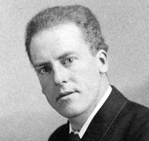
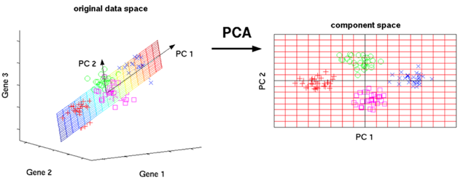
PCA = Principal Component Analysis
PCA was developed by Karl Pearson (in 1901)
PCA creates linear combinations of the original features. The new features are orthogonal, (uncorrelated).
Furthermore, the new features (Principal Components) are ranked in order of their "explained variance". The first principal component PC1 explains the most variance in your data, PC2 explains the second-most variance, and so on.
These Principal Components are then used in a machine learning model (instead of original features)
Karl Pearson
A major benefit of PCA: helps to simplify the model. PCA can often drastically reduce the dimensionality of our data, thereby greatly reducing the number of explanatory variables needed to be included within a machine learning model
A major drawback to PCA: A model constructed with Principal Components may be very difficult to interpret / explain – because they are not real features, but artificial combinations of them
Another major drawback to PCA: PCA should not be applied to categorical features, even if they have been converted to binary "one-hot" dummy variables
from sklearn import decomposition
# ...
pca = decomposition.PCA(n_components=3)
pca.fit(X)
X = pca.transform(X)

Slide 10
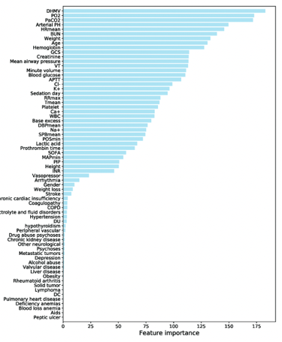
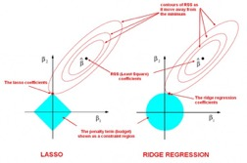
Feature Importance – part 1
The 5 Feature Selection Algorithms every Data Scientist should know
- https://towardsdatascience.com/the-5-feature-selection-algorithms-every-data-scientist-need-to-know-3a6b566efd2
Curse of dimensionality, Overfitting. If Ncols > Nrows, we can fit data perfectly, but that won’t generalize to the new samples. Thus we learn absolutely nothing.
Occam’s Razor. We want our models to be simple and explainable. We lose explainability when we have a lot of features.
Garbage In Garbage out. Many non-informative features (name, Id, etc.) add noise and reduce the quality of the model.
Some Feature Selection Methods:
Random Forest has built-in feature importance functionality
Correlation, Kolmogorov-Smirnov, chi-square, other filtering
Recursive Feature Elimination or other "search" methods
SHAP (SHapley) .. https://christophm.github.io/interpretable-ml-book/shap.html
Lasso has its own internal feature selection method
from sklearn.ensemble import RandomForestClassifier
model = RandomForestClassifier(random_state=0)
model.fit(X_train, y_train)
importances = model.feature_importances_

Slide 11
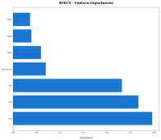

Feature Importance – part 2
Feature Importance
Backward Elimination – method of reducing the number of features.
We remove least significant features one by one and retrain the model.
The purpose is to get good model with smaller number of features.
Caution.
Dropping out features can give us wrong results when features are correlated.
Example:
We have two ice cream columns (features): chocolate and vanilla.
Having ice-cream present has strong influence on the target (label) column.
We evaluate the importance by removing each individual feature – and retraining the model.
Suppose that these two columns are tightly correlated (chocolate and vanilla either come together – or don't come).
If we drop vanilla column – and re-train, the model will still work because chocolate column is still present.
So we will wrongly conclude that vanilla column is not important.
Similarly we will wrongly conclude that chocolate column is not important for the same reason.

Slide 12
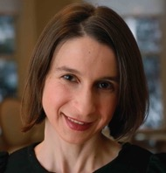
Cynthia Rudin - Interpretable Machine Learning
"Stop explaining black box machine learning models for high stakes decisions and use interpretable models instead"
Nature Machine Intelligence volume 1, pages206–215(2019)
- https://www.nature.com/articles/s42256-019-0048-x
"Please Stop Explaining Black Box Models and Use Interpretable Models Instead"
- https://www.youtube.com/watch?v=sl78EgrT4TY
Why People Love Black Boxes (Cynthia Rudin, 2019) :
they allow companies to make $$
they are "magical" and "uncover things"
they are easy to train, an excuse not to do any feature engineering
people think they are more accurate
we don't even teach interpretable ML
Cynthia Rudin
Professor at Duke University,
Prediction Analysis Lab,
interpretable machine learning
Conrastive Learning: Stage 1: find/train a contrastive representation of data.
Contrasive = Polarized. Get "cats" close to each other, and father from "dogs".
Stage 2: use softmax and cross-entropy to find separation (classification) of polarized data
Self-supervised learning - automatically creates labels
trains using those labels, generates representations,
then uses these representations for other tasks
Examples how labels can be created:
- remove word, and learn to predict it
- rotate picture, and learn to predict original picture
LIME Framework
Interpretable Machine Learning Using LIME Framework by Kasia Kulma (PhD), Data Scientist, Aviva - 2017
- https://www.youtube.com/watch?v=CY3t11vuuOM

Slide 13

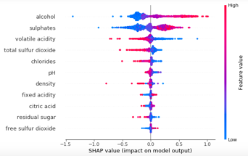


Shapley Value and SHAP (SHapley Additive exPlanations)
The Shapley Value, coined by Lloyd Shapley (1953),
is a method for assigning payouts to players
depending on their contribution to the total
payout - https://en.wikipedia.org/wiki/Lloyd_Shapley
Lloyd Stowell Shapley
1923 - 2016
American mathematician and Nobel Prize-winning economist
SHAP (SHapley Additive exPlanations)
by Lundberg and Lee (2016)
is a method to explain individual predictions.
SHAP authors proposed KernelSHAP, an alternative,
kernel-based estimation approach for Shapley values
inspired by local surrogate models.
And they proposed TreeSHAP,
an efficient estimation approach for tree-based models.
Also, SHAP comes with many global interpretation
methods based on aggregations of Shapley values.
Scott Lundberg
Univ. of Washington
Microsoft
https://scottlundberg.com/
https://github.com/slundberg/shap
Su-In Lee
Computer Science & Engineering
Univ. of Washington

Slide 14
More Resources
https://stackoverflow.com/questions/65472200/when-should-data-binning-be-used-in-data-processing
https://docs.tibco.com/pub/spotfire/7.0.1/doc/html/bin/bin_what_is_binning.htm
https://cxl.com/blog/outliers/
https://en.wikipedia.org/wiki/Data_binning
https://www.simplypsychology.org/boxplots.html
https://www.researchgate.net/figure/Examples-of-various-outliers-found-in-regression-analysis-Case-1-is-an-outlier-with_fig2_50946372
https://probabilityandstats.wordpress.com/2015/05/09/the-skewness-of-a-probability-distribution/
https://towardsdatascience.com/feature-engineering-for-machine-learning-3a5e293a5114
https://www.kaggle.com/ryanholbrook/what-is-feature-engineering
https://medium.com/@kyawsawhtoon/log-transformation-purpose-and-interpretation-9444b4b049c9
https://machinelearningmastery.com/why-one-hot-encode-data-in-machine-learning/
https://www.kaggle.com/dansbecker/using-categorical-data-with-one-hot-encoding
Automatic Feature Selection in python (using verstack module by Danil Zherebtsov) https://danilzherebtsov.medium.com/automatic-feature-selection-in-python-f72ec69215fe

