Slide 1
MLOps vs AIOps
MLOps = Machine Learning Operations
Standard Tools/frameworks to manage all stages of ML lifecycle as ongoing products.
It is basically DevOps for ML pipelines.
It covers building, scaling, deploying, monitoring, re-training ML products.
Google, Facebook, and other companies have their own frameworks (architectures) for that.
AIOps = Artificial Intelligence Operations
Process to analyze, optimize, and automate the IT.
Uses data, analytics, and machine learning to analyze and improve IT infrastructure & operations
Makes IT more efficient
Effectively automates DevOps and DataOps.
https://www.ibm.com/cloud/learn/aiops -
https://www.analyticsinsight.net/delivering-aiops-microsoft-azure-cloud-platform/ -
https://www.analyticsinsight.net/ -
https://www.moogsoft.com/moogsoft-aiops-in-microsoft-azure/ -
https://www.ibm.com/cloud/learn/hybrid-cloud -

Slide 2
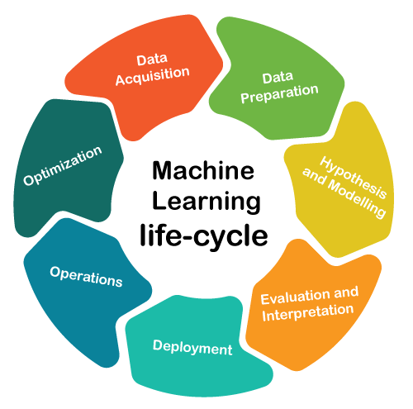
Machine Learning Reference Architectures
from Google, Facebook, Uber, DataBricks and Others
Nice Review about MLOps Reference Architectures
https://medium.com/dataseries/machine-learning-reference-architectures-from-google-facebook-uber-databricks-and-others-58191cf82b98
The lifecycle of Machine Learning solutions is
fundamentally different than other software disciplines,
because the deployed model needs to be constantly
re-trained and optimized.

Slide 3
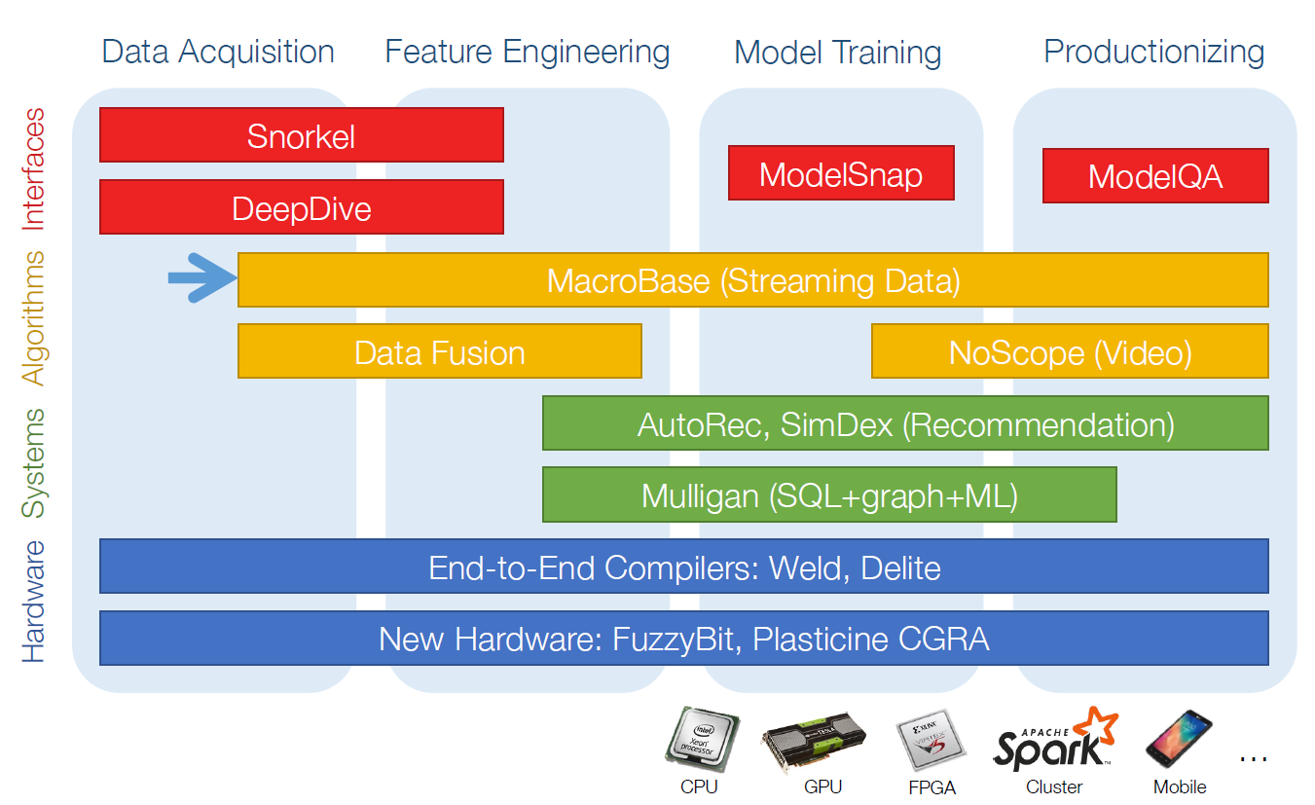
Stanford’s DAWN
Stanford’s DAWN - a series of tools, frameworks and an architecture reference
to streamline ML workflows. Includes projects such as training (Snorkel),
continuous analytics (MacroBase) or data computation(Weld).
- https://dawn.cs.stanford.edu/

Slide 4
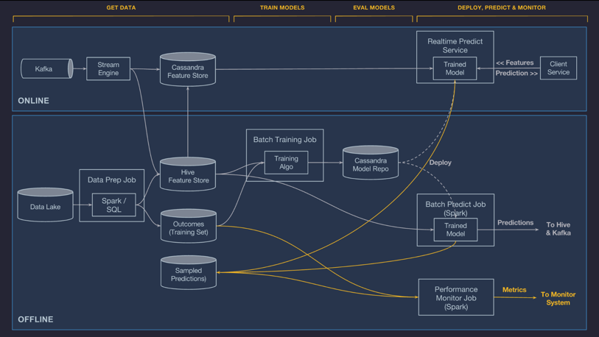
Uber’s Michelangelo
Uber’s Michelangelo – powers hundreds of ML workflows at Uber.
Works with other ML tools like Horovod, PyML or Pyro.
- https://eng.uber.com/michelangelo-machine-learning-platform/

Slide 5
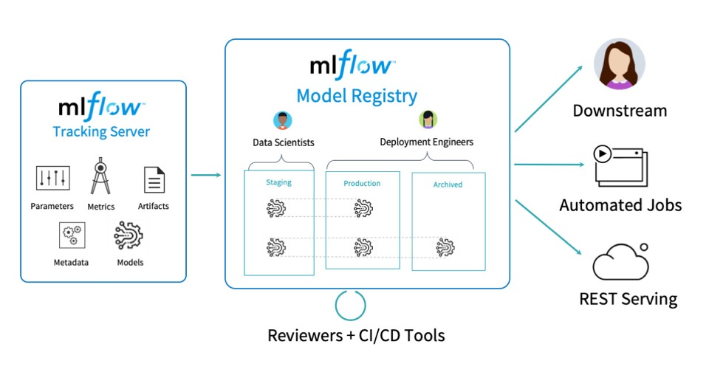
DataBricks’ MLflow
DataBricks’ MLflow is an open source platform for automating the lifecycle of machine learning solutions
The project focuses on training, project packaging and model serving
MLflow integrates well with many development frameworks
MLflow integrates well with runtime infrastructures
- https://www.mlflow.org

Slide 6
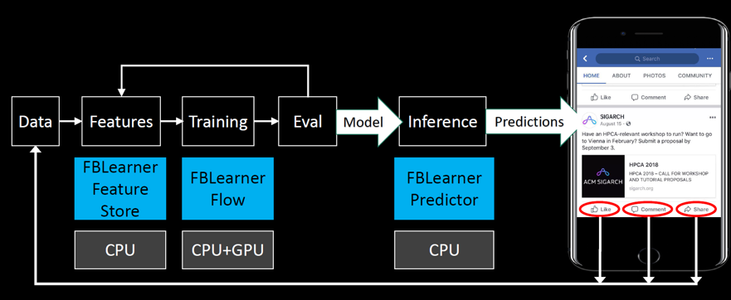
Facebook’s FBLearner Flow
Facebook’s FBLearner Flow automates feature extraction, training, model evaluation and inference. FBLearner Flow integrates with Facebook’s own Caffe2, PyTorch and ONNX.
- https://engineering.fb.com/ml-applications/introducing-fblearner-flow-facebook-s-ai-backbone/

Slide 7
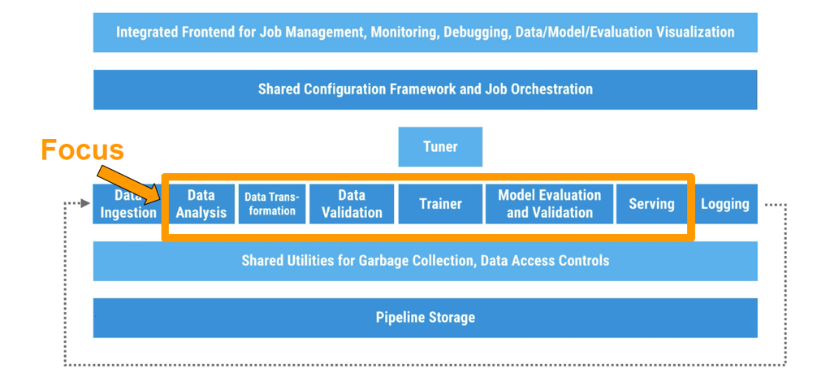
Google’s TFX
Google’s TFX – an architecture for executing ML workflows using TensorFlow programs
TFX includes
a learner for generating models based on training data
modules for analyzing and validating both data as well as models
infrastructure for serving models in production .. https://www.kdd.org/kdd2017/papers/view/tfx-a-tensorflow-based-production-scale-machine-learning-platform

Slide 8


Determined AI
Determined AI - Open-Source framework for
distributed training of Deep Learning models.
Whether you use PyTorch or TensorFlow+Keras,
you can speed up 20-100 times without
changing your code.
https://www.determined.ai/
https://www.determined.ai/product
https://github.com/determined-ai/determined
https://www.determined.ai/blog/production-training-pipelines-with-determined-and-kubeflow
The whole production system may be built using
three open-source technologies:
Kubeflow Pipelines - for ML pipelines - https://www.kubeflow.org/
Determined AI - for production-scale model training - https://www.determined.ai/
Seldon Core - for model deployment and serving - https://www.seldon.io/

Slide 9
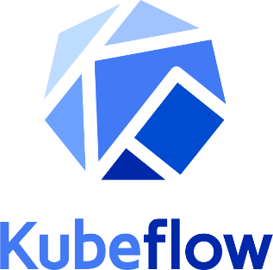



Kubeflow
Kubeflow began as an internal Google project,
it is a simple a way to ran TensorFlow on Kubernetes.
Kubeflow was open sourced at Kubecon conference (USA, December 2017).
Later it was expanded to be a multi-architecture, multi-cloud framework
for running entire ML (Machine Learning) pipelines.
Purpose - to make training and deployments of ML on Kubernetes simple, portable and scalable.
Kubeflow allows to:
do python coding in Jupyter notebooks
use popular training libraries and formats: TensorFlow, PyTorch, scikit-learn, XGBoost, ONNX - https://www.kubeflow.org/docs/components/serving/kfserving/
run code efficiently and securely in Kubernetes, isolated namespaces
portability between your laptop, on-prem cluster, or any of major clouds
portability between teams
Kubeflow’s hyperparameter tuner (Katib) saves days of training
Kubeflow Pipelines - build ML workflows for integration and deployment
- https://github.com/kubeflow/kubeflow/blob/master/ROADMAP.md
- https://www.kubeflow.org/docs/about/use-cases/
- https://en.wikipedia.org/wiki/Kubeflow
- https://medium.com/kubeflow/kubeflow-1-0-cloud-native-ml-for-everyone-a3950202751
Kubeflow was co-founded by Google engineers
Jeremy Lewi Google
David Aronchick Microsoft, Azure
(originally - Google)
Vishnu Kannan Google
David Aronchick - Azure, Microsoft (former Google)
- https://www.linkedin.com/in/aronchick/
Jeremy Lewi - Google - https://www.linkedin.com/in/jeremy-lewi-600aaa8/
Vishnu Kannan - Google - https://www.linkedin.com/in/vishnukanan/

Slide 10
Alternative 3rd Party Platforms
kubeflow
cnvrg.io – acquired by Intel
H2O.ai
DataRobot
Dataiku - https://www.dataiku.com/
Alterix
RapidMiner
Amazon SageMaker
Azure ML Studio
Azure Synapse Analytics
Google Cloud ML & AutoML
Qlik AutoML
IBM Watson Studio

