Slide 1
Model Evaluation
https://scikit-learn.org/stable/modules/model_evaluation.html
Regression:
- R² Score
- L1 vs L2: |a-b| vs (a-b)², Absolute Error vs Mean Squared Error
Classification Error:
- Log Loss
- Cross-Entropy
Classification:
- Confusion Matrix – True Positives, True Negatives, False Positives, False Negatives
- Precision (PRE = sniper)
- Recall (REC = Nuclear bomb)
- Accuracy : (TP + TN) / (TP+TN+FP+FN)
- F1 = 2 * PRE * REC / (PRE + REC)
- ROC Curve
- AUC Score
Overfitting and Regularization

Slide 2
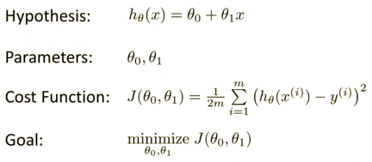


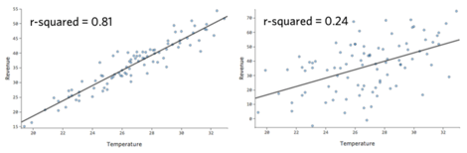

Linear Regression
In simplest case - draw a straight line through data points.
Data is given as tuples (x,y).
We want to draw line y = f(x) = ax + b,
where a & b are numbers (a - slope, b – intercept).
In more general case, “x” and “a” are vectors.
Always make sure that variation of (y-f) is much less than total variation of y. It is called coefficient of determination R² ("R squared”) and it should be close to 1 :
Calculations for simple case:
Method 1 – in Excel, pandas, and many libraries – use OLS functions
(OLS = Ordinary Least Squares).
Method 2 – do calculations yourself:
For more complex case you can find the minimum by iteratively using gradient descent. Or find “slope” by using inverse matrix (see Moore–Penrose pseudoinverse matrix):

Slide 3
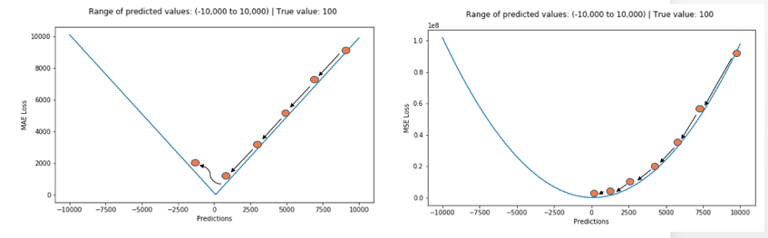
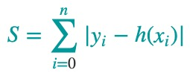
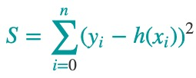
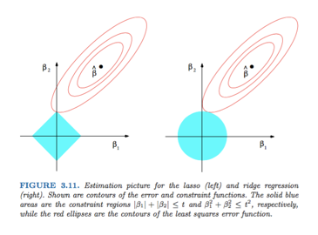
L₁
L₂
L₁ vs L₂ Loss

Slide 4
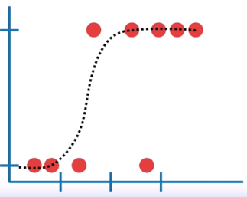
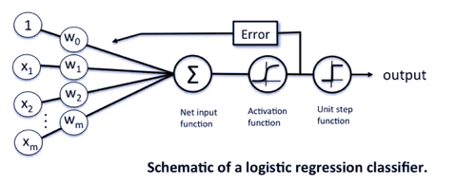

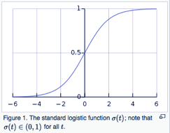
Logistic Regression
Logistic Function
sigma function σ(t) squeeze values into interval (0,1)
In Logistic Regression we model log-likelihood
as a linear combination of some predictors:
logit(p) = log(p/(1-p)) = b0 + b1*x1 + b2*x2 + . . . + bN*xN
Term: “p” - probability of success (then (1-p) is the probability of failure).
Term: Odds (a.k.a. likelihood) of success is the ratio p/(1-p)
Term: Log-likelihood = log(likelihood) = log(p/(1-p))
Term: Logit function logit(p) = log(p/(1-p))
Term: Logistic function σ(t) = 1/(1+exp(-t)) # inverse of logit

Slide 5
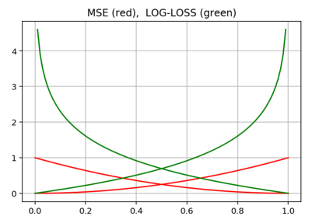

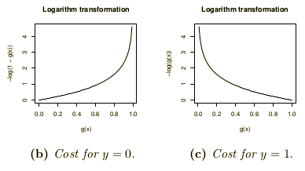

Logistic Regression
Goal - find parameters of a (function or network) to split data into categories (two or more categories).
We can find parameters either analytically (sometimes), or via
gradient descent. For GD we define cost function so that it strongly penalize for wrong categorization (cost J(θ) grows to infinity).
Consider simple case of 2 categories (y = 0 or y=1). ”h” is the prediction of the model, “y” is the label (0 or 1). Then we can represent
Cost function like cross-entropy between “h_{θ}” and “y”:
Log-Loss error function is better:
If “q” is model prediction, and “p” is probability of actual label, then similarity between q & p can be expressed as cross-entropy H(p,q):
So the loss function can be written like this:

Slide 6
Soft-Max
Normalization
Target /Label
Cross-Entropy (log loss) Error
y
Y_{t}
-ln(0.946) = ~ 0.055
7
0.946
1
+
4
0.047
0
-ln(1-0.047) = ~ 0.048
0.109
+
2
0.006
0
-ln(1-0.006) = ~ 0.006
One-hot
encoding
def CrossEntropy(Yt, y):
if Yt == 1:
return -log(y)
return -log(1 - y)

Slide 7




Kullback–Leibler Divergence
The KL-divergence is the penalty (in bits) you'll have to pay
if you try to compress data from one distribution
using a scheme optimized for another.
- https://en.wikipedia.org/wiki/Kullback–Leibler_divergence
- https://en.wikipedia.org/wiki/Solomon_Kullback - https://en.wikipedia.org/wiki/Richard_Leibler
Solomon Kullback (1907-1994)
Richard Leibler
(1914-2003)
Example:
To report weather in Sahara desert it is optimal to use short encoding for sunny days, because they are most frequent.
To report weather in Seattle it is optimal to use shorter messages for rainy days.
If we would use the message encoding scheme optimized for Sahara to encode messages for Seattle, we would end up with messages which are longer than needed.
sunny Sahara
More precisely:
if your data really comes from probability distribution P,
but you use a compression scheme optimized for Q,
the divergence D(P||Q) is the number of extra bits you'll require
to store a record of each sample from P.
D(Q||P) ≥ 0 because, by definition, it's the number of bits required
compared to the best possible.
Note: generally there's no reason to expect D(P||Q) to be equal to D(Q||P) .
rainy Seattle

Slide 8



Cross Entropy
The entropy H(p) of a distribution p measures how many bits you need
on average to encode data from p with the code that is optimal for p.
The cross-entropy of a distribution p with respect to a distribution q
measures how many bits you need on average to encode data from p with the code that is optimal for q.
The cross entropy for the distributions p and q over a given set is defined as follows:
… the output vector represents a probability distribution, and cross-entropy indicates the distance between what the network believes this distribution should be, and what the teacher says it should be …
… You should use the cost function that matches your output units and your probabilistic modeling assumptions. For a multi-class classification, that means a softmax + cross entropy. For regression (assuming a Gaussian distribution) - squared error…
Cross-entropy
H(p) – entropy of p
Kullback–Leibler divergence of q from p
D(p||q) >= 0 , because it represents additional bits needed to encode data with distribution p using encoding optimal for distribution q
For discrete p & q:
Cross-Entropy is always greater than Entropy,
because D(p||q) >= 0
Jensen–Shannon Divergence – symmetrical version of D():
JSD(p||q) = (D(p||m) + D(q||m)) / 2, where m = (p+q) / 2
- https://en.wikipedia.org/wiki/Cross_entropy
- http://stats.stackexchange.com/questions/31985/definition-and-origin-of-cross-entropy
- https://www.reddit.com/r/MachineLearning/comments/3klqdh/q_whats_the_difference_between_crossentropy_and/
- https://jamesmccaffrey.wordpress.com/2013/11/05/why-you-should-use-cross-entropy-error-instead-of-classification-error-or-mean-squared-error-for-neural-network-classifier-training/

Slide 9
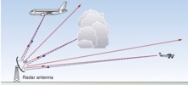

ROC Curve & Precision-Recall Curve
Receiver Operating Characteristic (ROC) curves for a binary classifier:
True Positive Rate (TPR) vs False Positive Rate (FPR)
at various threshold settings.
ROC curve was first developed by radar engineers during World War II
for quantifying the quality of detection of enemy airplanes.
TPR = REC = Recall or Sensitivity = TP/P = TP / (TP + FN)
( planes classified as planes / all planes' events)
FPR = False Positive Rate = fall-out = FP / N = FP / (FP + TN)
( noise classified as planes / all noise events )
PRE = Precision = TP/(TP+FP)
( planes classified as planes / all events classified as planes)
TNR = SPC = Specificity = TN/N = TN/(FP+TN)
(True Negative Rate)
--------------------------------------------------------------------------------
AUC = Area Under the Curve
Simply the area under the ROC curve (1 = very good, 0.5 = bad)
--------------------------------------------------------------------------------
F1 Score - a single number evaluation metric, harmonic average
of the precision and recall :
Radar detects planes.
It need to separate
"plane" signals from noise.
Planes
Noise
High Precision, Low Recall
Selecting Threshold
Low Precision, High Recall
Recall
Low Threshold
ROC
Curve
Precision-Recall
Curve
High Threshold
FPR

Slide 10
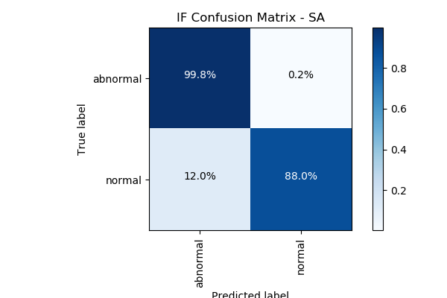
Confusion Matrix
For a simple binary classifier we are predicting one of two possibilities (Yes/No, Positive/Negative, Plane/No-Plane, Normal/Abnormal, etc.).
So we construct a 2x2 matrix to visualize True & False Positives and Negatives.
from sklearn import metrics
expected = target
predicted = model.predict(data)
metrics.precision_score(expected, predicted)
metrics.recall_score(expected, predicted)
metrics.roc_curve(expected, predicted)
metrics.roc_auc_score(expected, predicted)
metrics.confusion_matrix(expected, predicted)
[[194156 4864]
[ 23 321]]
Accuracy = sum(Diagonal) / sum(ALL) = sum(Correct) / sum(ALL)
Precision = TP / (TP+FP)
Recall = TP / (TP+FN) = TP / All_Actual_Positives

Slide 11
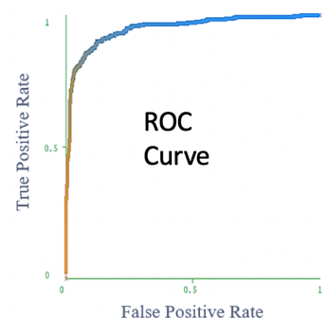
Why good ROC curve is above diagonal
TP/AP
FP/AN
ROC curve:
vertical – True Positives / All Actual Positives
horizontal – False Positives / All Actual Negatives

Slide 12
Overfitting and Regularization
Goal of training is to fit/learn a "regularity" in the data, and to avoid fitting noise (avoid overfitting).
How do we know that we are overfitting?
Let's split data into two sets:
- training
- testing
If we overfit on the training data (learn regularity and some noise specific to the training data), then accuracy measured on the test data may be bad
(model doesn't generalize well).
Solution – try to find a more "regular" solution (less noise, less overfitting).

Slide 13
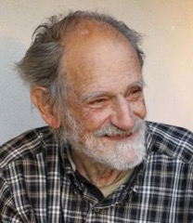
Shapley Values
The Shapley value, coined by Lloyd Shapley (1953),
is a method for assigning payouts to players depending on their contribution to the total payout - https://en.wikipedia.org/wiki/Lloyd_Shapley
SHAP (SHapley Additive exPlanations) by Lundberg and Lee (2016) is a method to explain individual predictions.
SHAP authors proposed KernelSHAP, an alternative, kernel-based estimation approach for Shapley values inspired by local surrogate models.
And they proposed TreeSHAP, an efficient estimation approach
for tree-based models.
Also, SHAP comes with many global interpretation methods based on aggregations of Shapley values.
Lloyd Stowell Shapley
1923 - 2016
American mathematician and Nobel Prize-winning economist

