Slide 1

Neural Modeling Fields (NMF)
Neural Modeling Fields (NMF) is a mathematical framework
for machine learning
combines ideas from neural networks, fuzzy logic, and model based recognition – also known as:
Modeling fields
Modeling Fields Theory (MFT)
Maximum Likelihood Artificial Neural Networks (MLANS)
Has been developed by Leonid Perlovsky at the AFRL (Air Force Research Laboratory)
is interpreted as a mathematical description of mind's mechanisms, including concepts, emotions, instincts, imagination, thinking, and understanding
NMF is a multi-level, hetero-hierarchical system. At each level in NMF there are concept-models encapsulating the knowledge; they generate so-called top-down signals, interacting with input, bottom-up signals
These interactions are governed by dynamic equations, which drive concept-model learning, adaptation, and formation of new concept-models for better correspondence to the input, bottom-up signals.
A problem that was not solvable due to combinatorial complexity becomes solvable using dynamic logic
Leonid Perlovsky
From Odessa
Novosibirsk State University
New York University
Northeastern University
- https://en.wikipedia.org/wiki/Leonid_Perlovsky
- https://en.wikipedia.org/wiki/Neural_modeling_fields
"Maximum-likelihood adaptive neural network (MLANS) application to classification while tracking" (1994)
by Leonid I. Perlovsky, Reimin Kwauk, David M. Tye
Nichols Research Corp. (United States)

Slide 2
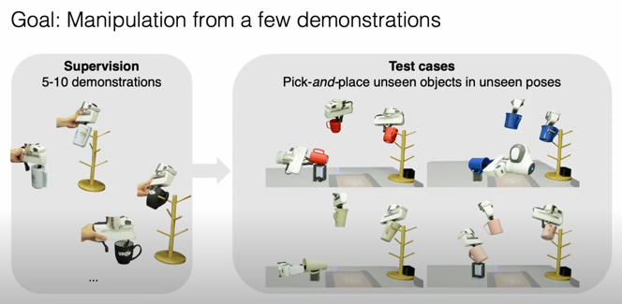
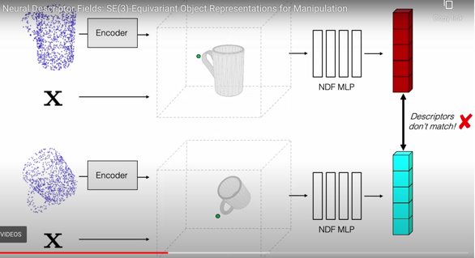
SE(3)-Equivariant Object Representations for Manipulation
- https://yilundu.github.io/ndf/ -
... given a task demonstration, we want to repeat the same task on a new object instance from the same category.
We propose to achieve this objective by searching (via optimization) for the pose whose descriptor matches that observed in the demonstration.
NDFs are conveniently trained in a self-supervised fashion via a 3D auto-encoding task that does not rely on expert-labeled keypoints.
Further, NDFs are SE(3)-equivariant, guaranteeing performance that generalizes across all possible 3D object translations and rotations.
We demonstrate learning of manipulation tasks
from few (~5-10) demonstrations
both in simulation and on a real robot.

