Slide 1
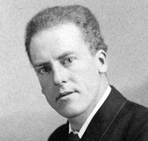
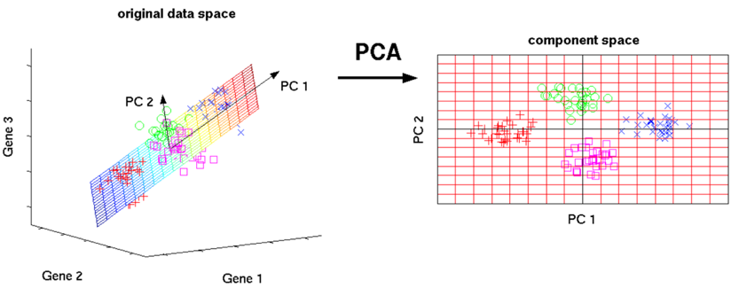
PCA = Principal Component Analysis
PCA was developed by Karl Pearson (in 1901)
Creates linear combinations of the original features. The new features are orthogonal, (uncorrelated).
Furthermore, they are ranked in order of their "explained variance." The first principal component (PC1) explains the most variance in your dataset, PC2 explains the second-most variance, and so on.
These new features are then used in a machine learning model in place of the original features that were used to generate the principal components.
Karl Pearson
A major benefit of PCA: helps to simplify the model. PCA can often drastically reduce the dimensionality of our data, thereby greatly reducing the number of explanatory variables needed to be included within a machine learning model
A major drawback to PCA: A model constructed with Principal Components may be very difficult to interpret / explain – because they are not real features, but artificial combinations of them
Another major drawback to PCA: PCA should not be applied to categorical features, even if they have been converted to binary "one-hot" dummy variables
from sklearn import decomposition
# ...
pca = decomposition.PCA(n_components=3)
pca.fit(X)
X = pca.transform(X)

Slide 2
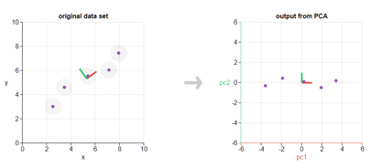
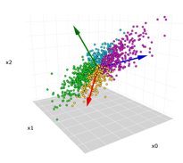
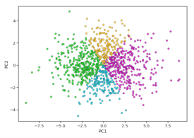
PCA Examples
2 dim to 1 dim
3 dim to 2 dim
The arrows on the left graph represent PC1, PC2, PC3

Slide 3
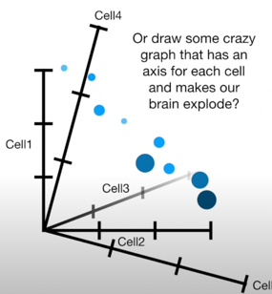
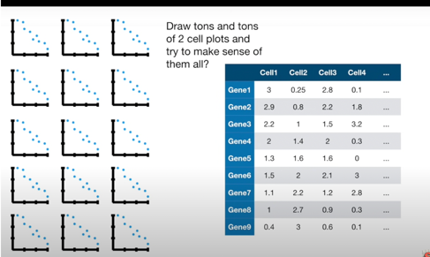
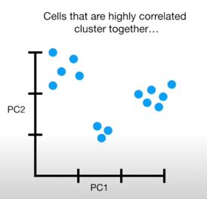
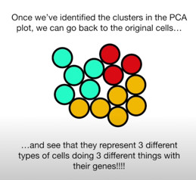
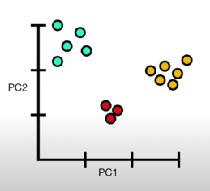
PCA Examples: mRNA Genes and Cells
mark them with colors

