Slide 1

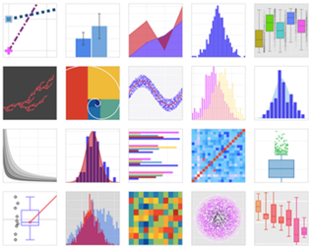
Plotly Dash
Plotly is a company in Montreal, Quebec. It was founded in 2012 by Alex Johnson, Jack Parmer, Chris Parmer, and Matthew Sundquist
Products:
Dash - open-source framework to build web-based analytic applications using Python, R, or Julia. ... https://plotly.com/dash/ ... Dash DAQ - build data acquisition GUIs, ... Dash Bio – tools for bioinformatics ... Dash Enterprise - paid product (build, test, deploy, scale)
Chart Studio Cloud - free, online tool for creating interactive graphs. It has a point-and-click graphical user interface for importing and analyzing data into a grid and using stats tools. Graphs can be embedded or downloaded. ... https://chart-studio.plotly.com/create/#/ ... https://plotly.com/chart-studio-help/tutorials/ ... Chart Studio Enterprise – paid product
Plotly.js - open-source JavaScript library for data visualization, creating graphs – works with plotly.py for Python (Jupyter notebooks), plotly.R for R, MATLAB, Node.js, Julia, and Arduino, and a REST API
Figure Converters - convert matplotlib, ggplot2, and IGOR Pro graphs into interactive, online graphs.
https://plotly.com
Gallery of Plotly Graphs
tutorials: https://www.youtube.com/watch?v=IcdD8-3-oiA

