Slide 1
Today's topic:
How do we evaluate the quality
of a binary classifier or a medical test ?
Precision, Recall, ROC, AUC,
F1, Sensitivity, Specificity, etc.

Slide 2
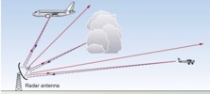

ROC Curve & Precision-Recall Curve
Receiver Operating Characteristic (ROC) curves for a binary classifier:
True Positive Rate (TPR) vs False Positive Rate (FPR)
at various threshold settings.
ROC curve was first developed by radar engineers during World War II
for quantifying the quality of detection of enemy airplanes.
TPR = REC = Recall or Sensitivity = TP/P = TP / (TP + FN)
( planes classified as planes / all planes' events)
FPR = False Positive Rate = fall-out = FP / N = FP / (FP + TN)
( noise classified as planes / all noise events )
PRE = Precision = TP/(TP+FP)
( planes classified as planes / all events classified as planes)
TNR = SPC = Specificity = TN/N = TN/(FP+TN)
(True Negative Rate)
--------------------------------------------------------------------------------
AUC = Area Under the Curve
Simply the area under the ROC curve (1 = very good, 0.5 = bad)
--------------------------------------------------------------------------------
F1 Score - a single number evaluation metric, harmonic average
of the precision and recall :
Radar detects planes.
It need to separate
"plane" signals from noise.
Planes
Noise
High Precision, Low Recall
Selecting Threshold
Low Precision, High Recall
Recall
Low Threshold
ROC
Curve
Precision-Recall
Curve
High Threshold
FPR

Slide 3


Noise
Planes
Noise
Planes
Precision – 100%
Recall – 15%
Good Precision = Sniper
Noise
Planes
Precision – 50%
Recall – 100%
Good Recall = Cover All
Good
Noise
Planes
Ideal:
Precision – 100%
Recall – 100%
+
Noise
Planes
Good:
Precision – 90%
Recall – 90%

Slide 4
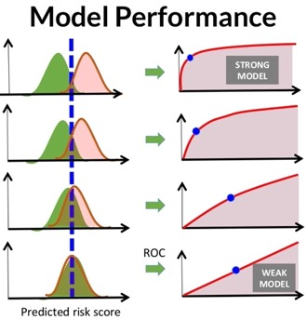
For measuring the performance of retrieval systems, several measures are used that depends on the following four major parameters:
True Positive (TP): True is identified True (correct identification)
True Negative (TN): False is identified False (correct identification)
False Positive (FP): True is identified False (wrong identification)
False Negative (FN): False is identified True (wrong identification)
P = TP + FN (number of correct identification cases)
N = FP + TN (number of wrong identification case) 25
Sensitivity = Recall = True Positive Rate (TPR) : TPR = (TP / P) = TP / (TP + FN)
Specificity (SPC) or True Negative Rate (TNR) : SPC = (TN / N) = TN / (FP + TN)
Precision or Positive Predictive Value (PPV) : PPV = TP / (TP + FP)
Negative Predictive Value (NPV) : NPV = TN / (TN + FN)
Fall-Out or False Positive Rate (FPR) : FPR = (FP / N) = FP / (FP + TN) = 1 – SPC
False Discovery Rate (FDR) : FDR = FP / (FP + TP) = 1 – PPV
Miss Rate or False Negative Rate (FNR) : FNR = FN / (FN + TP)
Accuracy (ACC) : ACC = (TP+TN) / (P+N)
F1 Score : F1 = 2*TP/(2*TP+FP+FN)
Mathews Correlation Coefficient (MCC):
MCC=(TP*TN-FP*FN)/sqrt((TP+FP)*(TP+FN)*(TN+FP) *(TN+FN))
Informedness = Sensitivity + Specificity -1
Markedness = Precision + NPV -1
From:
https://www.researchgate.net/post/How_do_I_calculate_the_false_alarm_rate_for_face_detection
From:
https://www.slideshare.net/KristenHunter/civitas-learning-understanding-roc-curves

Slide 5
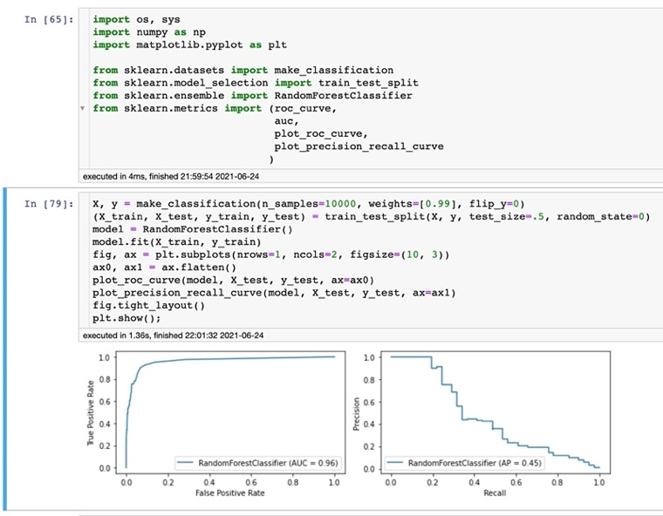
ROC AUC is terrible for imbalanced data.
Precision-Recall is much better.
Imagine imbalanced data set:
for 10 airplanes we get 10,000 noise spikes.
Suppose we have a classifier with reasonably good ROC curve, which at the "sweet spot" identifies 90% of planes and only 1% of noise as planes. The AUC will be very close to 1.
But it is actually a terrible classifier.
Because it will cry "plane!" for noise spikes 10 times more than for real planes!
The Precision-Recall curve is a much better indicator. Please see example on the right.
ROC
Precision - Recall

Slide 6
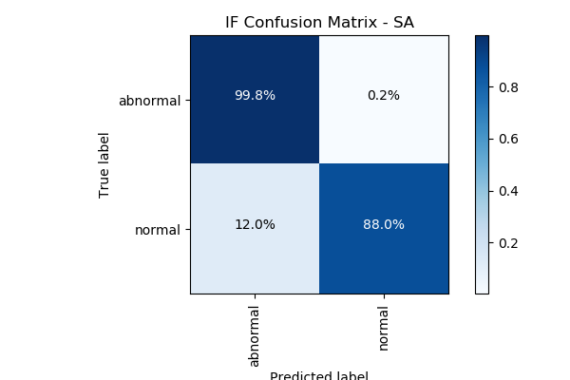
Confusion Matrix
For a simple binary classifier we are predicting one of two possibilities (Yes/No, Positive/Negative, Plane/No-Plane, Normal/Abnormal, etc.).
So we construct a 2x2 matrix to visualize True & False Positives and Negatives.
from sklearn import metrics
expected = target
predicted = model.predict(data)
metrics.precision_score(expected, predicted)
metrics.recall_score(expected, predicted)
metrics.roc_curve(expected, predicted)
metrics.roc_auc_score(expected, predicted)
metrics.confusion_matrix(expected, predicted)
[[194156 4864]
[ 23 321]]
Accuracy = sum(Diagonal) / sum(ALL) = sum(Correct) / sum(ALL)
Precision = TP / (TP+FP)
Recall = TP / (TP+FN) = TP / All_Actual_Positives

Slide 7
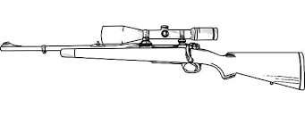

Accuracy = sum(Diagonal) / sum(ALL)
Precision = TP / (TP+FP) = TP / Predicted_Positives
Sniper
- high precision (zero FP)
- low recall (can't get everything)
Recall = TP / (TP+FN) = TP / Actual_Positives
Nuclear Bomb
- low precision (many FP)
- high recall (get everything)

Slide 8
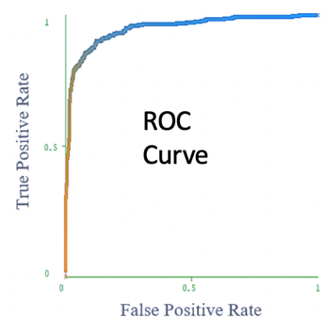
Good ROC curve is above diagonal
Optimal threshold – cut off most of noise, but catches most of planes
TP/P
Low Threshold – detect all events and all noise
Very high threshold.
Cut off all noise – and
most of "planes"
FP/N
ROC curve axes:
vertical = True Positives / All Actual Positives
horizontal = False Positives / All Actual Negatives

Slide 9
Medical Test Paradox – Predictive Power of Positive or Negative Test Result
from https://www.youtube.com/watch?v=lG4VkPoG3ko
Healthy
Sick
We have 1,000 people.
1% of them have a disease:
N_sick = 10
N_healthy = 990
We use a test with sensitivity SE = 90% and specificity SP = 91%.
This means that test shows results as following:
TP = True Positive = N_sick * SE/100 = 9 out of 10
TN = True Negative = N_healthy * SP/100 = 901 out of 990
FN = False Negative = 1 out of 10
FP = False Positive = 89 out of 990
What is the predictive power of this test?
Positive result : TP/(TP+FP) = 9/(9+89) = 0.092 (1 in 11 chance)
Negative result : TN/(TN+FN) = 901/(901+1) = 0.999 (very good)
Test Results:
Red = Positive
White = Negative
Specificity
Sensitivity
 | Positive | Negative
Disease | 9 | 1
Healthy | 89 | 901
Sensitivity = Recall = True Positive Rate (TPR) : TPR = (TP / P) = TP / (TP + FN)
Specificity (SPC) = True Negative Rate (TNR) : SPC = (TN / N) = TN / (FP + TN)

Slide 10
Example – Drug Test
Solution:
We have a drug test with the following characteristics:
false positives = 2%
false negatives = 1%
5% of population are drug positive.
If a person's test result is positive, what is the probability that this person is indeed drug positive?
FPR = 2% = FP/N
FP = 2% of 9,500 = 190
FNR = 1% = FN/P
FN = 1% of 500 = 5
TP = 500-5=495
95%
9,500 negative
10,000 people total
5%
500 positive
TN = 9,500-190 = 9310
TN = 9310
FN=5
If the person tests positive,
he is either TP or FP
Probability of being positive given the results of the test:
TP/(TP+FP) = 495/(495+190) = 0.72
FP
190
TP
495

Slide 11
Medical Tests
Merck Manuals:
https://www.merckmanuals.com/professional/special-subjects/clinical-decision-making/understanding-medical-tests-and-test-results
Healthy
Sick
Typical ROC Curves

Slide 12
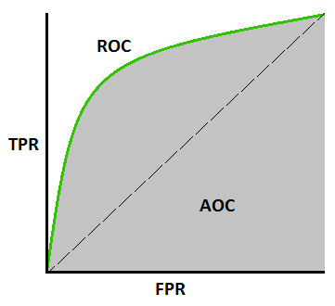
ROC AUC vs Accuracy
Accuracy = sum(Diagonal) / sum(ALL)
Accuracy may be also a bad criteria for highly imbalanced sets. Suppose we have the same example with 10 planes and 1000 noise spikes. Suppose our classifier is completely "blind". It simply labels everything as noise. Then its confusion matrix will look like this:
Suppose we have classification problem (planes vs noise) which is highly imbalanced: 10 planes and 1000 noise spikes. Suppose we have good ROC curve with good AUC close to 1.
The "sweet spot" in the top left corner with coordinates (0.1,0.9).
If we run our classifier at this spot, this means that we will identify as planes : 9 planes (90% out of 10) and 100 noise spikes (10% out of 1000).
So this will be a very bad classifier – it will cry "plane" on noise events 10 times more often than on real planes.
0
10
0
1000
Accuracy = 1000/1010 = 0.99 – almost perfect.
So we have good accuracy while the classifier is completely blind!
Note: AUC is NOT a function of threshold. It is an evaluation of the classifier as threshold varies over all possible values. It is a metric of the quality of the internal value that the classifier generates and then compares to a threshold. It is not testing the quality of a particular choice of threshold.

