Slide 1
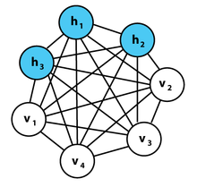
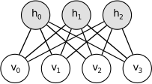

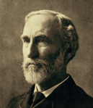
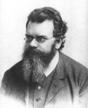


Restricted Boltzmann Machine – two interconnected layers, with restriction that there is no connection inside the layers. RBM can learn a probability distribution over its set of inputs.
Boltzmann Machine is a fully interconnected network with visible and hidden units, and with an energy defined using Boltzmann distribution.
E
Gibbs’ exponential energy distribution
Ludwig Boltzmann (1844-1906) Austrian physicist, developer of statistical mechanics.
Josiah Willard Gibbs
1839-1903,New Haven, CT
statistical mechanics
Deep Belief Network - training a deep network - one RBM layer at a time
For energy-based models with latent variables h, some algorithms are phrased in terms of the negative log - called the free energy :

